Slide 1
CMPSC 274: Advance Topics on Database System
Data-Management for Data-intensive Computing
Divyakant Agrawal
Department of Computer Science
University of California at Santa Barbara

Slide 2
Prelude
Data management is at the cross-roads:
New models for data-intensive computing
Significant turmoil in terms of technological advances
Rapid changes have presented the data management research community with unprecedented challenges.
Inevitable to re-examine the context in which data management evolved in the past.
In the same vein, we need to explore the role of data management in the future.
Course Objective: Comprehensive understanding of data management and data analysis paradigms.

Slide 3
Data-intensive Computing
Storage and retrieval management of persistent data.
Large-scale data analysis for data-centric decision making.

Slide 4
Course Organization
First Half of the Course (4 weeks):
Persistent Stores for Enterprise Applications
Second half of the Course (2 Weeks):
Persistent Stores for Internet and Web-scale Applications

Slide 5
Course Organization
Second half of the course (2 Weeks):
Enterprise-class Solutions for Large-scale Data Analysis
Second half of the course (2 Weeks):
Internet and Web-scale Solutions for Large-scale Data Analysis

Slide 6
Course Grading
First half of the course (assignment/assessment based):
Home-works
Mid-term Exams
Text book
Second half of the course:
Project based
Large programming/implementation project (2 person)

Slide 7
Data Management Overview

Slide 8
Historical Perspective
Advent of computer technology:
Persistent storage of data and information
Value of data/information realized very early especially in the context of business entities
Early efforts in the industry:
Effective data management solutions
Based on storing data:
Files: logical abstraction
Tapes: physical realization
File based data management
Problems in accessing data
Problems in processing data
In general, problems in effective usage of data

Slide 9
Historical Perspective
Emergence of alternative storage models:
Departure from file-based storage
New data models to enable data access based on its attributes
New language models to enable effective manipulation of data
Data models (circa 1965):
Network model: essentially to model business entities using the information paradigm
Hierarchical model: another variant
Standardization efforts:
Economies-of-scale/minimize duplication
CODASYL

Slide 10
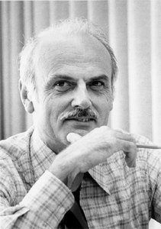
E. F. Codd

Slide 11
Codd’69: Relational Data Model
Relational Data Model:
Tabular framework for data representation
Intuitive and easy to comprehend
Complete theoretical framework
Relational algebra (operational framework):
An algebraic framework for operating on relational data
Well-defined algebraic operators
Relational calculus (theoretical framework):
First-order logic
Declarative querying framework
Equivalent to relational algebra

Slide 12
Relational Data Model
RDBMS model became extremely successful.
Logical Data Model:
Intuitive
Well-defined
Design time considerations need not focus on physical issues
Physical storage independence:
Run-time system maintains the access methods
Dynamic mapping from logical to physical level
Declarative Query Interface:
Users did not need to be expert programmers

Slide 13
Data Management Evolution
RDBMS became highly successful:
Widely adopted by both large and small business entities
Enterprises became increasingly reliant on databases
Primarily used for day-to-day operations:
Banking operations
Retail operations
Travel industry

Slide 14
Data Management Evolution
Typically:
Database modeled the state of the enterprise
Client operations were applied to update the state.
Modified
State
Of the
Enterprise
State
Of the
Enterprise
Client Operations
(Transactions)

Slide 15
Batched Transaction Processing
Nomenclature:
Transaction Processing Systems
Typical usage:
Spool client transactions during the day
During the night, spooled transactions applied to the database state of previous night
New database state becomes available for the next working day
Advantages:
Almost up-to-date information on the finger-tips
Failure-recovery is in-built in the paradigm
No issues of concurrency

Slide 16
Batched Transaction Processing
Problem:
Database state did not reflect up-to-date information
Impact on daily operations:
Some amount of guess-work in formulating the application state of client transactions:
seat availability on a flight
funds availability in a bank account
inventory information for re-order
Impact on batch update:
Transaction failures if the “guess” is wrong

Slide 17
The OLTP Paradigm
On-line Transaction Processing:
Database state is up-to-date at all times
Significant challenges:
Multiple users/clients need to be supported
Handle hardware and software failures
Emergence of what is now commonly referred to as:
The Transaction Concept:
Concurrency
Failures

Slide 18
Concurrency & Failures: A Quick Preview
List maintenance:
lookup/find operations in O(log N) time.
Read-only operations:
Concurrency does not cause any difficulties.
List updates:
Inserts/deletes also in O(log N) time if executed sequentially.
What if I specify that operations are arbitrarily interleaved?
Worse yet: what happens if the updaters can fail?
Can you do it safely? Do you have the necessary tools to solve this problem?

Slide 19
Data Analysis Overview

Slide 20
Data Analysis ➔
Business Intelligence

Slide 21
Hans Peter Luhn

Slide 22
50 Years of Business Intelligence
Vision of Business Intelligence:
Hans Peter Luhn in a 1958 article.
Predates the notions of Databases and Data Management.
A pioneer in Information Sciences:
New use of the term thesaurus
Automatic creation of literature abstracts
16 digit Luhn’s number widely used for credit cards and other banking instruments
…

Slide 23
Luhn’s Vision
Defined BI as:
“… provides means for selective dissemination to each of its action points in accordance with their current requirements or desires.”
Key technologies:
Auto-abstracting of documents,
Auto-encoding of documents, and
Auto creation and updating of profiles
Breadth of the vision:
“… business is a collection of activities carried on … be it science, technology, commerce, industry, law, government, defense, et cetra.”
“… intelligence is also defined … as the ability to apprehend the interrelationships of presented facts in such a way as to guide action towards a desired goal.”
Notes:
Need to stress that although he was working in the document domain – he did not specify “selective dissemination” – so clearly he was thinking beyond ordinary document delivery system.
He was already thinking of technologies well-beyond stored data and information – in that – he was thinking in terms of machine learning and data mining.
Finally, his original vision was well-beyond ordinary reporting and analysis – he was determined to use the “business intelligence” as an actionable control tool.

Slide 24
The intervening years

Slide 25
The Early Years (1970s-1980s)
Contrary to Luhn’s overarching vision – early efforts on business information remained focused on database management technology.
With the advent of the relational model:
DBMS technology became pervasive and matured.
Widely adapted by most enterprises.
Online Transaction Processing became a proven paradigm for business operations.
Consequence:
Massive proliferation of OLTP systems especially within a single enterprise.
Data-driven decision making became a norm.
Disparate reporting from multiple operational data sources.

Slide 26
Notion of “Data Analytics” (1990s)
Presence of multiple operational systems created a fractured view of an enterprise.
Devlin & Murphy introduced the term business data warehouse in 1988:
A unified view of the enterprise primarily for integrated reporting.
Catalysts:
Demand for reporting – key factors being PCs and spread-sheets.
Market potential – Teradata, Red-brick Systems, etc.
Negative factors:
Unproven, immature, and expensive technology proposition.
Distinction between DBMS and DW: no clarity, ?duplication?
Fairly laborious and time-consuming data integration process
No clear stake-holders ➔ 2nd Class Entity often resulting in adversarial atmosphere.

Slide 27
Data Warehousing: Current State
Keys to success:
Enormous contribution of DW evangelist Ralph Kimball
STAR schema & Dimensional model for DW: intuitive and scalable
No compromise on the autonomy of operational data sources
Persisting head-winds:
Since does not directly contribute to P&L:
ROI question still persists.
Not a plug & play technology:
Very high consulting costs.
Legacy of significant time and cost over-runs of most data warehousing projects.
Batch-oriented DW Architecture:
Deemed too costly just for integrated reporting.
Needed intuitive analytical capabilities.

Slide 28
Hither “Business Intelligence” (2000-)
Gray et al. [1996] introduced the CUBE operator for roll-up and drill-down analysis of multi-dimensional data (i.e., DW Model).
DW enterprises (Hyperion, Cognos, Analysis Services, etc.) adapted the CUBE architecture and called it:
business intelligence.
Problem:
Early BI (CUBE) technology had serious issues of scaling ➔ only accentuated the ill-repute of DW/BI technologies
Underlying problem: exponential explosion of data storage

Slide 29
Business Intelligence: Current State
While the BI/Cube technology was still evolving – the spin doctors needed to undo the early damage.
Hence, perhaps the term Real-time Business Intelligence – to convey the “criticality” of such technology to business leaders.
Current debate: what exactly is meant by “real-time” in Business Intelligence?
In 2006, in this workshop, Donovan Schneider – gave numerous examples of “degree of timeliness” for a variety of analysis tasks.
My personal view is that the correct term should have been: Online Business Intelligence.
Assuming that – redefine the DW/BI architecture to support RTBI.

Slide 30
The present & the future

Slide 31
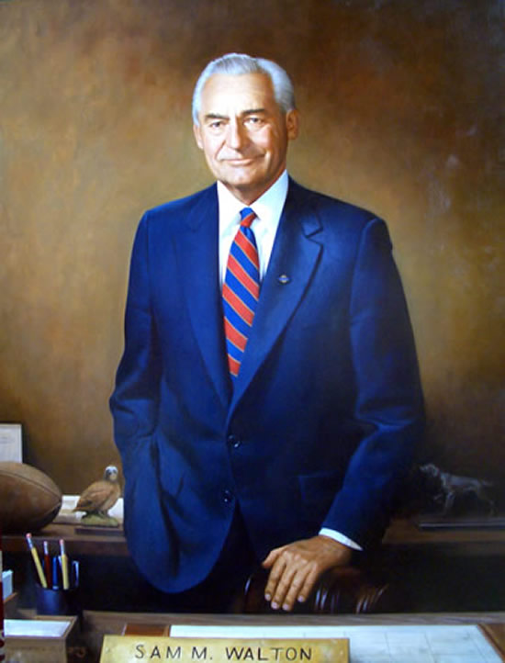
Real-time Business Intelligence: Required?
Anecdotal evidence from Sam Walton
Airplane & Parking Lot Story
Demonstrates the power of 10,000 feet view (from the airplane) versus the local view (from the parking lot).
Numerous cases where “timeliness” of “intelligence” is extremely valuable.
➔ The case of RTBI is very-well justified.
➔ The question however is at what cost?

Slide 32
Concluding Remarks
Data Management:
Will study the models, paradigms, theory, and algorithms needed for Enterprise Scale Data Management (& application development)
Will then examine the disruption that has occurred with the Internet and Web-based application:
underlying factors for this disruption and
Proposed solution

Slide 33
Concluding Remarks
Data Analysis:
Will study the well-accepted principles, architecture, and solutions for enterprise class Data Analysis platforms.
Will then explore the disruption caused by Internet and Web-scale Applications.
Time permitting:
Multi-core processors
GPU platforms and databases
Data stream processing

