Slide 1
UCSB Verification Lab Director: Tevfik Bultan
Research areas
automated verification, program analysis, formal methods, software engineering, computer security
Recent research results
String analysis for web application vulnerability detection and repair [FMSD,IJFCS,ISSTA’14,ICST’14,ICSE’12,ISSTA’12,ICSE’11,SPIN’11]
Data model verification for MVC based web applications [TOSEM, ICSE’15,ASE’15,ICSE’14,ISSTA’13,ASE’12,ISSTA’11]
Analyzing message-based interactions in distributed systems [IEEE TSC,ASE’14,FACS’13,POPL’12,VMCAI’12,WWW’11]
Automata based model counting constraint solver [CAV’15]
Path complexity analysis for programs [ESEC/FSE’15]
Recent awards
ACM SIGSOFT Distinguished Paper Award in ASE’14
Best paper and best paper runner-up awards at UCSB GSWC’14
ACM SIGSOFT 2015 Outstanding Dissertation Award

Slide 2
Web App Vulnerability Detection & Repair
GOAL: To automatically detect and repair vulnerabilities that are caused by input validation and sanitization errors (such as XSS and SQL Injection)
(1) Sanitizer Extraction
(2) String Analysis
(3) Bug Detection and Repair
Static and dynamic program analysis to extract input validation and sanitization operations
Web App
Automata based string analysis using symbolic fixpoint computations
Differential or policy directed (using attack patterns) bug detection
and repair
Sanitizer functions
Vulnerability
signatures
Bug reports (attack strings) and code patches

Slide 3
Web App Data Model Verification & Repair
GOAL: To automatically detect and repair data model errors in web apps written using MVC based frameworks (such as Ruby on Rails)
Rails
code
User specified properties
Bug reports (property violating instances)
Code
patches
Formal data model +
properties
Formal data model
FOL or Boolean formulas
(1) Model Extraction
(2) Property Inference
(3) Logic Translation
(4) Verification
(5) Data Model Repair
Static analysis
+
instrumented
execution
Search for property
patterns
in
data model schema
Encoding in
First Order
Logic (unbounded)
or
Boolean logic (bounded)
Verification
via
automated theorem
provers
or
SAT solvers
Automated
repair based
on property
patters
Notes:
Inference is based on data model schema, extracted from the object-relational mapping
... we infer a set of properties about the data model that we expect to hold
Verification component is our earlier work. Including bounded and unbounded verification, etc.
The heuristics for inferring properties are described next.

Slide 4
Analyzing Message-based Interactions
GOAL: Automated analysis of distributed systems which use message-based communication
APPLICATIONS: Deadlock detection in web services, Erlang programs, Singularity OS processes
Input communication protocol
Realizability check:
Is the protocol implementable in a distributed manner without deadlocks?
ReadyState$0
C→S:Send
S→C:AckStartSend
S→C:SendComplete
ReadyState
IO_RUNNING
C→S:GetTpmStatus
S→C:TpmStatus
Synchronizability check:
Does the protocol behavior change
with synchronous vs. asynchronous communication
S→C:TpmStatus
C→S:GetTpmStatus
ReadyState$1
IO_RUNNING$0
Message-based communication:
asynchronous
(using FIFO message buffers)
synchronous
(rendezvous communication)
Results:
Realizability and synchronizability checks are decidable
Identified a subclass of asynchronously communicating systems which can be verified automatically
Identified a flaw in Singularity OS protocol verification framework

Slide 5
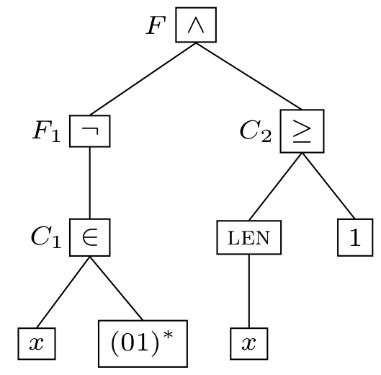
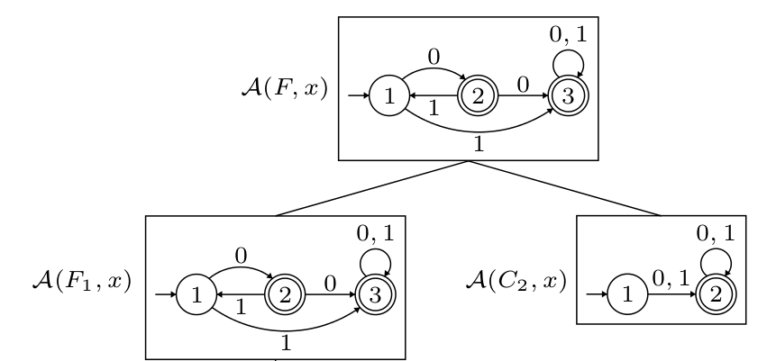
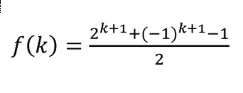
Model Counting Constraint Solver
GOAL: Given a constraint, generate a model counting function that returns the number of solutions within a given bound
APPLICATIONS: Quantitative information flow, probabilistic verification
APPROACH: Construct an automaton that accepts all the solutions to the given constraint, which reduces the model counting to path counting
(3) Path counting function generation based on algebraic graph theory
Input bound
Input Constraint
(SMT-LIB format)
3.1. Generating function construction
3.2. Recurrence relation
construction
3.3. Closed form solution
generation
Model counting function
(1) syntactic
simplification
& normalization
Number of solutions
for the constraint
within the given
input bound
Constraint AST
Constraint Automata
(2) Incremental
automata
construction

Slide 6
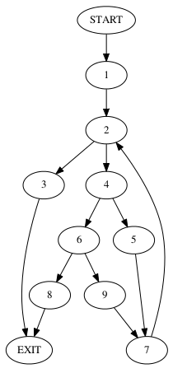
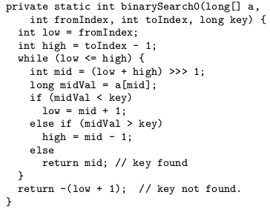
Computing Path Complexity of Programs
GOAL: Given a program, generate a path complexity function that returns the number of paths in the program within a given depth
APPLICATIONS: Determining difficulty of path coverage, guidance for verification and testing heuristics
APPROACH: Path counting function generation on the control flow graph
(2) Control Flow Graph
(3) Path complexity function
(1) Input Java code
n
path(n) = 6.86 (1.17) +
n
0.22 (1.09) +
n
0.13 (0.84) + 2
(4) Asymptotic path complexity
n
path(n) = Θ( 1.17 )

