Slide 1

Differential String Analysis
Tevfik Bultan
(Joint work with Muath Alkhalaf, Fang Yu and Abdulbaki Aydin)
bultan@cs.ucsb.edu
Verification Lab
Department of Computer Science
University of California, Santa Barbara
http://www.cs.ucsb.edu/~vlab

Slide 2
VLab String Analysis Publications
Semantic Differential Repair for Input Validation and Sanitization [ISSTA’14]
Automated Test Generation from Vulnerability Signatures [ICST’14]
Automata-Based Symbolic String Analysis for Vulnerability Detection [FMSD’14]
ViewPoints: Differential String Analysis for Discovering Client and Server-Side Input Validation Inconsistencies [ISSTA’12]
Verifying Client-Side Input Validation Functions Using String Analysis [ICSE’12]
Patching Vulnerabilities with Sanitization Synthesis [ICSE’11]
Relational String Verification Using Multi-Track Automata [IJFCS’11], [CIAA’10].
String Abstractions for String Verification [SPIN’11]
Stranger: An Automata-based String Analysis Tool for PHP [TACAS’10]
Generating Vulnerability Signatures for String Manipulating Programs Using Automata-based Forward and Backward Symbolic Analyses [ASE’09]
Symbolic String Verification: Combining String Analysis and Size Analysis [TACAS’09]
Symbolic String Verification: An Automata-based Approach [SPIN’08]
2

Slide 3
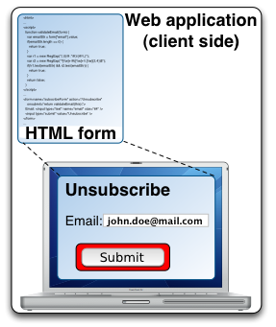

Anatomy of a Web Application
php
unsupscribe.php
Submit
DB
Notes:
- Let us take a look at how Input validation works in web applications
- Do animation
- What is the problem? Why high rate of bugs?

Slide 4
Web Application Inputs are Strings
php
unsupscribe.php
Submit
DB

Slide 5
Input Needs to be
Validated and/or Sanitized
php
unsupscribe.php
Submit
DB

Slide 6
Web Applications are Full of Bugs
Source: IBM X-Force report
OWASP Top 10 Web Application Vulnerabilities
2007
XSS
Injection Flaws
Malicious File Exec.
2010
Injection Flaws
XSS
Broken Auth. Session M.
2013
Injection Flaws
Broken Auth. Session M.
XSS

Slide 7
Vulnerabilities in Web Applications
There are many well-known security vulnerabilities that exist in many web applications. Here are some examples:
  SQL injection: where a malicious user executes SQL commands on the back-end database by providing specially formatted input
  Cross site scripting (XSS) causes the attacker to execute a malicious script at a user’s browser
  Malicious file execution: where a malicious user causes the server to execute malicious code
These vulnerabilities are typically due to
  errors in user input validation and sanitization or
  lack of user input validation and sanitization
7

Slide 8
Why Is Input Validation & Sanitization Error-prone?
Extensive string manipulation:
  Web applications use extensive string manipulation
    To construct html pages, to construct database queries in SQL, etc.
  The user input comes in string form and must be validated and sanitized before it can be used
    This requires the use of complex string manipulation functions such as string-replace
  String manipulation is error prone
8

Slide 9
String Related Vulnerabilities
String related web application vulnerabilities occur when:
  a sensitive function is passed a malicious string input from the user
  This input contains an attack
  It is not properly sanitized before it reaches the sensitive function
String analysis: Discover these vulnerabilities automatically
9

Slide 10
String Manipulation Operations
Concatenation
  “1” + “2” → “12”
  “Foo” + “bAaR” → “FoobAaR”
Replacement
  replace(“a”, “A”)
  replace (“2”,””) (delete)
  toUpperCase (multiple replace)
bAaR
bAAR
234
34
ABC
abC

Slide 11

String Filtering Operations
Branch conditions
  length < 4 ?
    “Foo”
    “bAaR”
  match(/^[0-9]+$/) ?
    “234”
    “a3v%6”
  substring(2, 4) == “aR” ?
    ”bAaR”
    “Foo”

Slide 12
Javascript Input Validation
function validateEmail(inputField, helpText){
if (!/.+/.test(inputField.value)) {
if (helpText != null)
helpText.innerHTML = "Please enter a value.";
return false;
}
else {
if (helpText != null)
helpText.innerHTML = "";
if( !/ˆ[a-zA-Z0-9\.-_\+]+@[a-zA-Z0-9-]+(\.[a-z
A-Z0-9]{2,3})+$/.test(inputField.value)) {
if (helpText != null)
helpText.innerHTML = “enter a valid email”;
return false;
}
else {
if (helpText != null)
helpText.innerHTML = "";
return true;
}}}
Notes:
Let us take a look at an example of an erroneous input validation function written in javascript

Slide 13
Input Validation Error
function validateEmail(inputField, helpText){
if (!/.+/.test(inputField.value)) {
if (helpText != null)
helpText.innerHTML = "Please enter a value.";
return false;
}
else {
if (helpText != null)
helpText.innerHTML = "";
if( !/ˆ[a-zA-Z0-9\.-_\+]+@[a-zA-Z0-9-]+(\.[a-z
A-Z0-9]{2,3})+$/.test(inputField.value)) {
if (helpText != null)
helpText.innerHTML = “enter a valid email";
return false;
}
else {
if (helpText != null)
helpText.innerHTML = "";
return true;
}}}
foo=;bar@bar.com
[a-zA-Z0-9\.-_\+]
.-_ means all characters from . to _
This includes ; and =

Slide 14
GOAL
Automatically Find and Repair Bugs
CAUSED BY
String filtering and manipulation operations
IN
Input validation and sanitization code
IN
Web applications

Slide 15
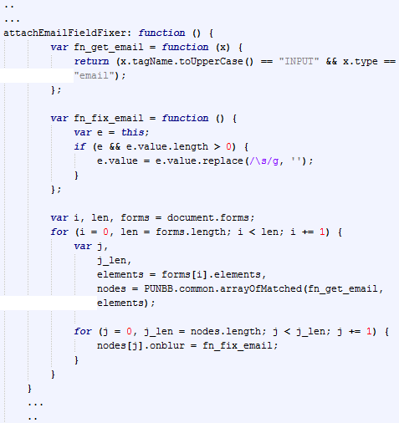
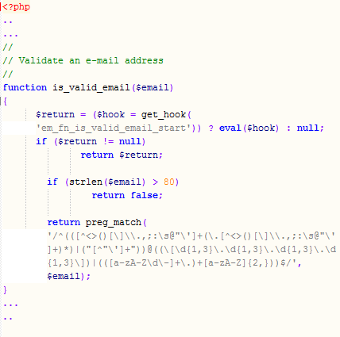


Differential Analysis:
Verification without Specification
Client-side
Server-side
Notes:
Basic idea: Use the inherent redundancy in input validation to check the correctness of the input validation functions
The same input field is checked twice, one on the client side and once on the server side
It makes sense to compare the two functions to each other without the need for manually written policies
If we find a difference especially when the server accepts different strings than the client then this may point to a vulnerability

Slide 16
Sanitization Code is Complex
function validate() {
...
switch(type) {
case "time":
var highlight = true;
var default_msg = "Please enter a valid time.";
time_pattern = /^[1-9]\:[0-5][0-9]\s*(\AM|PM|am|pm?)\s*$/;
time_pattern2 = /^[1-1][0-2]\:[0-5][0-9]\s*(\AM|PM|am|pm?)\s*$/;
time_pattern3 = /^[1-1][0-2]\:[0-5][0-9]\:[0-5][0-9]\s*(\AM|PM|
am|pm?)\s*$/;
time_pattern4 = /^[1-9]\:[0-5][0-9]\:[0-5][0-9]\s*(\AM|PM|
am|pm?)\s*$/;
if (field.value != "") {
if (!time_pattern.test(field.value)
&& !time_pattern2.test(field.value)
&& !time_pattern3.test(field.value)
&& !time_pattern4.test(field.value)) {
error = true;
}
}
break;
case "email":
error = isEmailInvalid(field);
var highlight = true;
var default_msg = "Please enter a valid email address.";
break;
case "date":
var highlight = true;
var default_msg = "Please enter a valid date.";
date_pattern = /^(\d{1}|\d{2})\/(\d{1}|\d{2})\/(\d{2}|\d{4})\s*$/;
if (field.value != "")
if (!date_pattern.test(field.value)||!isDateValid(field.value))
error = true;
break;
...
if (alert_msg == "" || alert_msg == null) alert_msg = default_msg;
if (error) {
any_error = true;
total_msg = total_msg + alert_msg + "|";
}
if (error && highlight) {
field.setAttribute("class","error");
field.setAttribute("className","error"); // For IE
}
...
}
Mixed input validation
and sanitization for multiple
HTML input fields
2) Lots of event handling
and error reporting code

Slide 17


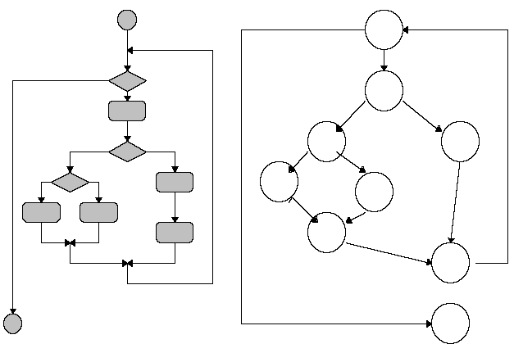


Modular Verification Process
Extraction
String Analysis
Bug Detection and Repair
Web App
Sanitizer
Functions
Symbolic
representation of attack strings and vulnerability signatures
Notes:
"The work I am going to present today has been published in the following papers. I am not going to be able to give details of all the techniques presented in these papers. So, after giving a high level overview of extraction and string analysis techniques, I will focus more on our recent work on differential analysis and repair in the second half of my presentation."

Slide 18
Classification of Input Validation and Sanitization Functions
Input
Input
Input
Pure
Validator
Validating
Sanitizer
Pure
Sanitizer
Yes
(valid)
No
(invalid)
Output
No
(invalid)
Output
Notes:
What do we mean by input validation function and input sanitization function?
Input validation …
Input sanitization function is a function which takes a set of inputs which may contain a subset of malicious values and gives a set of outputs that only contain benign values

Slide 19
Static Extraction for PHP
$_POST[“email”]
$_POST[“username”]
Sources
Static extraction using Pixy
  Augmented to handle path conditions
Static dependency analysis
Output is a dependency graph
  Contains all validation and
  sanitization operations between
  sources and sink
Input
Validating
Sanitizer
Output
No
(invalid)
Sink
mysql_query(……)
printf ……
Notes:
What do we mean by input validation function and input sanitization function?
Input validation …
Input sanitization function is a function which takes a set of inputs which may contain a subset of malicious values and gives a set of outputs that only contain benign values

Slide 20
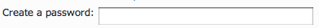
Dynamic Extraction for Javascript
Enter email:
Source
Run application on a number of inputs
  Inputs are selected heuristically
Instrument execution
  HtmlUnit: browser simulator
  Rhino: JS interpreter
  Convert all accesses on objects and
  arrays to accesses on memory locations
Dynamic dependency tracking
Input
Validating
Sanitizer
Output
No
(invalid)
Sink
submit
xmlhttp.send()
Notes:
What do we mean by input validation function and input sanitization function?
Input validation …
Input sanitization function is a function which takes a set of inputs which may contain a subset of malicious values and gives a set of outputs that only contain benign values

Slide 21

String Analysis & Repair
Target
Sanitizer
Reference
Sanitizer
Automata-based
String
Analysis
?
$$⊆$$
Generate
Patch
No
Yes
Validation
Patch
Length
Patch
Sanitization
Patch

Slide 22
Automata-Based String Analysis
String
Analysis
Sanitizer
Function
Symbolic Forward
Fix-Point Computation
Post-Image
(Post-Condition)
Pre-Image
(Pre-Condition)
Symbolic Backward
Fix-Point Computation
Negative
Pre-Image
(Pre-Condition
for reject)

Slide 23
Sanitizers
Σ*
Σ*∪
T
rejecting
invalid inputs
aa
aa
bb
ab
bb
Σ = {a, b}
aab
ba
bbb
.
.
.
.
.
.
.
.
.
.
.
.
T
sanitizer(x){
if (x != “aa” && x != “bb” && x != “ab”)
reject;
x = replace(/^ab$/, “ba”, x);
return x;
}

Slide 24
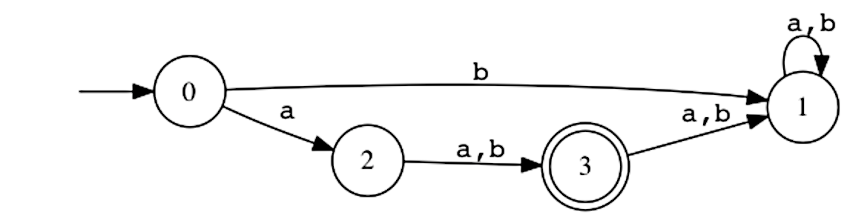
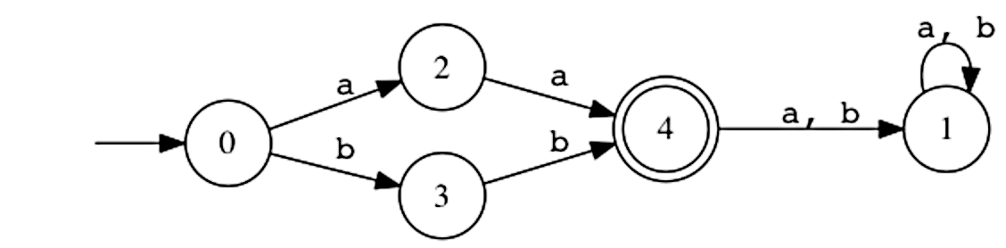
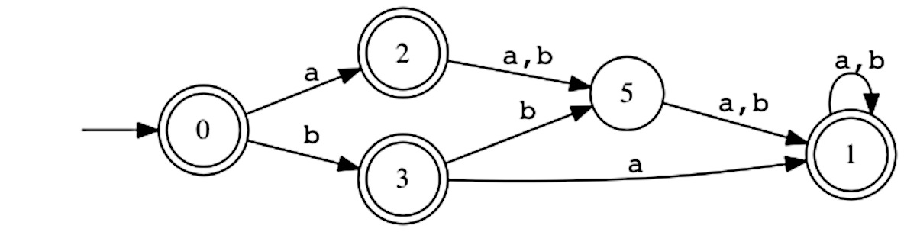
Post-Image, Pre-Image and Negative Pre-Image
b
a,
Σ*
Σ*∪
T
Possible output
(Post Image)
Pre-image
aa
aa
bb
bb
ab
ba
(Non)
Preferred
Output
aab
Negative
Pre-Image
.
.
.
.
bbb
.
.
.
.
.
.
.
.
T
Reject
sanitizer(x){
if (x != “aa” && x != “bb” && x != “ab”)
reject;
x = replace(/^ab$/, “ba”, x);
return x;
}

Slide 25
Symbolic Automata
Explicit DFA representation
Symbolic DFA representation
.
.
.
.
.
.
1
0
.
.
.
.
.
.
2
.
.
.
Notes:
30 transitions

Slide 26
1st Step: Find Inconsistency
Target
Reference
Σ*
Σ*∪
Σ*
Σ*∪
T
T
?
⊆
T
T
Output difference:
Strings returned by target
but not by reference
Notes:
Let us start with

Slide 27
2nd Step: Differential Repair
Target
Reference
Σ*
Σ*∪
Σ*
Σ*∪
T
T
⊈
T
T
Repaired Function
Σ*
Σ*∪
T
T
Notes:
The second step is to repair the difference. What is the goal of the repair algorithm?
Given a target function and reference function, we will compare the output of the two functions
If they are different, then we generate a stronger more conservative function where its output is a subset of the output of the two functions

Slide 28
Composing Sanitizers?
Can we run the two sanitizers one after the other?
Does not work due to lack of Idempotency
  Both sanitizers escape ’ with \
  Input ab’c
  1st sanitizer → ab\’c
  2nd sanitizer → ab\\’c
    Security problem (double escaping)
We need to find the difference

Slide 29
function target($x){
$x = preg_replace(“’”, “\’”, $x); return $x;
}
function reference($x){
$x = preg_replace(“<“, “”, $x);
if (strlen($x) < 4)
return $x;
else
die(“error”);
}
Σ*
Σ*∪
Σ*
Σ*∪
T
T
sanitize
X
reject
T
T
Output difference:
Strings returned by target
but not by reference

Slide 30
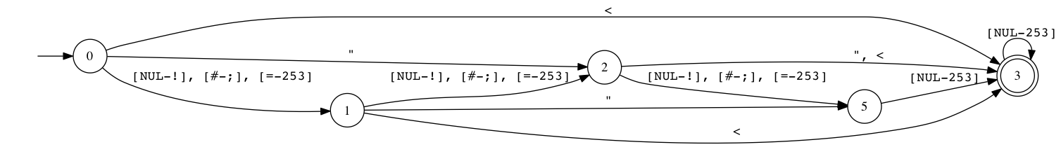
function target($x){
$x = preg_replace(“’”, “\’”, $x); return $x;
}
function reference($x){
$x = preg_replace(“<“, “”, $x);
if (strlen($x) < 4)
return $x;
else
die(“error”);
}
Set of input strings that resulted in the difference: input difference automaton
‘
‘
‘
Input | Target | Reference | Diff Type
“<“ | “<“ | “” | Sanitization
“’’” | “\’\’” | “’’” | Sanitization + Length
“abcd” | “abcd” |  | Validation
T

Slide 31
How to Generate a Sanitization Patch?
Basic Idea: Modify the input strings so that they do not cause a difference
How? Make sure that the modified input strings do not go from the start state to an accept state in the input difference automaton
How? 1) Find a min-cut that separates the start state from all the accepting states in the input difference automaton, and 2) Delete all the characters in the cut

Slide 32
function target($x){
$x = preg_replace(“’”, “\’”, $x); return $x;
}
function reference($x){
$x = preg_replace(“<“, “”, $x);
if (strlen($x) < 4)
return $x;
else
die(“error”);
}
For the example above:
Min-Cut results in deleting everything
  “foo” → “”
Min-Cut is too conservative!
Why? You can not remove a validation difference using a sanitization patch
Input difference automaton
‘
‘
Min-Cut = Σ
‘

Slide 33
(1) Validation Patch
function valid_patch($x){
if (semrep_match1($x))
die(“error”);
}
function reference($x){
$x = preg_replace(“<“, “”, $x);
if (strlen($x) < 4)
return $x;
else
die(“error”);
}
function target($x){
$x = preg_replace(“’”, “\’”, $x); return $x;
}
Σ*
Σ*∪
Σ*
Σ*∪
T
T
T
Validation patch DFA
T

Slide 34
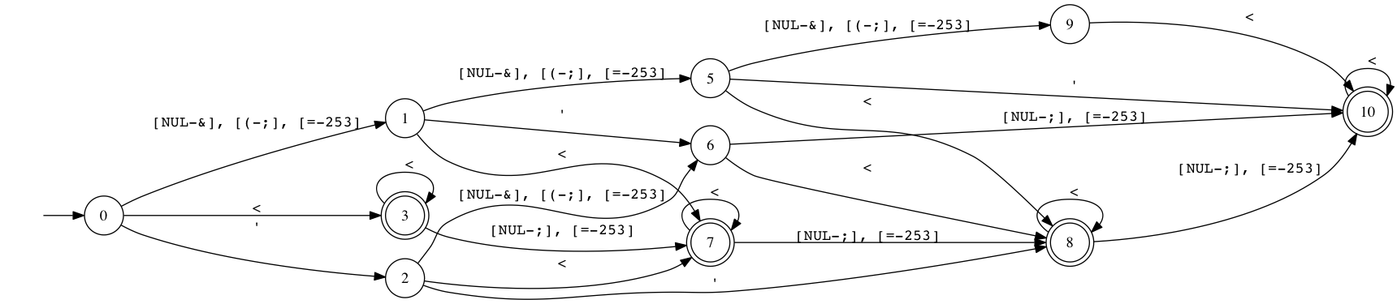
function valid_patch($x){
if (semrep_match1($x))
die(“error”);
}
function reference($x){
$x = preg_replace(“<“, “”, $x);
if (strlen($x) < 4)
return $x;
else
die(“error”);
}
function target($x){
$x = preg_replace(“’”, “\’”, $x); return $x;
}
Σ*
Σ*∪
Σ*
Σ*∪
T
T
X
T
T
Min-Cut = {‘, <}
“fo’” → “fo\’”

Slide 35
(2) Length Patch
function valid_patch($x){
if (semrep_match1($x))
die(“error”);
}
function length_patch($x){
if (semrep_match2($x))
die(“error”);
}
function valid_patch($x){
if (semrep_match1($x))
die(“error”);
}
function reference($x){
$x = preg_replace(“<“, “”, $x);
if (strlen($x) < 4)
return $x;
else
die(“error”);
}
function target($x){
$x = preg_replace(“’”, “\’”, $x); return $x;
}
Σ*
Σ*∪
Σ*
Σ*∪
T
T
Length DFA
T
T
Unwanted length
in target caused
by escape
Notes:
Length dfa will accept anystring of a length l where there is a string in the post image of the reference that has the same length

Slide 36
(3) Sanitization Patch
function valid_patch($x){
if (semrep_match1($x))
die(“error”);
}
function length_patch($x){
if (semrep_match2($x))
die(“error”);
}
function reference($x){
$x = preg_replace(“<“, “”, $x);
if (strlen($x) < 4)
return $x;
else
die(“error”);
}
function target($x){
$x = preg_replace(“’”, “\’”, $x); return $x;
}
Σ*
Σ*∪
Σ*
Σ*∪
T
T
X
Length
Restricted
Post-image
Length DFA
T
T
Unwanted length
in target caused
by escape
Reference
Post-image
Length
Restricted
Post-image
Sanitization
difference

Slide 37
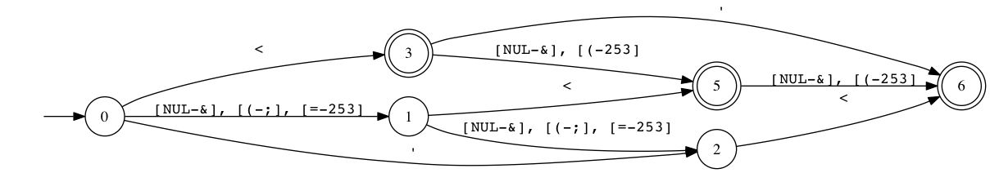
function valid_patch($x){
if (semrep_match1($x))
die(“error”);
}
(3) Sanitization Patch
function length_patch($x){
if (semrep_match2($x))
die(“error”);
}
function reference($x){
$x = preg_replace(“<“, “”, $x);
if (strlen($x) < 4)
return $x;
else
die(“error”);
}
function sanit_patch($x){
$x = semrep_sanit(“<“, $x);
return $x;
}
function target($x){
$x = preg_replace(‘”’, ‘\”’, $x); return $x;
}
function target($x){
$x = preg_replace(“’”, “\’”, $x); return $x;
}
Min-Cut = {<}

Slide 38
Min-Cut Heuristics
We use two heuristics for mincut
Trim:
  Only if min-cut contain space character
  Test if reference Post-Image is does not have space at the beginning and end
  Assume it is trim()
Escape:
  Test if reference Post-Image escapes the mincut characters

Slide 39
Experimental
Results

Slide 40
Differential Repair Evaluation
We ran the differential patching algorithm on 5 PHP web applications
Name | Description
PHPNews v1.3.0 | News publishing software
UseBB v1.0.16 | Forum software
Snipe Gallery v3.1.5 | Image management system
MyBloggie v2.1.6 | Weblog system
Schoolmate v1.5.4 | School administration software

Slide 41
Number of Patches Generated
Mapping | # Pairs | # Valid. | # Length. | # Sanit.
Client-Server | 122 | 61 | 11 | 0
Server-Client | 122 | 53 | 2 | 30
Server-Server | 206 | 49 | 0 | 33
Client-Client | 19 | 34 | 0 | 5
Notes:
This table shows the number of patches generated
The first column show the number of pair sanitizers
A Client server pair means the sanitizer on the client-side is the reference and the sanitizer on the server-side is the target

Slide 42
Sanitization Patch Results
Mapping | min-cut Avr. size | min-cut Max size | #trim | #escape | #delete
Server-Client | 4 | 10 | 15 | 10 | 20
Server-Server | 3 | 5 | 23 | 0 | 20
Client-Client | 7 | 15 | 3 | 0 | 2
Notes:
This shows the mincut results
The max mincut which means the max number of characters in a mincut was 15. – reason → disjoint output, the 10 chars cause server does much more than client
We apply some heuristics to detect the type of sanitization operations applied to mincut characters.
For example, we detect trim() by (1) finding space in the mincut (2) looking at the post-image of the reference and see if it does not start or end with space
we detect escape() by (1) taking the mincut characters (2) looking at the post-image of the reference and see if they are always preceded by the same character
Why large mincut? Why escape patch

Slide 43
Time and Memory Performance of Differential Repair Algorithm
Repair phase | DFA size (#bddnodes) |  | peak DFA size (#bddnodes) |  | time (seconds)
 | avg | max | avg | max | avg | max
Valid. | 997 | 32,650 | 484 | 33,041 | 0.14 | 4.37
Length | 129,606 | 347,619 | 245,367 | 4,911,410 | 9.39 | 168.00
Sanit. | 2,602 | 11,951 | 4,822 | 588,127 | 0.17 | 14.00
Notes:
We can see that the length patch is the most expensive. We even reached MONA’s hard limit on BDD size
The max time taken to generate the length patch was 168 seconds
The max memory was around 5 million bdd nodes where the size of a bdd node is about 16 bytes

Slide 44
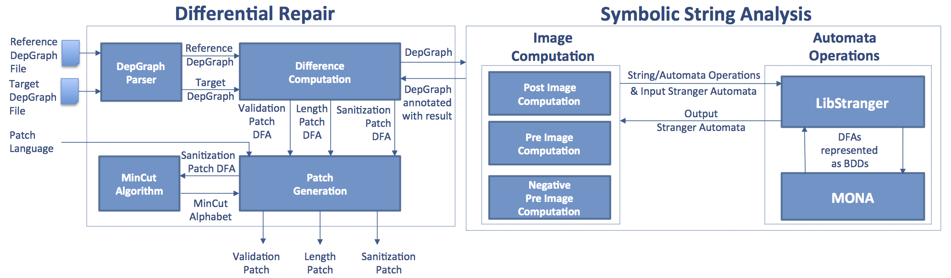

SemRep: Differential Repair Tool
https://github.com/vlab-cs-ucsb
http://www.cs.ucsb.edu/~vlab
A recent paper [Kausler, Sherman, ASE’14] that compares sound string constraint solvers: (JSA, LibStranger, Z3-Str, ECLIPSE-Str), reports that LibStranger is the best!

Slide 45
String Analysis Bibliography
Automata based string analysis:
A static analysis framework for detecting SQL injection vulnerabilities [Fu et al., COMPSAC’07]
Saner: Composing Static and Dynamic Analysis to Validate Sanitization in Web Applications [Balzarotti et al., S&P 2008]
Symbolic String Verification: An Automata-based Approach [Yu et al., SPIN’08]
Symbolic String Verification: Combining String Analysis and Size Analysis [Yu et al., TACAS’09]
Rex: Symbolic Regular Expression Explorer [Veanes et al., ICST’10]
Stranger: An Automata-based String Analysis Tool for PHP [Yu et al., TACAS’10]
Relational String Verification Using Multi-Track Automata [Yu et al., CIAA’10, IJFCS’11]
Path- and index-sensitive string analysis based on monadic second-order logic [Tateishi et al., ISSTA’11]
45

Slide 46
String Analysis Bibliography
Automata based string analysis, continued:
An Evaluation of Automata Algorithms for String Analysis [Hooimeijer et al., VMCAI’11]
Fast and Precise Sanitizer Analysis with BEK [Hooimeijer et al., Usenix’11]
Symbolic finite state transducers: algorithms and applications [Veanes et al., POPL’12]
Static Analysis of String Encoders and Decoders [D’antoni et al. VMCAI’13]
Applications of Symbolic Finite Automata. [Veanes, CIAA’13]
Automata-Based Symbolic String Analysis for Vulnerability Detection [Yu et al., FMSD’14]
46

Slide 47
String Analysis Bibliography
String analysis and abstraction/widening:
A Practical String Analyzer by the Widening Approach [Choi et al. APLAS’06]
String Abstractions for String Verification [Yu et al., SPIN’11]
A Suite of Abstract Domains for Static Analysis of String Values [Constantini et al., SP&E’13]
47

Slide 48
String Analysis Bibliography
String analysis based on context free grammars:
Precise Analysis of String Expressions [Christensen et al., SAS’03]
Java String Analyzer (JSA) [Moller et al.]
Static approximation of dynamically generated Web pages [Minamide, WWW’05]
PHP String Analyzer [Minamide]
Grammar-based analysis string expressions [Thiemann, TLDI’05]
48

Slide 49
String Analysis Bibliography
String analysis based on symbolic execution/symbolic analysis:
Abstracting symbolic execution with string analysis [Shannon et al., MUTATION’07]
Path Feasibility Analysis for String-Manipulating Programs [Bjorner et al., TACAS’09]
A Symbolic Execution Framework for JavaScript [Saxena et al., S&P 2010]
Symbolic execution of programs with strings [Redelinghuys et al., ITC’12]
49

Slide 50
String Analysis Bibliography
String constraint solving:
Reasoning about Strings in Databases [Grahne at al., JCSS’99]
Constraint Reasoning over Strings [Golden et al., CP’03]
A decision procedure for subset constraints over regular languages [Hooimeijer et al., PLDI’09]
Strsolve: solving string constraints lazily [Hooimeijer et al., ASE’10, ASE’12]
An SMT-LIB Format for Sequences and Regular Expressions [Bjorner et al., SMT’12]
Z3-Str: A Z3-Based String Solver for Web Application Analysis [Zheng et al., ESEC/FSE’13]
Word Equations with Length Constraints: What's Decidable? [Ganesh et al., HVC’12]
(Un)Decidability Results for Word Equations with Length and Regular Expression Constraints [Ganesh et al., ADDCT’13]
50

Slide 51
String Analysis Bibliography
String constraint solving, continued:
A DPLL(T) Theory Solver for a Theory of Strings and Regular Expressions [Liang et al., CAV’14]
String Constraints for Verification [Abdulla et al., CAV’14]
S3: A Symbolic String Solver for Vulnerability Detection in Web Applications [Trinh et al., CCS’14]
A model counter for constraints over unbounded strings [Luu et al., PLDI’14]
Evaluation of String Constraint Solvers in the Context of Symbolic Execution [Kausler et al., ASE’14]
51

Slide 52
String Analysis Bibliography
Bounded string constraint solvers:
HAMPI: a solver for string constraints [Kiezun et al., ISSTA’09]
HAMPI: A String Solver for Testing, Analysis and Vulnerability Detection [Ganesh et al., CAV’11]
HAMPI: A solver for word equations over strings, regular expressions, and context-free grammars [Kiezun et al., TOSEM’12]
Kaluza [Saxena et al.]
PASS: String Solving with Parameterized Array and Interval Automaton [Li & Ghosh, HVC’14]
52

Slide 53
String Analysis Bibliography
String analysis for vulnerability detection:
AMNESIA: analysis and monitoring for NEutralizing SQL-injection attacks [Halfond et al., ASE’05]
Preventing SQL injection attacks using AMNESIA. [Halfond et al., ICSE’06]
Sound and precise analysis of web applications for injection vulnerabilities [Wassermann et al., PLDI’07]
Static detection of cross-site scripting vulnerabilities [Su et al., ICSE’08]
Generating Vulnerability Signatures for String Manipulating Programs Using Automata-based Forward and Backward Symbolic Analyses [Yu et al., ASE’09]
Verifying Client-Side Input Validation Functions Using String Analysis [Alkhalaf et al., ICSE’12]
53

Slide 54
String Analysis Bibliography
String Analysis for Test Generation:
Dynamic test input generation for database applications [Emmi et al., ISSTA’07]
Dynamic test input generation for web applications. [Wassermann et al., ISSTA’08]
JST: an automatic test generation tool for industrial Java applications with strings [Ghosh et al., ICSE’13]
Automated Test Generation from Vulnerability Signatures [Aydin et al., ICST’14]
54

Slide 55
String Analysis Bibliography
String Analysis for Interface Discovery:
Improving Test Case Generation for Web Applications Using Automated Interface Discovery [Halfond et al. FSE’07]
Automated Identification of Parameter Mismatches in Web Applications [Halfond et al. FSE’08]
String Analysis for Specification Analysis:
Lightweight String Reasoning for OCL [Buttner et al., ECMFA’12]
Lightweight String Reasoning in Model Finding [Buttner et al., SSM’13]
55

Slide 56
String Analysis Bibliography
String Analysis for Program Repair:
Patching Vulnerabilities with Sanitization Synthesis [Yu et al., ICSE’11]
Automated Repair of HTML Generation Errors in PHP Applications Using String Constraint Solving [Samimi et al., 2012]
Patcher: An Online Service for Detecting, Viewing and Patching Web Application Vulnerabilities [Yu et al., HICSS’14]
Differential String Analysis:
Automatic Blackbox Detection of Parameter Tampering Opportunities in Web Applications [Bisht et al., CCS’10]
Waptec: Whitebox Analysis of Web Applications for Parameter Tampering Exploit Construction. [Bisht et al., CCS’11]
ViewPoints: Differential String Analysis for Discovering Client and Server-Side Input Validation Inconsistencies [Alkhalaf et al., ISSTA’12]
Semantic Differential Repair for Input Validation and Sanitization [Alkhalaf et al. ISSTA’14]
56

