Slide 1
Understanding and Mitigating the Impact of RF Interference on 802.11 Networks
Ramki Gummadi (MIT), David Wetherall (UW)
Ben Greenstein (IRS), Srinivasan Seshan (CMU)
Presented by Lei Yang in CS595H, W08

Slide 2
The impact of interference?
Shannon Channel Capacity
Capacity = Bandwidth*log(1+Signal/Noise)
Very useful in communication theory
Give the upper bound
Give directions for approaching the upper bound
E.g. Telephone line moderm
Very difficult to extend to wireless networks
Too many factors and optimization goals
signal
noise
sender
receiver

Slide 3
Extend to wireless networks?
Current status of network information theory
Succesfully extend to broadcast and multi access channel
But the simplest cases are still unknown
The simplest relay channel
The simplest interference channel
Real networks are much more sophisticated
Factors are difficult to model
Real interference are not stationary, white and additive
MAC scheduling
Delay
User cooperation/relay/multi-hop
Dynamic traffic
Hardware implementation factors
Interference
channel

Slide 4
What can we do?
Information theoretical view
CT: bit-meters/second
Scaling law results O(n), O(√n)…
Estimate performance in real networks
Modeling based on simplifications
Markov process for MAC behavior
Poisson arrival of traffic
Capture hardware impacts…
Simulations
Experiments
Design better schemes to improve performance
Physical layer: modulation, coding
MAC/Network layer: scheduling, routing
Joint optimization: network coding, distributed source coding

Slide 5
Another interference paper
Last week’s paper
Theoretical approach
This paper
Experimental approach
In wireless networks, Blog(1+S/N) doesn’t consider CSMA MAC and traffic demand
Develop a model to estimate pairwise throughput and packet loss ratio
Propose a new scheduling method?
Even for a single 802.11 link, show interference generates worse impacts by experiments
Extend existing SINR model to capture the impacts
Show that simple solutions don’t work, propose a channel-hopping method to reduce the impacts
5

Slide 6
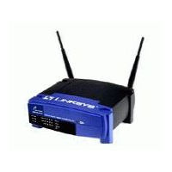
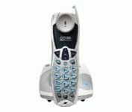
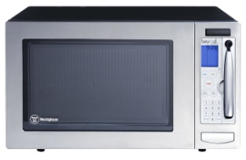
Motivations
Growing interference in unlicensed bands
Anecdotal evidence of problems, but how severe?
Characterize how 802.11 operates under interference in practice
Other 802.11

Slide 7
What do we expect?
Throughput to decrease linearly with interference
There to be lots of options for 802.11 devices to tolerate interference
Bit-rate adaptation
Power control
FEC
Packet size variation
Spread-spectrum processing
TX/RX diversity
Theory
Throughput (linear)
Interferer power
(log-scale)

Slide 8
What we see
Effects of interference more severe in practice
Caused by hardware limitations of commodity cards, which theory doesn’t model
Theory
Throughput (linear)
Practice
Interferer power
(log-scale)

Slide 9
Overview of this paper
Characterize the impact of interference
Extend the SINR model
Simple interference mitigation methods don’t help much
Apply channel hopping to tolerating interference

Slide 10
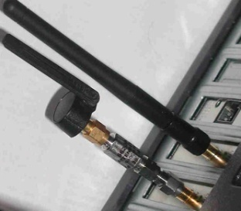
Experimental setup
Access Point
UDP flow
802.11 Interferer
802.11 Client

Slide 11
802.11 receiver path
PHY
MAC
PHY
MAC
To RF Amplifiers
Amplifier control
RF
Signal
AGC
Analog
signal
ADC
Timing Recovery
Barker
Correlator
Data
(includes beacons)
Demodulator
Descrambler
6-bit
samples
Preamble Detector/ Header CRC-16 Checker
Receiver
SYNC
SFD
CRC
Payload
PHY header
Extend SINR model (in paper) to capture these vulnerabilities
Interested in worst-case natural or adversarial interference

Slide 12
Timing recovery interference
Interferer sends continuous SYNC pattern
Interferes with packet acquisition (PHY reception errors)
Weak interferer
Moderate
interferer
Log-scale

Slide 13
Dynamic range selection
Interferer sends on-off random patterns (5ms/1ms)
AGC selects a low-gain amplifier that has high processing noise (packet CRC errors)

Slide 14
Header processing interference
Interferer sends continuous 16-bit Start Frame Delimiters
Affects PHY header processing (header CRC errors)
Unsynchronized interferer

Slide 15
Extending the SINR Model
Original Model
Extended Model
Accounting for processing gain
Accounting for AGC behavior
Acouting for non-linearity in receiver sensitivity
Not very useful

Slide 16
Interference mitigation options
Lower the bit rate
Decrease the packet size
Choose a different modulation scheme
Leverage multipath (802.11n)
Move to a clear channel

Slide 17
Impact of 802.11 parameters
Rate adaptation, packet sizes, FEC, and varying CCA parameters do not help
With and without FEC
Changing CCA mode
Rate adaptation
Changing packet size

Slide 18
Impact of 802.11g/n
No significant performance improvement
High throughputs without interference
Significant drops with weak interferer

Slide 19
Impact of frequency separation
But, even small frequency separation (i.e., adjacent 802.11 channel) helps
Channel hopping to mitigate interference?

Slide 20
Rapid channel hopping
Use existing hardware
Design dictated by radio PHY and MAC properties (synchronization, scanning, and switching latencies)
Design must accommodate adversarial and natural interference → channel hopping
Test with an oracle-based adversary
Design overview
Packet loss during switching + adversary’s search speed → 10ms dwell period
Next hop is determined using a secure hash chain
Triggered only when heavy packet loss is detected

Slide 21
Evaluation of channel hopping
Good TCP & UDP performance, low loss rate
Weak interference,
17% degradation
Moderate interference,
1Mbps throughput

Slide 22
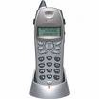
Evaluation of channel hopping
Acceptable throughput even with multiple interferers
Three orthogonal
802.11 interferers
Linear scale
Interferers

Slide 23
Conclusions
Lot of previous work on RF interference
We show 802.11 NICs have additional PHY and MAC fragilities
Interference causes substantial degradation in commodity NICs
Even weak and narrow-band interferers are surprisingly effective
Changing 802.11 parameters does not mitigate interference, but rapid channel hopping can

Slide 24
Pros & Cons
Pros
Clear structure
Useful results
Clearly separation of hardware limitations
Cons
Extended model is not useful
Channel Hopping solution is not novel

