Slide 1
Evaluating Opportunistic Routing Protocols with Large Realistic Contact Traces
by Libo Song and David F. Kotz
Computer Science,Dartmouth College

Slide 2
background
DTN characterization
Long delays
Frequent Link breakages
Mobile Opportunistic Networks - DTNs with sparse nodes
Link failures are a norm, not an exception
Usage of carriers
Why a real scenario instead of modeling?

Slide 3
What's different about this paper?
Use mobility traces collected over a production wireless network at Dartmouth (over 5000 users)
Synthetic message generation model
Comparison of different routing DTN routing protocols (Direct delivery, random contact and epidemic routing, Prophet and Link state)
Propose a new prediction based routing protocol and compare its performance

Slide 4
DTN …
Transfer Probability
Replication Probability
Two extremes:
Direct Delivery
TP=1 for destination, 0 for rest, Replication=0
pro’s? cons?
Epidemic Routing
TP=1 for every node, Replication=1
pro’s? cons?
Optimizations? Indexes
How about Random routing?

Slide 5
PRoPHET -
Probabilistic Routing using History of past Encounters and Transitivity

Slide 6
Link State
Links are assigned weights
Median Inter-contact Duration
Exponentially decreasing inter contact duration
Node i meets j, the link weight becomes:
Protocol operation:
Nodes exchange link state during contact
Paths with least link weight chosen

Slide 7
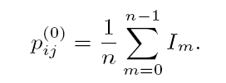
New Protocol Features
Timely CONTACT PROBABILITY

Slide 8
The NEW Routing Protocol
Two Scenarios:
Two hop scenario
Multi hop scenario
Two hop: Decision for forwarding made at either
Sender
Receiver
Multi hop scenario
Exchange Contact Probability Matrix to determine best path

Slide 9
Evaluation
Mobility Traces
Dartmouth university WiFi logs over 1 month (Nov 2003)
(MAC, AP, Association Time, disassociation time)
Nodes and AP considerations
Determination of connection between nodes
Warming up
Simulator
A custom simulator – NS2 issues (slow and irrelevant data)
Models interference

Slide 10
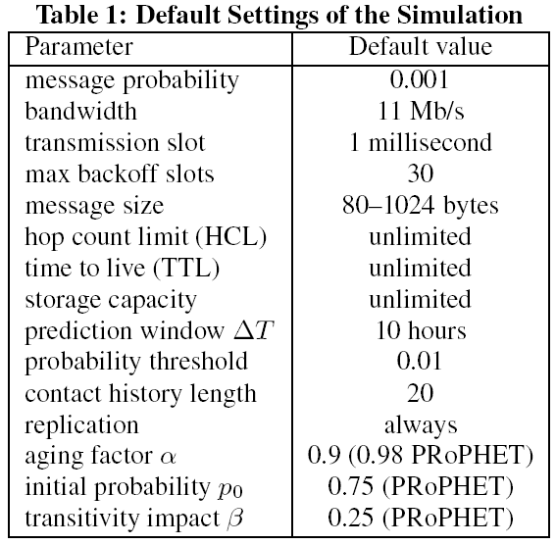
Evaluation … Scenario

Slide 11
Evaluation
Message Generation
Uniform Random Distribution of Source and Destination nodes
Diurnal behavior
TTL and expiration
Metrics
Delivery Ratio
Message transmissions
Meta data transmission
Message duplication
Delay
Storage

Slide 12
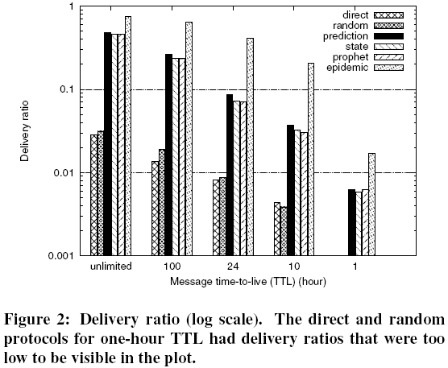
Results!!!
Total Messages generated for every scenario: 2077
Random and Direct contact only made 59 of them
High delivery ratio of Epidemic comes with a cost of being 10 times more expensive than all of the predictive algorithms.

Slide 13
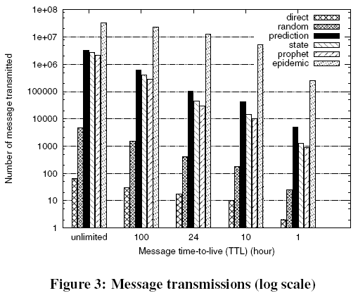
Results …
Random performs slightly better than Direct Delivery as it chooses with higher probability the nodes with greater mobility

Slide 14
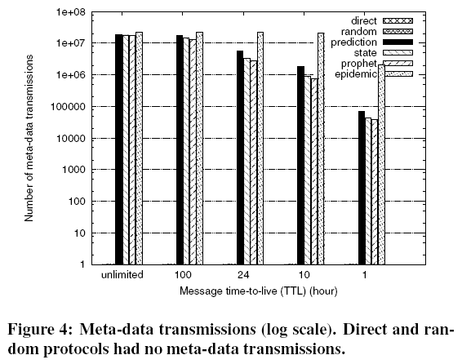
More Results …

Slide 15
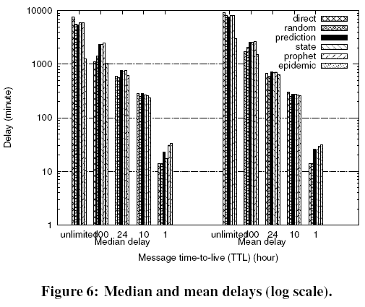
More Results …
Epidemic has high delays for both unlimited and 100 hrs.
Direct delivery had the longest delay for unlimited and 100 hours TTL.
The reason - Direct Delivery with low TTL implies that the packet is not delivered at all.

Slide 16
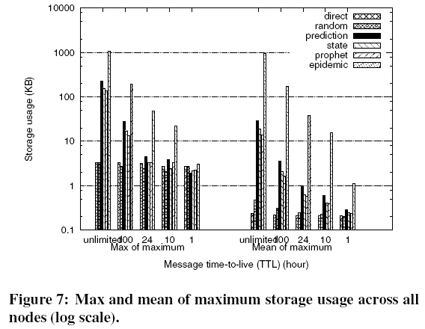
More and more Results …
TTL affects storage!

Slide 17
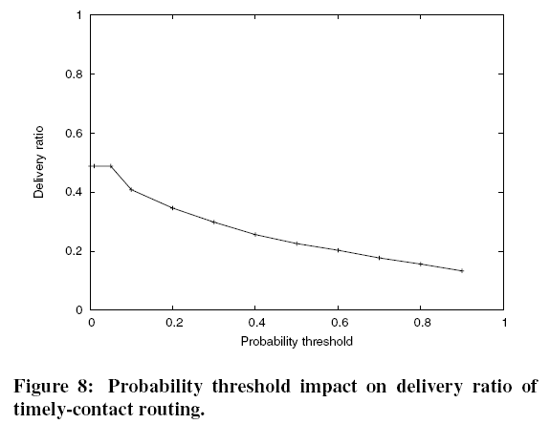
and more results …
Increasing Threshold results in higher Delivery ratio at the cost of storage and power overhead

Slide 18
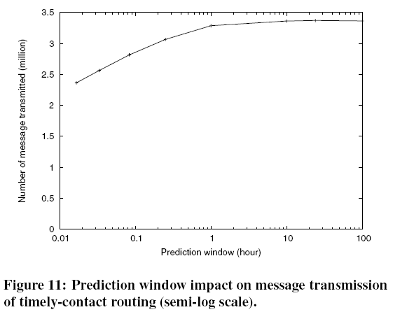
and … a little more Results!
Increasing prediction window results in higher probability values. Can be tailored to average packet transfer times/contact duration

Slide 19
Other work on Opportunistic Routing
Often require domain specific knowledge
Location
Le Brun – location based delay tolerant network
Mobility patterns
Leguay
Musolei
Network Encoding

Slide 20
Finally … summary!
Direct Delivery – lowest delivery ratio, lowest storage requirements, no meta data, no replication – same with Random (but random gives an edge in low mobility environments) – best suited to achieve highest power savings
Contrary would be epidemic – highest delivery ratio, high latency – not desirable even with high resources (storage and power)
All three unsuitable for any opportunistic routing environments
Prediction based – Timely contact, PRoPHET and LINK STATE – 10 times more delivery ratio than predictive. Tuning parameters – for higher priority (more replication, first delivery on contact)
Location based predictive routing – messages replicated across all nodes in a particular location – location information can be used to predict movement of nodes and choose better relays for forwarding messages

Slide 21
Thank you!

