Slide 1
Introduction to
eXtreme Science and Engineering Discovery Environment (XSEDE): Comet and Jetstream
Sharon Solis
Research Computing Consultant
Enterprise Technology Services (ETS)
swsolis@ucsb.edu
Paul Weakliem
IT Director of California NanoSystems Institute (CNSI)
weakliem@cnsi.ucsb.edu
Center for Scientific Computing
UC Santa Barbara

Slide 2
XSEDE is a single, virtual cyberinfrastructure that scientists use to interactively share computing resources, data, and expertise. XSEDE resources may be broadly categorized as follows: High Performance Computing, High Throughput Computing, Visualization, Storage, and Data Services. It is a National Science Foundation (NSF) sponsored service organization that connects national computing resources.
Resources are provided through allocations:
Trial
Startup
Educational
Research
Notes:
Your Campus Champion is your local source of knowledge about high-performance computing opportunities and resources. Your Campus Champion can direct researchers and educators to national high-performance computing resources and services that are available to you and that will help you to advance scientific discovery.

Slide 3
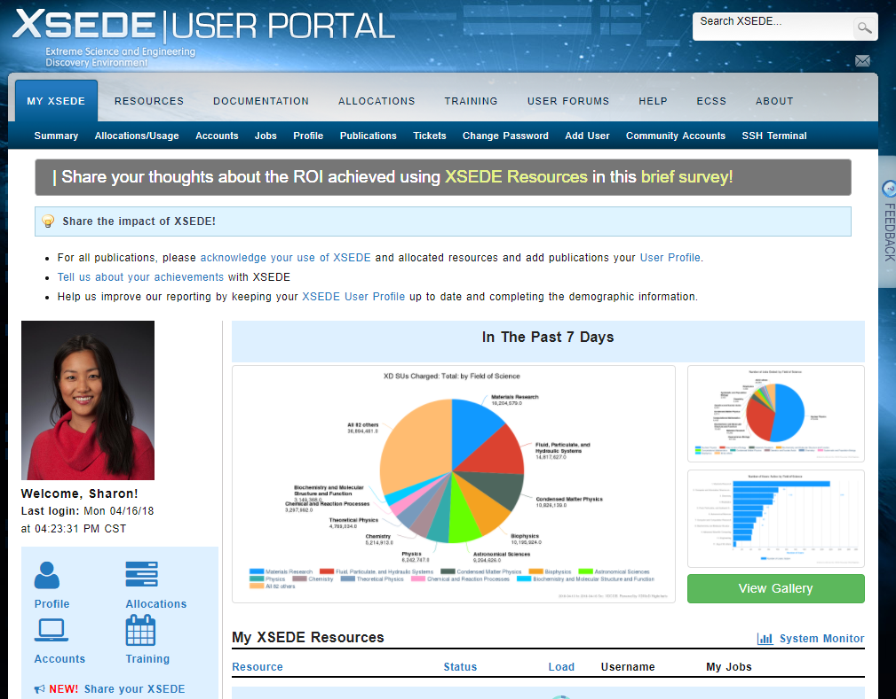
XSEDE Portal
The portal is your main source of information. You can access:
Documentation, webinars
Status of clusters (in your case, Comet and Jetstream)
account usage
Help ticket submission

Slide 4
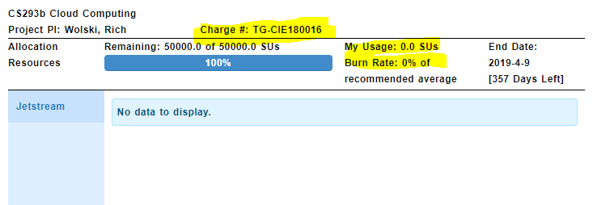
XSEDE Portal
Charge # is important if you have multiple accounts on Comet
Track your usage (SUs)
For each team:
Jetstream SU usage should up to a maximum of 10,000 Service Units (SU), 1 hr on one core = 1 SU.
Comet SU Usage should be no more than 6,000 Service Units (SU).
Please keep track of your usage.

Slide 5
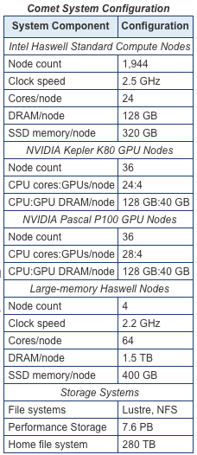
Comet
Comet is a dedicated XSEDE cluster designed by Dell and SDSC delivering 2.76 peak petaflops. It features Intel next-gen processors with AVX2, Mellanox FDR InfiniBand interconnects, and Aeon storage.
designed and is operated on the principle that the majority of computational research is performed at modest scale.
an NSF-funded system operated by the San Diego Supercomputer Center at UC San Diego, and is available through the XSEDE program.
Detailed Documentation: Comet User Guide
Notes:
Add intros to Wrangler, Stampede2

Slide 6
Logging In & File Transfer
•
•
•
By default, XSEDE resources support Single Sign On (SSO) Hub
also requires two factor authentication
The central Hub is: portal.xsede.org
For Linux and Mac, open a terminal:
$ ssh your_user_name@login.xsede.org
For Windows, you may need a client (e.g. Putty, www.putty.org)
login.xsede.org

Slide 7
Two factor Authentication
https://portal.xsede.org/mfa
•
•
•
It uses the DUO Mobile app
Download and install the Duo Mobile App on your iPhone or Android device. Search for "Duo Mobile" from your mobile device. You can identify the Duo Mobile app by its green logo.

Slide 8
Logging In & File Transfer
(to Single Sign on Hub)
Next, login to Comet
$ gsissh comet

Slide 9
Logging In & File Transfer
This is what you will see after logging in:
Check your usage after logging in each time:
$ show_accounts

Slide 10
Logging In & File Transfer
Two factor authentication makes life difficult for file transfer by sap, rsync
Globus Online is the preferred method for large file (you can put ‘globus connect personal’ on your desktop) transfers File transfers managed by a simple web interface
Advantages over scp and rsync commands, no data loss for interrupted connections.
https://portal.xsede.org/software/globus

Slide 11
Running jobs (Comet)
•
•
•
Login nodes are only for editing, file transfer, and compiling. All jobs need to be submitted to the queue.
There are a few available queues:
•
When you submit a job to the queue, all of the CPUs in a node is reserved for you, except
If you submit a job to a shared node (i.e. shared and gpu-shared)
In shared nodes, CPUs are used by multiple users, and there is smaller queue wait times.
Shared nodes cost less SUs.
Do not expect high performance in these nodes, they are for testing and debugging.
•
•
•
•

Slide 12
Running jobs
Example costs:
A job that runs 1 hour and uses 2 CPUs in the compute node:
1 x 24 = 24 SUs
Number of CPUs in one node
A job that runs 1 hour and uses 24 CPUs in the compute node:
1 x 24 = 24 SUs
A job that runs 1 hour and uses 2 CPUs in the shared node:
1 x 2 = 2 SUs
Note the difference in SU costs and use the resources wisely..

Slide 13
Keep track of your usage
Each group will a maximum of 6000 SUs on Comet
From Comet:
$ show_accounts
From Portal:

Slide 14
SLURM
Comet uses the Simple Linux Utility for Resource Management (SLURM) batch environment.
When you run in the batch mode, you submit jobs to be run on the compute nodes using the sbatch command as described below.
Remember that computationally intensive jobs should be run only on the compute nodes and not the login nodes.
Detailed Documentation: Running Jobs on Comet
Notes:
Comet uses the Simple Linux Utility for Resource Management (SLURM) batch environment. When you run in the batch mode, you submit jobs to be run on the compute nodes using the sbatch command as described below. Remember that computationally intensive jobs should be run only on the compute nodes and not the login nodes.

Slide 15
Example Job Submission
$ cd examples
$ mpicc hello_mpi.c
Replace with your favorite editor (nano is easy for beginners)
$ vi submit.job
#!/bin/bash
#SBATCH --job-name="hellompi" #SBATCH --output="hellompi.%j.%N.out" #SBATCH --partition=shared
#SBATCH --nodes=1
#SBATCH --ntasks-per-node=8 #SBATCH --export=ALL #SBATCH -t 01:00:00 #SBATCH -A TG-CIE160012
#This job runs with 1 node, 8 cores per node for a total of 24 cores. #ibrun in verbose mode will give binding detail
cd /home/$USER/CS239Spring17 ibrun -v ./a.out
Notes:
Comet uses the Simple Linux Utility for Resource Management (SLURM) batch environment. When you run in the batch mode, you submit jobs to be run on the compute nodes using the sbatch command as described below. Remember that computationally intensive jobs should be run only on the compute nodes and not the login nodes.

Slide 16
Example Job Submission
$ sbatch submit.job
Submit to the queue
$ squeue -u your_username
Check status
$ scancel jobId
Cancel job with id JobId
There are many examples in the Comet user Guide, please take a look:
http://www.sdsc.edu/support/user_guides/comet.html

Slide 17
Example Job Submission
After the run is complete:
Contents of the combiner error/output file
-v option in ibrun
output of hello_mpi

Slide 18
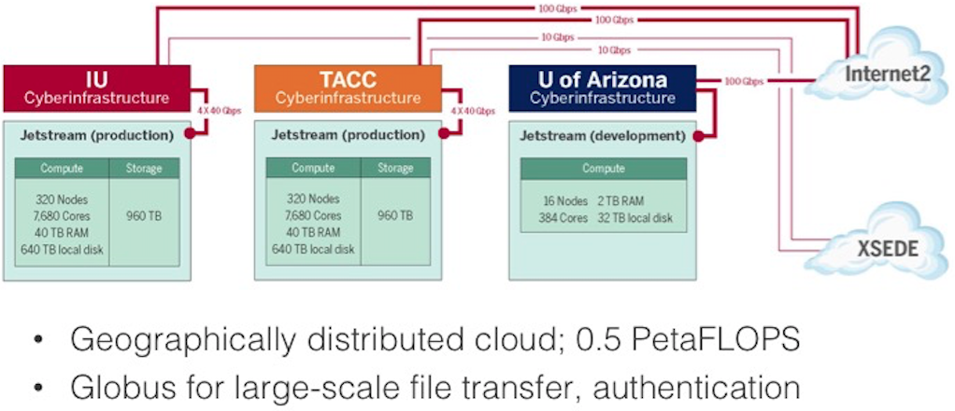
Texas Advanced Computing Center (TACC)
Detailed Documentation: Jetstream User Manual

Slide 19
Texas Advanced Computing Center (TACC)
Jetstream is a user-friendly cloud environment designed to give researchers access to interactive computing and data analysis resources on demand, whenever and wherever they want to analyze their data. It is not a traditional High Performance Computing (HPC) or High Tech Computer (HTC) environment.
provides a library of virtual machines designed to do discipline specific scientific analysis. Software creators and researchers will also be able to create their own customized virtual machines (VM) or their own private computing system within Jetstream.
features a web-based user interface based on the popular Atmosphere cloud computing environment developed by the CyVerse (formerly known as the iPlant Collaborative) that has been extended to support science and engineering research generally. The operational software environment is based on OpenStack.
Detailed Documentation: Jetstream User Manual
Jetstream Quick Start Guide

Slide 20
Accessing Jetstream
Jetstream is accessible primarily through a web interface https://use.jetstream-cloud.org using XSEDE credentials via Globus Auth.
Jetstream is not accessible via XSEDE's Single Sign-On Login Hub.
Newly created XSEDE accounts must be added to a Jetstream specific allocation by the PI or Resource manager in order to access Jetstream. In our case, Professor Wolski sends me each of your XSEDE username.

Slide 21
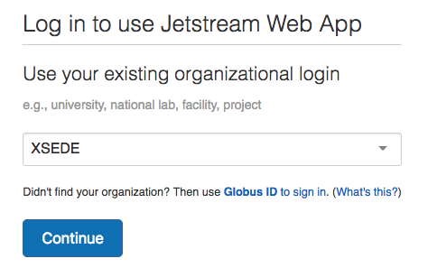
Getting Started with
To start the VM provisioning process, navigate to https://use.jetstream-cloud.org.
Click Login in the top right to authenticate
using your XSEDE credentials.
On the Globus Auth screen click .
Enter your XSEDE credentials; confirm whether you will allow your credentials to be used to access Jetstream.
To proceed, click Allow and the web interface to Jetstream will load.

Slide 22
Getting Started with
Once you are authenticated via Globus Auth, you will end up on the Jetstream landing page, also called the Dashboard. On this page you will be able to:
launch a new instance
browse help resources
change your settings
see your resources and usage history
view a Jetstream Community Activity feed
As SSH is a primary method to access Jetstream resources, we recommend you add SSH keys for each host machine from which you will connect to Jetstream.

Slide 23
Transferring Your Files
There are a number of clients and methods for transferring files to and from your VM Instances.
All involve establishing a secure connection between your instance and another computer, whether inside or outside Jetstream.
Web shell/Web Desktop:
The web shell and web desktop provide a mechanism for transferring files. Instructions for using it are here.
SSH/SCP/SFTP:
SCP/SFTP: Instructions and recommended clients for transferring files with SCP or SFTP
Examples of how to backup/export files using ssh/scp/sftp from within your instance
RSYNC:
Examples of how to backup/export files using rsync from within your instance
GLOBUS File Transfer tools:
Globus Online is a fast, reliable, and secure file transfer service for easily moving data to, from, and between digital resources on the Extreme Science and Engineering Discovery Environment (XSEDE).
HOW TO: File transfer using Globus on Your Home Computer, Clusters, and Jetstream

Slide 24
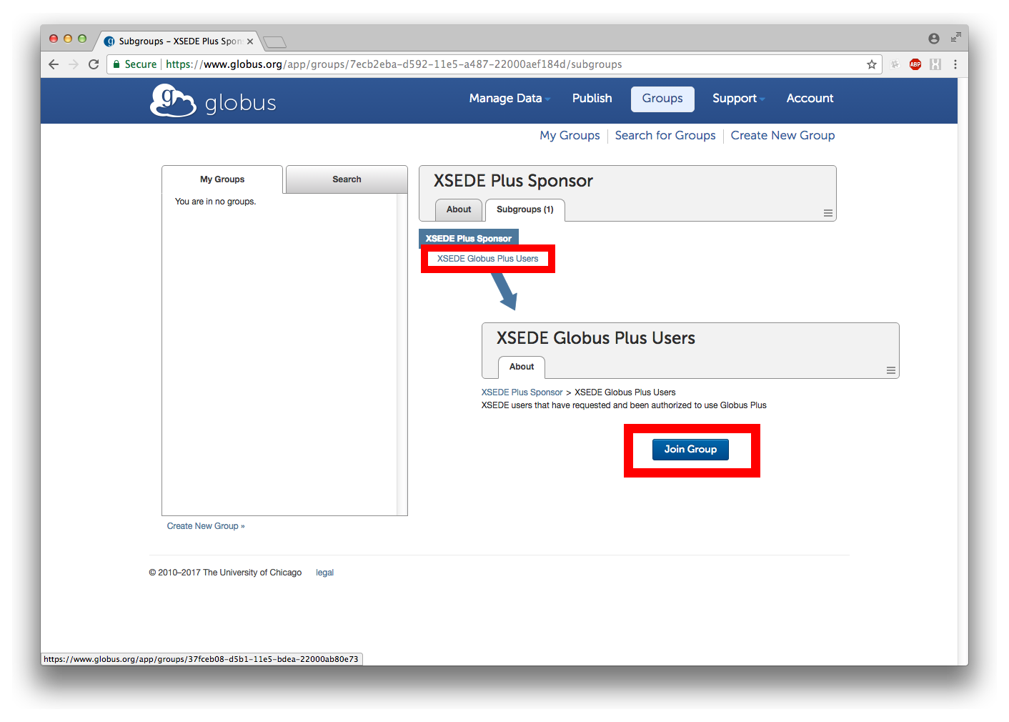
Global File Transfer with
Login into your globus account, and select on “Accounts”.
Go to subsection “Globus Plus”. Under “Select another organization” select option XSEDE Plus Sponsor.
Under the Subgroups tab, find a link to XSEDE Global Plus Users. Select Join group.
Once your request to join the group is approved (usually takes ~hour), you will receive an email to your primary identity (email account) listed under Accounts.
As soon as you are accepted, you will be able to transfer between two Globus personal endpoints (i.e. your computer and your Jetstream VM)!
Detailed Documentation:
Transferring Files
Getting Started with Globus

Slide 25
Launching an Instance
Selecting an Image
Within Atmosphere, you launch an instance (a launched image of a virtual machine), selecting from the list of available images (a template of a virtual machine containing an installed operating system, software, and configuration).
It is recommended that you familiarize yourself with Linux command-line as some actions require some degree of knowledge of the command-line interface.
Detailed Documentation: Jetstream Quick Start Guide

Slide 26
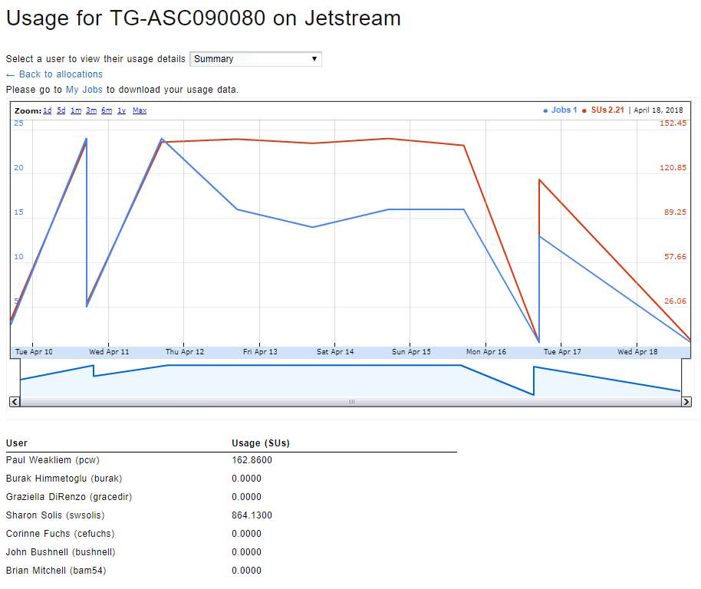
Keep track of your usage
•
Each group will have
10,000 SUs.
XSEDE Portal
> Allocations/Usage Tab
> View Usage

Slide 27
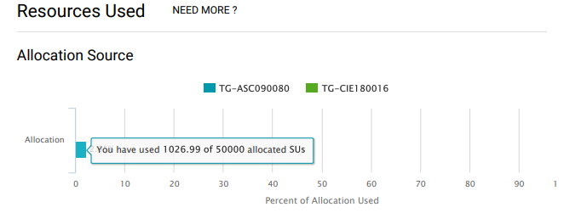
Keep track of your usage
Each group will have 10,000 SUs.
Jetstream Dashboard

Slide 28
Using the Jetstream API
Each team will need to request OpenStack API access at help@xsede.org
Please see Instructions on How to Request OpenStackAPI access
Once you are granted access, please visit Jetstream Public Wiki for Detailed Documentation.

