Slide 1
Data Encapsulating Services: A New Paradigm for Developing Enterprise Systems
Jianwen Su
University of California, Santa Barbara

Slide 2
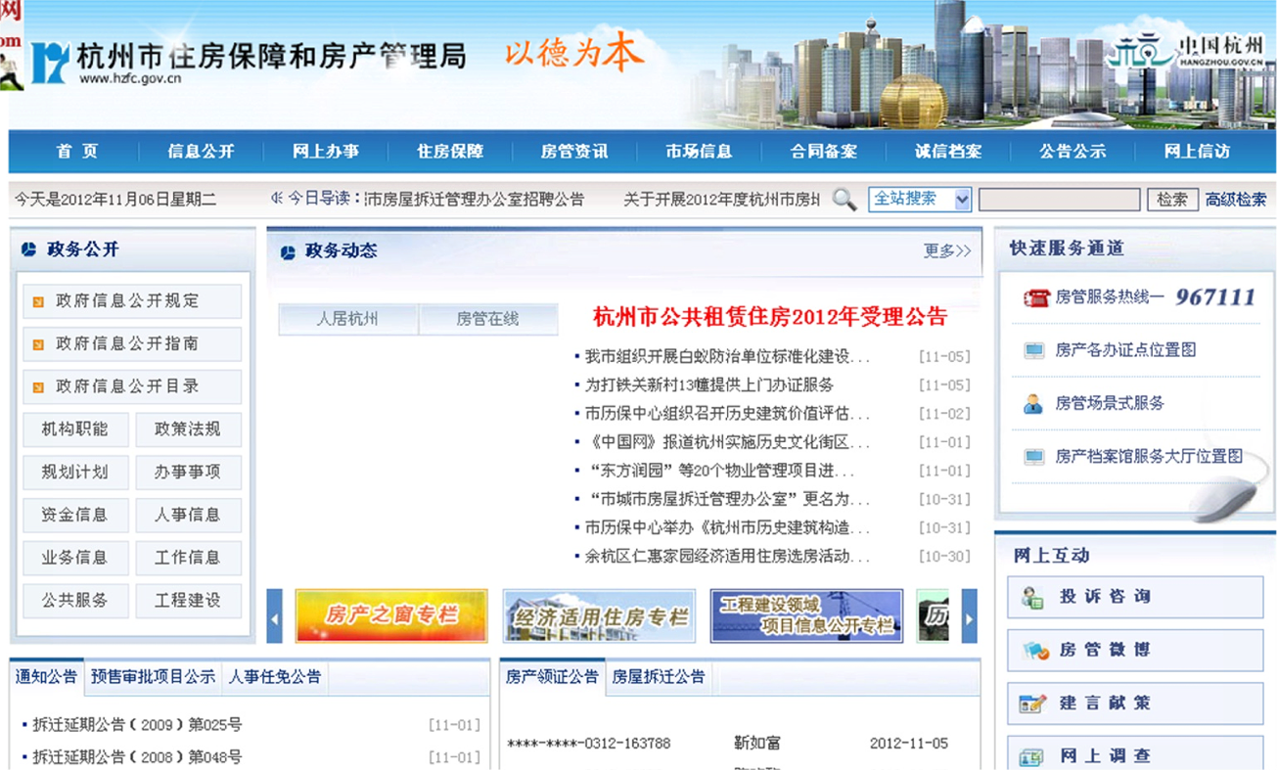
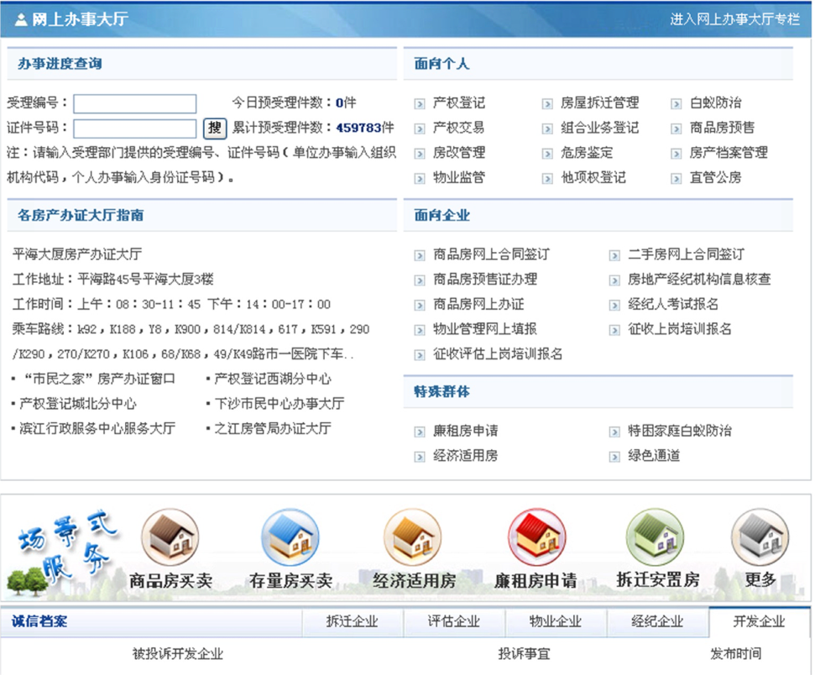
Hangzhou Housing Management Bureau
500 workflow models
300,000 cases/year

Slide 3
Permit for Selling an Unbuilt Appartment
Obtaining a Permit (商品房预售申请)
preliminary review
初审
secondary review
复审
Application
申请
Approval
审批
Delivary
递交
Certificate
制证
lic. fee payment
缴费

Slide 4
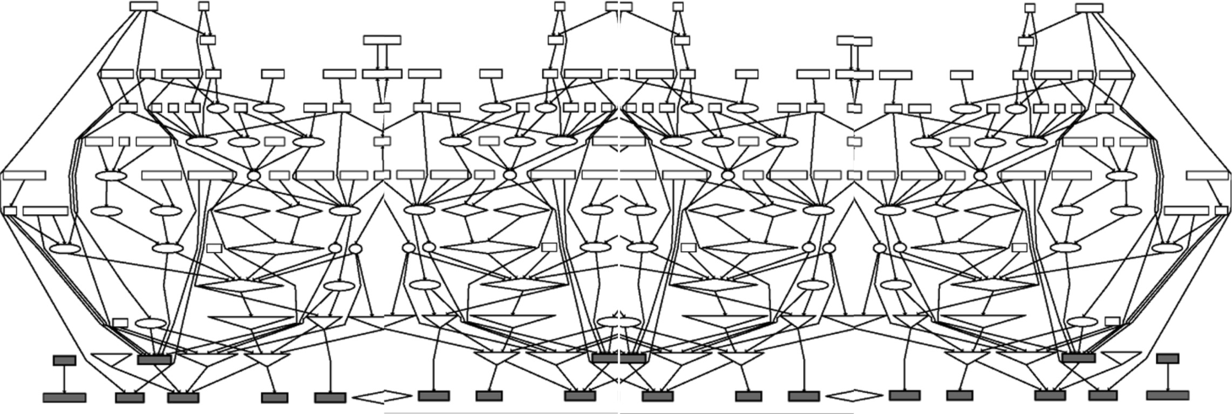
A Typical Housing Management System
Ad hoc design, developed over time, patches, multiple technologies, … a typical legacy system
Problems:
Embedded business logic, hard to learn
hard to maintain, costly to add new functionality
hard to change/evolve

Slide 5
Virtual Enterprise Systems
OpenAPI approach towards
Business Process as a Service (BPaaS)
Enterprise may run virtual IT systems
HR
Appraisal
Accounting
Assessor
Enterprise System
Inheritance
Reassessment
Title Change
Tax Calculation
Determine tax base
Tax
Title
Good idea but need to manage enterprise data

Slide 6
Current Practice
Data and services are separately modeled, designed, managed
Adds difficulties in design, execution, maintenance, and making changes
Furthermore, many issues can’t be addressed
Workflow transaction remains an art
Data consistency is a concern of DBMS even though violations are caused by service execution
Business analytics is an after thought
Long tail phenomenon is a “holy grail”
Big data

Slide 7
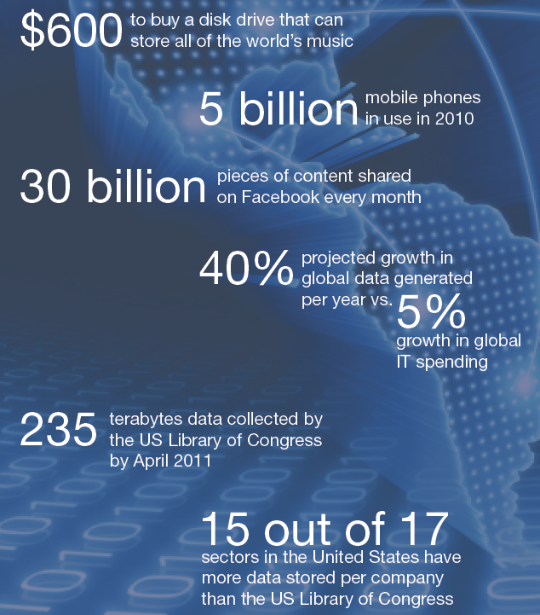
Big Data—A Gowing Torrent
Mckinsey Global Institute, June 2011: Big data: The next frontier for innovation, competition, and productivity
Availability of “big data” brings opportunities for improving productivity

Slide 8
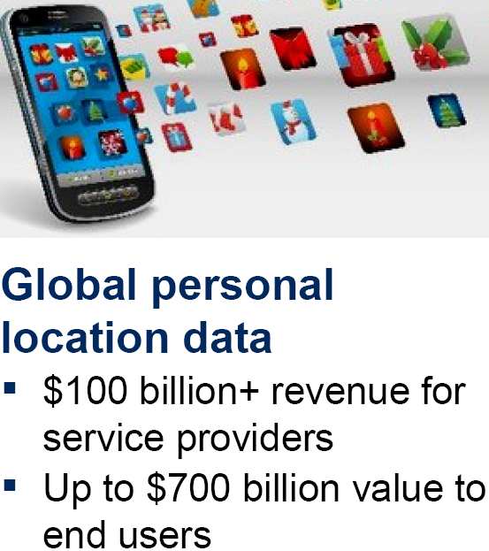
Big Data + Biz Processes Big Potential
Two observations
A significant portion of big data generated by biz processes
Productivity growth only obtainable via more efficient/effective biz processes
Source: MGI Analysis

Slide 9
Virtual ES’s: Data Management Problem
OpenAPI approach towards
Business Process as a Service (BPaaS)
Enterprise may run virtual IT systems
HR
AppraisalPAL
AccountingPAL
AssessorPAL
Enterprise System
Reassessment
Inheritance
Title Change
Tax Calculation
Determine tax base
?
TaxPAL
TitlePAL

Slide 10
An Open Market Model
No major players
Enterprise makes its own data management plan
Bring Your Own Data (BYOD)
BPaaS with
OpenAPI
Data needed for services
+ services states
Enterprise system

Slide 11
Business Artifacts (业务流程工单)
A business artifact is a key conceptual business entity that is used in guiding the operation of the business
fedex package delivery, patient visit, application form, insurance claim, order, financial deal, registration, …
both “information carrier” and “road-maps”
Technically, it includes two parts:
Information model: data needed to move through workflow
Lifecycle: possible ways to evolve
Very natural to business managers and BP modelers

Slide 12
Example: Restaurant Processes
repository
Artifacts
Activity
Create Guest Check
GC
Add Item
Guest Check
KO
Kitchen Order
Prepare Receipt
Open GCs
Pending KOs
Receipt
RC
Cash Balance
Pending Receipts
Closed GCs
Prepare & Test Quality
Payment
Paid Receipts
Update Cash Balance
Ready KOs
Disagreed Receipts
Deliver
Recalculate Receipt
Archived Receipts
Archived GCs
CB
Archived KOs
Cash Balance
Notes:
Data flows
Data flow view, cite, and differences
Data flow diagramming [DeMarco-78]

Slide 13
SeGA: A Service Wrapper/Mediator
[Sun-Xu-S.-Yang CoopIS 12]
SeGA separates data from execution engine
Serves as a mediator
Incoming event
to SeGA
SeGA
...
Event Queue
Fetch correlated instances of the event
Dispatcher
Repository
Send the event, the process instances, & their schemas to the engine
. . .
EZ-Flow
Engine n
Dispatcher retrieves the updated instances & stores into the repository
Outgoing event
Barcelona
Engine n
Barcelona
Engine 1
Process the event, update the instances, & emit outgoing events
1. SeGA receives incoming events
...
2. A dispatcher fetches the correlated BP instances according to the type of the incoming event
SeGA
Event Queue
Artifact
Repository
Dispatcher
Incoming event
BP instance
Schema
Outgoing event
3. The dispatcher sends the incoming event, the BP instances, and their schemas to the corresponding engine
Barcelona
Engine 1
EZ-Flow
Engine 1
. . .
. . .
. . .
5. The dispatcher retrieve the updated BP instances from the engine and store them back to the repository
Barcelona
Engine n
4. The engine then processes the incoming event, updates the BP instances, and sends outgoing events

Slide 14
Data Encapsulating Services
Data package between SeGA & services:
Business data, enactment data, resource data, correlation data
Data encapsulating services: Stateful services but the engine need not maintain state
Independence of data and service management
SeGA
Enterprise system

Slide 15
Research Challenges
Design: What are appropriate service designs? Choreography vs orchestration (Part II)? Design aid (analysis/model checking tool), interoperation
Runtime: Enforcement of process/data constraints, KPI/monitoring techniques, resource planning and management
Transactions: What is the notion of workflow transaction?
Change/evolution: Process vs instance changes, long lasting vs temporary, longtail
Big data: monitoring to analytics to change

Slide 16
Potential Applications
Traditional and new service sectors and businesses
Housing management (房管)
Social security (社保)
Retail
Auditing (审计)
…
May spawn new types of service businesses such as
cloud platforms for BPaaS providers
consulting businesses to analyze and improve business processes (big data)

Slide 17
Conclusions
Inclusion of persistent data is critical to capture business logics into services
Data encapsulating services enable separation of data and service management and support
Independence of data and service management
Many research challenges

