Slide 1
Choreography Revisited
Jianwen Su
University of California at Santa Barbara

Slide 2
Computing
Foundation for Science, Technology, Engineering
Modeling & abstraction
Algorithmic thinking
This talk concerns business processes
Retail industry, legal & government, health care, …
BPs could be helped by CS in
Management of data and processes
Techniques for modeling & design, automation
Business informatics (as a new sector?)
Focus: collaboration between business processes

Slide 3
Collaboration Models (Extreme Cases)
Hub-and-spoke or mediated
Peer to peer (communicate when needed)
global state
bottle neck: - performance - failure - security - …
Orchestration
(parallel programming)
Mediator
Store
Seller
Warehouse
Bank
no bottle neck
global state
Store
Bank
CS can contribute here
Seller
Warehouse

Slide 4
Choreography
A choreography defines how biz processes should collaborate to achieve a business goal
Goal: Support for choreography languages:
Design “correctness”, auto realization, mechanisms for monitoring, …
Store
Bank
choreography
Seller
Warehouse

Slide 5
Outline
Choreography & biz processes
Key Aspects of choreography specification
Weaknesses of existing choreography languages
Ingredients of our approach
Artifacts as biz processes
Correlations
Message diagrams
Snapshots and temporal (choreography) constraints
Realization
Conclusions

Slide 6
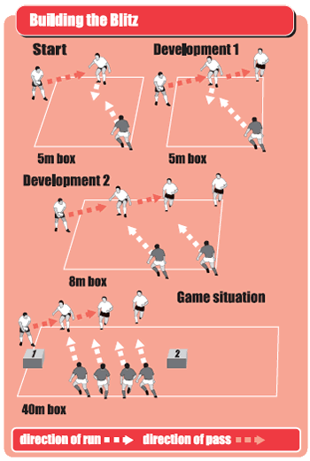
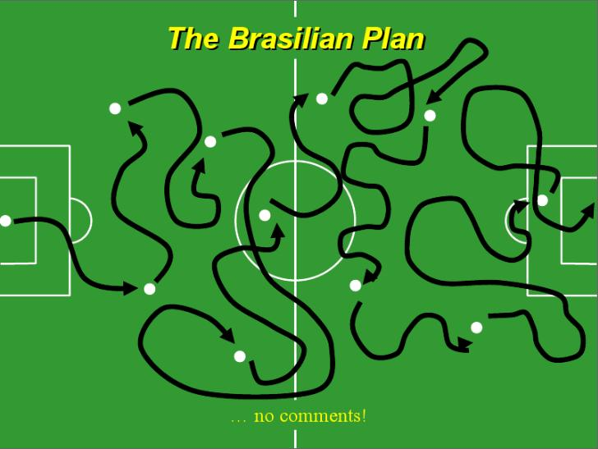
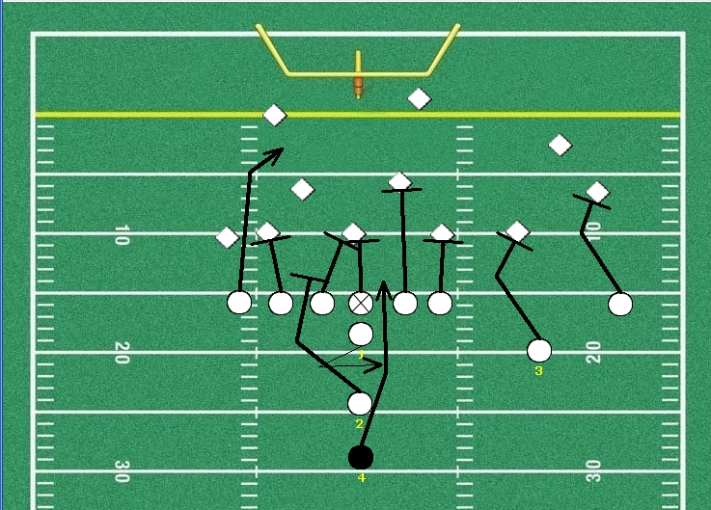
Examples: Choreographies for Soccer

Slide 7
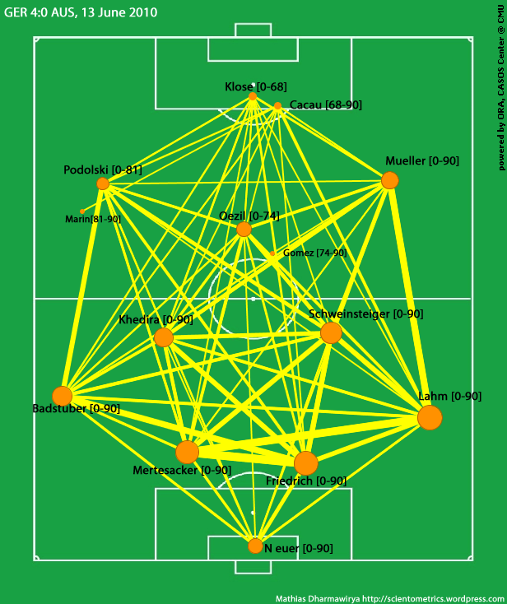
Choreographies for BPs Are More Complex
usiness
Views (for Analytics)

Slide 8
Correlation of Process Instances
A choreography should be aware of process instances not just biz process types
Existing languages? None support such correlations:
WS-CDL, BPMN, process algebras, conversation protocols, Let’s Dance, (BPEL,) …
Store
Bank
Seller
Warehouse
Seller
Warehouse
Seller
Warehouse

Slide 9
Data in Messages and Process Instances
Choreography constraints may depend on message contents and data from process instances
Most choreography languages support no data, or no general models for data
Store
Bank
Seller purchase completion
is not needed for “small” purchases
Seller
Warehouse
Seller
Warehouse
Seller
Warehouse

Slide 10
What are Needed?
Order
Payment
Data: if the amount is less 10, then a fulfillment instance can ship even the check is not received
O₁
M₁
Purchase
P₁
P₂
P₃
F₁
F₂
Fulfillment
Instance-level correlation: Which instances are correlated during the runtime? Who sends messages to whom?

Slide 11
Existing Choreography Languages
 | Instance correlation | Schema correlation | Data
Conversation model [Fu et al 2004] | no | yes | no
WS-CDL [W3C 2005] | no | yes | message variables*
Let’s Dance [Zaha et al 2006] | no | yes | no
BPEL4Chor [Decker et al 2007] | 1-to-m only | yes | message variables*
Artifact-centric choreography [Lohmann-Wolf 2010] | no | yes | no
Our model | yes | yes | yes
*no clear linkage between variables and processes

Slide 12
Outline
Choreography & Biz Processes
Key Aspects of Choreography Specification
Weaknesses of existing choreography languages
Ingredients of Our Approach
Artifacts as Biz Processes who
Correlations to whom
Message Diagrams sends what at what time
Snapshots and Temporal (Choreography) Constraints
Realization
Conclusions

Slide 13
Four Types of Data in Biz Processes
Essential business data for the process logic: items, shipping addresses, ...
Current execution or enactment states: order sent, shipping request made, ...
Resource usage and states: cargo space reserved, truck schedule to be determined, ...
Correlation between processes instances: 3 warehouse fulfillment process instances for a customer order instance, ...
All data should be persistent (maintained properly)
Traditional biz process modeling languages are weak in modeling related data

Slide 14
BP Models: Data Abstraction to Artifacts
Four classes of Biz process models:
Data agnostic models: data mostly not present
WF nets (Petri nets), BPMN, …
Data-aware models: data (variables) present, but storage and management hidden
BPEL, YAWL, …
Storage-aware models: schemas for persistent stores, data mappings to/from BPs defined/managed manually
jBPM, …
Artifact-centric models: logical modeling for biz data, automated: modeling other 3 types, data-storage mapping
GSM, EZ-Flow

Slide 15
Artifacts As Process Models
Should support: instances, process contents, messages
Artifact class or interface, data attributes, attribute types may be relational or other artifact classes
Store: Order
Bank: Payment
Seller: Purchase
Warehouse: Fulfillment
ID
CName
Addr
Cart
…
INo
Seller
WHouse
Price
INo
Vendor
WHouse
Price
INo
Vendor
WHouse
Price
INo
Vendor
WHouse
Price
INo
Vendor
WHouse
Price
ID
OrdID
…
Lifecycle specifications not shown
ID
…
ID
…

Slide 16
Correlation Diagrams
Two process instances are correlated if they are involved in a common collaborative BP instance
Messaging only between correlated instances
Correlations of a CBP are defined in a diagram, with one BP as the root or primary process
Directed edge indicates creation of BP instance(s)
Cardinality constraints are also defined
Some syntactic restrictions (acyclic, “1” on root, …)
1
1
Order
Payment
store
1
1
bank
m
Purchase
m
Fulfillment
seller
warehouse

Slide 17
Referencing Correlated BP Instances
1
1
Skolem notations reference correlated instances
Fulfillment⟨o₅⟩ is the set of all Fulfillment instances IDs that are correlated to an Order instance with ID o₅
Order⟨o₇⟩ is the Order instance correlated to a Payment instance with ID o₇
Path expressions used to access contents of artifact attributes, o₅.Cart.Seller denotes all sellers of items in the cart of order o₅
Order
Payment
o₅
1
1
o₇
m
m
Purchase
Fulfillment

Slide 18
Derived Correlations
1
1
A Purchase instance and a Fulfillment instance is correlated if both correlated to the same Order instance and share at least one item
CORRELATE (Purchase, Fulfillment) if Order⟨Purchase⟩ = Order⟨Fulfillment⟩ ∧ Purchase.Items.INo ⎡⎤ Fulfillment.Items.INo
Derived correlations have no cardinality constraints specified, nor instance creation
Order
Payment
1
1
m
m
Purchase
Fulfillment

Slide 19
“Managing” Correlations
Correlations are generated at runtime
Some correlations are generated within collaborative BP execution, e.g., creating Fulfillments by Order
Some correlations are obtained through external means, e.g., Payment & Order
Need to know messaging “patterns”
Runtime management of BP instance correlations using Petri nets: [Zhao-Liu CAiSE 07]

Slide 20
Messages Diagrams
A message diagram defines message types and sender/receiver of each type
“External” denotes the environment
“+” means creation of new BP instance
Message may have data attributes
Path expressions are used to access data contents
InVoice
OrderComplete
PaymentReq⁺
OrderReq⁺
External
Order
OrderPayment
Payment
ReqShipping
ProcPurchase⁺
ProcFulfillment⁺
Purchase
PurchaseComplete
Fulfillment
ShippingComplete

Slide 21
Outline
Choreography & Biz Processes
Key Aspects of Choreography Specification
Weaknesses of existing choreography languages
Ingredients of Our Approach
Artifacts as Biz Processes
Correlations
Message Diagrams
Snapshots and Temporal (Choreography) Constraints
Realization
Conclusions

Slide 22
System Snapshots (States)
A system snapshot is a triple (A, M, m)
A : a set of “active” artifact instances, M : a set of messages that are already sent, and m : the current message sent
Note that data contents are included
Also “tracked”:
Artifact instance correlations
Message-artifact dependencies (a message creates an artifact instance)
Message-message dependencies (a message replies to the previous message)

Slide 23
Message Predicates and Data Atoms
Message predicates: M(μ, a, b)
M: message type, μ message instance ID, a, b: ID of artifact instance (sender, receiver)
With a data atom: ProcPurchase(μ, a, b) ∧ μ.cart.price>100
data atoms can involve artifacts (e.g., a, b)
Message-message dependencies
M[γ]: ID of the message of type M in response to γ
M(M[γ], a, b) abbreviated as M[γ](a, b)
A snapshot formula: a message predicate with one or more data atoms

Slide 24
Choreography Constraints
General form: ψ₁ op ψ₂
ψ₁, ψ₂ : snapshot formulas
op : binary operators from DecSerFlow:
^{[van der Aalst et al, 2006]}
(co-)exists, SUCCession (resp., prec.), etc. (11 kinds)
Examples

Slide 25
Messages Diagram for the Example
InVoice
OrderComplete
PaymentReq⁺
OrderReq⁺
External
Order
OrderPayment
Payment
ReqShipping
ProcPurchase⁺
ProcFulfillment⁺
Purchase
PurchaseComplete
Fulfillment
ShippingComplete

Slide 26
Choreography Constraints
General form: ψ₁ op ψ₂
ψ₁, ψ₂ : snapshot formulas
op : binary operators from DecSerFlow:
^{[van der Aalst et al, 2006]}
(co-)exists, SUCCession (resp., prec.), etc. (11 kinds)
An example:
OrderReq(μ,EXT,x) ∧ μ.amount>10
ProcPurchase[μ](x,Purchase⟨x⟩)
Each order request over 10 should be followed by one (or more) processing purchase messages
Free (artifact/message ID) variables are universally quantified
SUCC
⎯→

Slide 27
Another Example
∀x∈Fulfillment ∀y∈Purchase⟨x⟩
PurchaseComplete(μ, y, x) ∧ y.cart.price>100
ReqShipping[μ](Order⟨x⟩, x)
If there is an item priced >100, shipping request is after all purchasing completion
SUCC
⎯→
InVoice
OrderComplete
PaymentReq⁺
OrderReq⁺
External
Order
OrderPayment
Payment
ReqShipping
ProcPurchase⁺
ProcFulfillment⁺
Purchase
PurchaseComplete
Fulfillment
ShippingComplete

Slide 28
Semantics Based on FO-LTL
DecSerFlow operators are expressible in Linear-Time Logic (LTL)
Choreography constraints can be translated to first-order LTL
Semantics of FO-LTL is based on sequences of system snapshots

Slide 29
Outline
Choreography & Biz Processes
Key Aspects of Choreography Specification
Weaknesses of existing choreography languages
Ingredients of Our Approach
Artifacts as Biz Processes
Correlations
Message Diagrams
Snapshots and Temporal (Choreography) Constraints
Realization
Conclusions

Slide 30
Realization
Store
Bank
A choreography = a set C of snapshot sequences that satisfy constraints
Executable system = a set E of snapshot sequences that may be produced
The choreography is realized by the executable system if C = E
choreography
Seller
Warehouse

Slide 31
Choreography Decision Problem
Problem: Given a choreography, is it realizable?
Raised in [Bultan-Fu-Hull-S. WWW 03]
Studied in many contexts, especially with process algebras since 2004 [S.-Bultan-Fu-Zhao, WS-FM 07]
Crux of the problem:
When A, B, C, D operate autonomously, m₂m₁ is possible
A→B: m₁
A
B
C
D
!m₁
?m₁
!m₂
?m₂
C→D: m₂
Choreography and projection to 4 peers

Slide 32
Choreography Realization Problem
Given a choreography, how do we design an executable system to realize it?
More practical:
Choreography design is a business decision
System design is software engineering problem
Preliminary result: If a choreography has only 1-1 correlations, it can be realized
The executable system uses a small number of auxiliary messages to synchronize
Store
Bank
choreography
Seller
Warehouse

Slide 33
Outline
Choreography & Biz Processes
Key Aspects of Choreography Specification
Weaknesses of existing choreography languages
Ingredients of Our Approach
Artifacts as Biz Processes
Correlations
Message Diagrams
Snapshots and Temporal (Choreography) Constraints
Realization
Conclusions

Slide 34
Conclusions
BPM is a rich research area for CS: modeling, analytics, interoperation, evolution, …
Collaborative BPs an interesting & very relevant thread in BPM
CS techniques helpful for orchestration
CS techniques necesssary for choreography
This talk: trying to get to the technical details
development of specification languages, realization techniques, runtime monitoring and support, making changes, etc.

Slide 35
Future Problems
Choreography specification with instance and data
FO+LTL semantics [Sun 2013]
Alternative framework? E.g., FSMs, process algebras, Petri nets, …
Analysis of choreography
Satisfiability? (Seems undecidable for our language)
Finiteness? (Guarantee to terminate in finite steps, likely undecidable)
Realization
Static compilation
Dynamic schemes

