Slide 1
Exploring Workflow Enactments through Querying Execution Logs
Business Intelligence Revisited
Jianwen Su
Dept. of Computer Science
UC Santa Barbara
(Joint work with Yan Tang)

Slide 2
Outline
Business Workflow and Analytics (=BI)
Classical Approach to BI
Workflow Logs
Exploration as An Example
Research Challenges

Slide 3







Business Processes & Workflow Management
A BP is an assembly of tasks to accomplish an objective
  Eg: Obtaining a Permit
Each workflow model matches a BP model
Each workflow activity (☐) is a software program
that interfaces one task in the BP
A WfM system manages executions, resources, documents, etc.
Application
Init review
Review
Fee
Certificate
Delivery
BP
Approval
workflow
Workflow Management (WfM) System

Slide 4


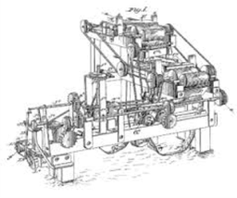
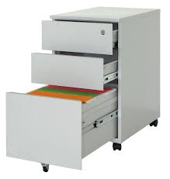

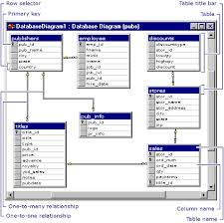
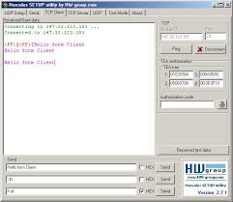

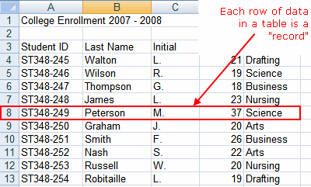

BP and Workflow: Another View
Biz Proc Model
Biz Proc Execution
On-site
Repair
documents,
people,
devices,
resources,
collaboration,
…
Repair
Application
Repair
Assignment
Post-repair
Visit
Application
Review
Doc.
Archive
Only
activities
are present
software
development
Workflow Model
Workflow Execution
flow mgmt,
services,
db’s,
software,
resources,
…

Slide 5
BP/Workflow: Change is Essential
Causes of changes: policy/regulation change, environment change, market, improvements, . . .
To incorporate changes, need to modify:
  BP/workflow models
  Databases
  WfM systems
  …
  Very hard problem but not the focus of here
To find opportunity for change from past executions
  Business intelligence (BI)
  Needs data, where are data?

Slide 6
An Example from Univ of California
TC Travel Council oversees travel policies, programs, and travel related business services
Allowing AirBnB: what steps in e.g., reimbursement are affected?
  State funding
  Federal funding
  Gifts and donations
Defined procedures in 10 campuses, 5 hospitals, & Office of President
Actual practices vary, need to find from past cases,
e.g. travel reimbursement
  ? Where are data

Slide 7
BP and Workflow: Another View
Biz Proc Model
Biz Proc Execution
On-site
Repair
documents,
people,
devices,
resources,
collaboration,
…
Repair
Application
Repair
Assignment
Post-repair
Visit
Application
Review
Doc.
Archive
Only
activities
are present
software
development
data &
documents
Workflow Model
Workflow Execution
flow mgmt,
services,
db’s,
software,
resources,
…
Workflow execution generates a lot of data:
biz data, execution status, resource usages, correlations, …

Slide 8




Workflow Management System
(John Doe, 2017, UCORP meeting, Oakland, …)
business
processes
. . .
workflow
(John Doe, 2017, UCORP meeting, Oakland, …)
workflow
management
data management

Slide 9
Where Are Data in WfM Systems
Typical architecture:
Logging often an option:
  Workflow instance, activity (task), variables, …, etc all logged separately, sometimes in difference dbs
[van der Aalst-van Hee 2004]
(Pre-architecture [Bussler 1997])
WfMS
Includes all data required for control flow decisions, correlations, …
Task
wrapper
Enterprise
database
Execution
Engine
Task
wrapper
Local
data store
. . .
Task
wrapper

Slide 10
Outline
Business Workflow and Analytics (=BI)
Classical Approach to BI
Workflow Logs
Exploration as An Example
Research Challenges

Slide 11
Traditional Approach to BI (Big Data)
Biz analytics (intelligence): Extract-Transform-Load
inventory
Transactions
Transactions
activities
Data
Warehouse
Analysis
catalog
Biz Processes are missing!
cust_db
Transactions

Slide 12
A Few Details on ETL-OLAP
Typically, extract via relational queries (SQL, relational algebra, etc.) on other relational databases
  Could be from other types
Relational queries may be chained together and combined, results loaded into data warehouse
The types of queries are predetermined:
  What data to get
  How data from different sources are combined
  Fixed semantics and representations of data

Slide 13
Example: TaoMart
Whole sales, dominant online sales
Could like to do market predictions based on past sales
Fact table: sales transactions
Dimensions:
  Shopper demographics
  Locations
  Seasons
  Classifications of goods
  Possible others
OLAP: data cube operations
Does an excellent job for the types of queries, but…

Slide 14







Hospital Referring Example
[Tang-S. PED 17]
receipt
Get reimbursement
Complete referral
Check in
See doctor
Pay fees
*Update referral
get referral
Q1: Are there any students update referral?
Q2: Any students update referral then get reimbursement?
Notes:
Problem: design a query language

Slide 15
Weaknesses of ETL-OLAP
Analysis only limited to data extracted
Hard to support exploration/ad hoc queries
Loss of enactment information
  Only some actions are represented in the loaded data
  Temporal information is lost
  Usually no correlations
When processes change, ETL must be reconfigured
Also, process mining techniques: no data

Slide 16
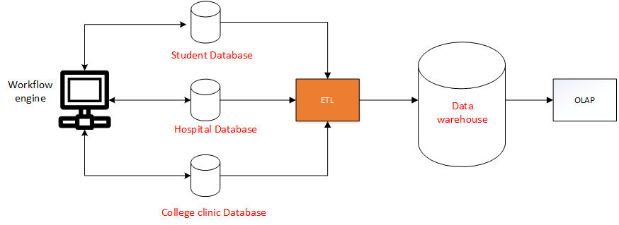
Traditional BI Framework is NOT Flexible
Lack flexibility
ETL processes need to change,
when data needed changes or the process model changes
[Chaudhuri,Dayal SIGMODrecord97]
[Vassiliadis IJDWM09]
Notes:
Current don’t consider databases from different institutions

Slide 17
Outline
Business Workflow and Analytics (=BI)
Classical Approach to BI
Workflow Logs
Exploration as An Example
Research Challenges

Slide 18
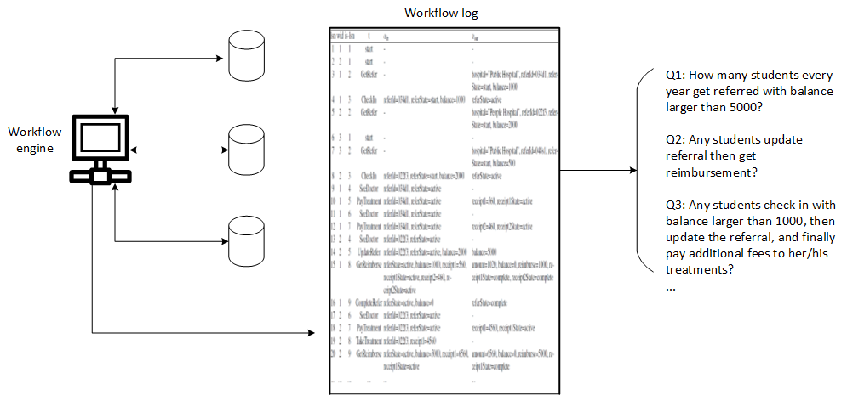
A Framework for Flexible Process Analytics
General-purpose log structure
No data selection
Easy-to-use query language

Slide 19
Workflow Logs
Faithfully captures workflow executions
Includes the following information
  workflow id
  workflow instance id
  activity id
  activity instance id
  timestamps
  data (read/written)
  correlation information
  ...
Granularity of logging

Slide 20
Example Log: A Concrete Log Record
One log record per activity execution
Logical timestamp based log sequence numbers
lsn | wid | is-lsn | task name | input map | output map
4 | 1 | 3 | CheckIn | referId=034d1,referState=start,balance=1000 | referState=active
Equivalent json:
{
"referId":"034d1",
"referState":"start",
"balance":1000
}
Equivalent json:
{
"referState":"active",
}
Notes:
A concrete log structure may depend on choices such as granularities

Slide 21
Log Records within One Instance
lsn | wid | is-lsn | task name | input map | output map
1 | 2 | 1 | start | - | -
5 | 2 | 2 | GetRefer | - | hospital=”People Hospital”, referId=022f3, referState=start,balance=2000
8 | 2 | 3 | CheckIn | referId=022f3,referState=start, balance=2000 | referState=active
13 | 2 | 4 | SeeDoctor | referId=022f3, referState=active | -
14 | 2 | 5 | UpdateRefer | referId=022f3, referState=active, balance=2000 | balance=5000
17 | 2 | 6 | SeeDoctor | referId=022f3, referState=active | -
18 | 2 | 7 | PayFees | referId=022f3, referState=active | receipt1=4560, receipt1State=active
19 | 2 | 8 | TakeTreatment | referId=022f3, receipt1=4560 | -
20 | 2 | 9 | GetReimburse | referState=active, balance=5000, receipt1=6560,receipt1State=active | amount=6560, balance=0, reimburse=5000, receipt1State=complete

Slide 22
Log Example: College Hospital Referring Application
lsn | wid | is-lsn | task name | input map | output map
1 | 1 | 1 | start | - | -
2 | 2 | 1 | start | - | -
3 | 1 | 2 | GetRefer | - | hospital=”Public Hospital”,referId=034d1,referState=start,balance=1000
4 | 1 | 3 | CheckIn | referId=034d1,referState=start,balance=1000 | referState=active
5 | 2 | 2 | GetRefer | - | hospital=”People Hospital”,referId=022f3,referState=start,balance=2000
6 | 3 | 1 | start | - | -
7 | 3 | 2 | GetRefer | - | hospital=”Public Hospital”,referId=048s1,referState=start,balance=500
8 | 2 | 3 | CheckIn | referId=022f3,referState=start,balance=2000 | referState=active
9 | 1 | 4 | SeeDoctor | referId=034d1,referState=active | -
10 | 1 | 5 | PayFeest | referId=034d1,referState=active | receipt1=560,receipt1State=active
11 | 1 | 6 | SeeDoctor | referId=034d1, referState=active | -
12 | 1 | 7 | PayFees | referId=034d1, referState=active | receipt2=460, receipt2State=active
13 | 2 | 4 | SeeDoctor | referId=022f3, referState=active | -
14 | 2 | 5 | UpdateRefer | referId=022f3, referState=active,balance=2000 | balance=5000
15 | 1 | 8 | GetReimburse | referState=active, balance=1000,receipt1=560, receipt1State=active, receipt2=460, receipt2State=active | amount=1020, balance=0, reimburse=1000, receipt1State=complete, receipt2State=complete
16 | 1 | 9 | CompleteRefer | referState=active, balance=0 | referState=complete
... | ... | ... | ... | ... | ...
Notes:
workflow system log (complete log)

Slide 23
Outline
Business Workflow and Analytics (=BI)
Classical Approach to BI
Workflow Logs
Exploration as An Example
Research Challenges

Slide 24
Example Queries
[Tang-S. 17]
Find instance ids where activity UpdateRefer occurs before activity CheckIn
Find the value of attribute balance where the activity GetRefer occurs before CheckIn with balance greater than 500 right after the getRefer activity

Slide 25
Incident Query Language
[Tang-S. 17]
Basic query language implemented
Optimization based on costs
Preliminary evaluation study (on the cost most and optimization
Still to do:
  Multi-instance, multi-log queries
  Aggregates

Slide 26
Outline
Business Workflow and Analytics (=BI)
Classical Approach to BI
Workflow Logs
Exploration as An Example
Research Challenges

Slide 27
Research Problems and Challenges
Workflow logs and (re-)construction
Query languages for workflow logs
Process mining with data
Application techniques and tools

Slide 28
Workflow Logs and (Re-)construction
No current standards on workflow logs/logging
Is there a universal model for logging?
Existing systems all have logging utility but
  Spread through several types of logs (activity, instance, variables, etc.)
  Sometimes incomplete
It seems possible to construct workflow log from these logs, general tools and techniques?

Slide 29
Query Languages for Logs
Development of query languages
  Understanding the properties, expressiveness, usefulness, etc.
  Equivalence of log query languages
  Indexing and optimization techniques
Aggregation? Multi-instances? Multi-log queries?

Slide 30
Process Mining with Data
Existing process mining techniques not compatible with data
Expressions in log query languages provide abstractions for data
  Possibly combined with existing process mining algorithms

Slide 31
Application Techniques and Tools
Many existing tools are developed for ad hoc environment
Reporting tools, e.g.,
  Ministry of Housing & Urban-Rural Development needs reports from local Housing Management agencies
  Could be helped by reporting tools based on logs
Medical fraud detection
Staff training
Many other possibilities

Slide 32
Conclusions
Growing need for business intelligence beyond the traditional types (retail transactions)
ETL-OLAP is limited
Workflow logs lead to a general framework for business analytics
Many research problems and challenges

