Slide 1
Accurate Translucent Material Rendering under Spherical Gaussian Lights
Pacific Graphics 2012
PG 2012
Ling-Qi Yan¹, Yahan Zhou², Kun Xu¹, Rui Wang²
¹ Tsinghua University
² University of Massachusetts
Notes:
Thanks for the introduction.
Good afternoon, my name is Ling-Qi Yan, I’m from tsinghua university.
In this talk, I will present a technique for accurate translucent material rendering under spherical Gaussian lights.

Slide 2
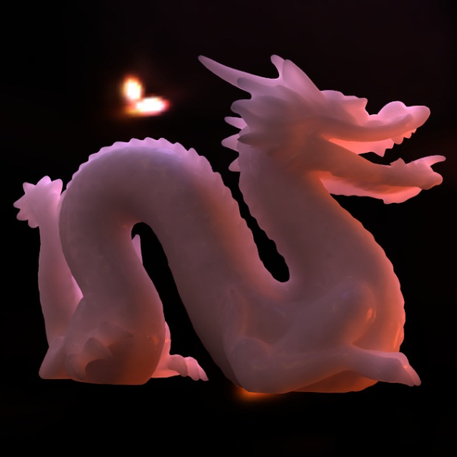
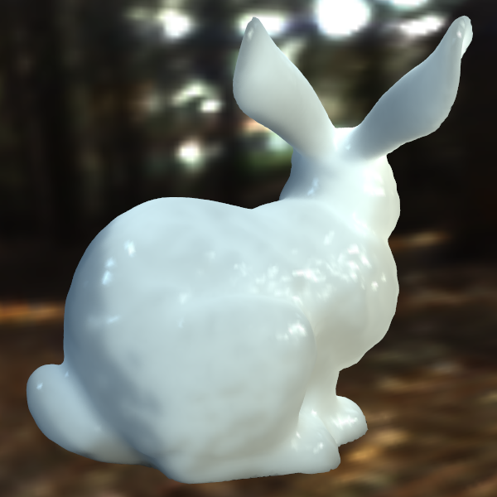
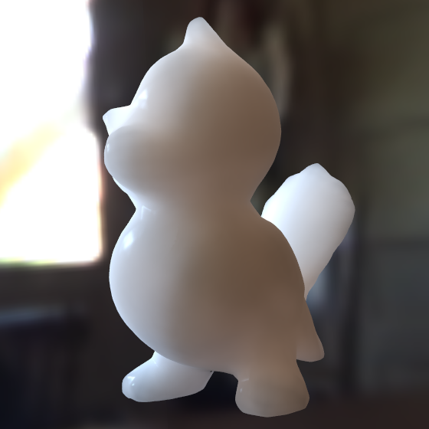
Introduction
Pacific Graphics 2012
Motivation
Natural illumination
Accurate rendering
Goal
Analytic solution
Challenge
Light integration complexity
Accurate Translucent Material Rendering under Spherical Gaussian Lights
Notes:
Realistic image synthesis often requires accurate simulation of translucent materials. At the appropriate scale level, many materials exhibit translucency effects, giving them a smooth and soft look.
Our work is based on two key observations.
Firstly, As is well known, environment lighting is very important,
because it can convey the look of translucent material under natural illumination.
Secondly, recent studies are focused on enhancing the accuracy in translucent material rendering, but it is still a problem for the balance between accuracy and efficiency.
So, our goal is to propose an accurate and analytic translucent material rendering model under natural illumination.
The main challenge lies in how to efficiently integrate the environment lighting with complex scattering functions.

Slide 3
Background
Pacific Graphics 2012
Translucent Material Rendering
BSSRDF representation
Multiple Scattering & Single Scattering
BRDF
$$F(x,ω_{i},ω_{o})$$
BSSRDF
$$S(x_{i},ω_{i},x_{o},ω_{o})$$
Accurate Translucent Material Rendering under Spherical Gaussian Lights
Notes:
Before introducing our work, let me first review some facts.
Translucent material rendering is different from opaque material rendering, because light could enter translucent objects, scatter under the surface, and exit from any other point on the surface.
So, instead of using traditional BRDF model, we use BSSRDF model to render translucent materials, where ‘SS’ means “subsurface scattering”.
The main difference between BRDF and BSSRDF is that, BSSRDF considers contribution from an incident point to any other outgoing point, while BRDF considers the same point on the surface.
Practically, since it is not clear to us exactly how many times the light has scattered under the surface before it exits, previous work simply split the scattering conditions into multiple scattering and single scattering, which consider light scattering under the surface for multiple times or once, respectively. We follow this idea.

Slide 4
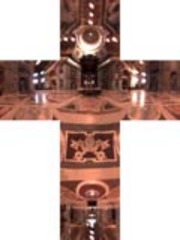
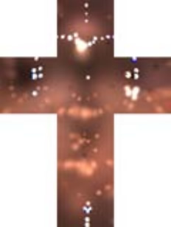
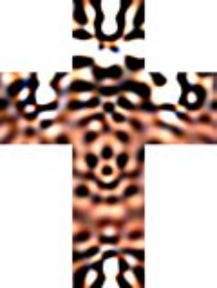
Background
Pacific Graphics 2012
Environment Lighting
Natural illumination
Light modeling methods
Spherical Harmonics
Wavelets
SRBFs
Spherical Harmonics
Wavelets
SRBFs
Accurate Translucent Material Rendering under Spherical Gaussian Lights
Notes:
As mentioned above, environment lighting is very important for natural illumination.
Environment lighting could be seen as an all-frequency spherical function. So, for easier application, previous researchers proposed many light modeling methods to analytically represent environment lighting, such as spherical harmonics, wavelets and SRBFs.
As we can see, SRBFs have the best approximation effect. So we take a close look at SRBF.

Slide 5
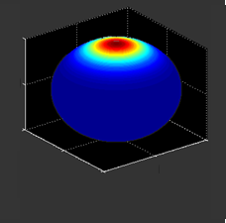
Background
Pacific Graphics 2012
SRBF (Spherical Radial Basis Function)
Typically Spherical Gaussian (SG) $G\left(i;i_{c},λ\right)=\exp\left(λ\left(i⋅i_{c}−1\right)\right)$
Useful Properties
Closed under multiplication
Has analytic solution under spherical integration
Widely used in rendering
Environment lighting [Tsai and Shih 2006]
Light Transport [Green 2007]
BRDF [Wang 2009]
Accurate Translucent Material Rendering under Spherical Gaussian Lights
Notes:
SRBF is the abbreviation for Spherical Radial Basis Function.
Spherical Gaussian is the most typically used SRBF, which is defined using Gaussian functions with a spherical center i_c and a radius lambda.
Spherical Gaussian has many good mathematic properties. Among them, the most useful properties are that SGs are closed under multiplication, which means the product of two SGs is still an SG, and that SGs have analytic solution under spherical integration.
SRBF, or SG, has been widely used in rendering, such as environment lighting, light transport and BRDF representation.

Slide 6
Introduction
Pacific Graphics 2012
Motivation
Natural illumination
Accurate rendering
Goal
Analytic solution
Challenge
Light integration complexity
Use SG lights!
Accurate Translucent Material Rendering under Spherical Gaussian Lights
Notes:
Since SG has such good environment lighting representation ability and mathematic properties, we use SG lights for natural illumination.

Slide 7
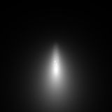
Related Works
Pacific Graphics 2012
Translucent Material Rendering
Limitations:
Vertical scattering path
$$Incient:45°$$
$$Incient:80°$$
Jensen et al. 2001
d’Eon et al. 2011
[d’Eon et al, 2011]
ground truth
Accurate Translucent Material Rendering under Spherical Gaussian Lights
Notes:
To describe our work clearly, let’s first review some related works.
In 2001, Jensen proposed the first translucent material rendering model, which assumes that light scatters at a certain depth under the incident point.
In 2011, d’Eon proposed an analytic model, which considers that light scatters along the scattering path.
However, these works assume scattering events happen vertically under the incident point, while physically speaking, the real scattering events happen along the refracted incident light path. This assumption would introduce symmetric profiles. These profiles have significant difference compared to the ground truth, which should be asymmetric.

Slide 8
Introduction
Pacific Graphics 2012
Motivation
Natural illumination
Accurate rendering
Goal
Analytic solution
Challenge
Light integration complexity
Use SG lights
Account for oblique scattering path
Accurate Translucent Material Rendering under Spherical Gaussian Lights
Notes:
So, for accurate rendering, our work accounts for oblique scattering path, generating asymmetric profiles.

Slide 9
Related Works
Pacific Graphics 2012
Translucent Material Rendering
Limitations:
Vertical scattering path
Unable to handle area lights (require sampling)
Jensen et al. 2001
d’Eon et al. 2011
Accurate Translucent Material Rendering under Spherical Gaussian Lights
Notes:
Furthermore, previous works handle only single light rays. For area lights, they need sampling or numerical integration, so it is not possible to get an analytic solution under SG lights.

Slide 10
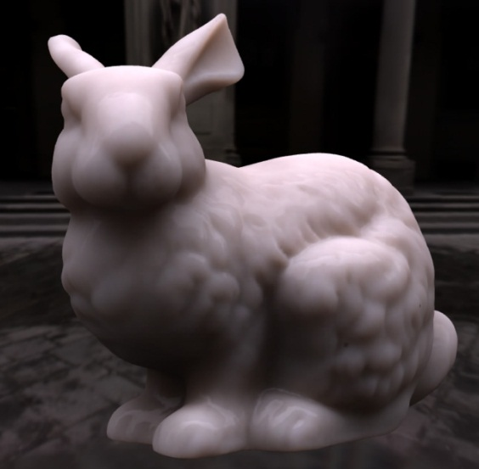
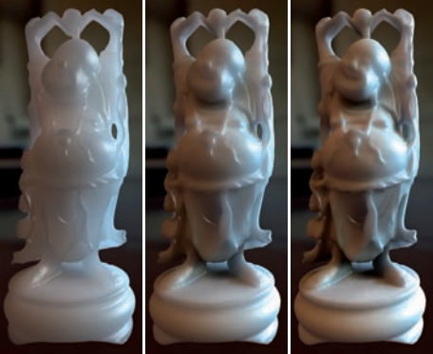
Related Works
Pacific Graphics 2012
Translucent Rendering under Environment Lighting
Wang et al. 2005
Xu et al. 2007
……
Based on pre-computation!
Accurate Translucent Material Rendering under Spherical Gaussian Lights
Notes:
There does exist translucent rendering method under environment lighting.
In 2005, Wang proposed a pre-computation based method to render translucent material in real time. But this method is scene dependent. The object is limited to non-deformable, and the material cannot be changed during display time.
In 2007, Xu proposed another pre-computation based method. In this work, material could be edited on the fly, but the environment lighting is fixed, i.e. rotating light is not allowed.
The biggest limitation of these works is pre-computation, which is scene dependent.

Slide 11
Introduction
Pacific Graphics 2012
Motivation
Natural illumination
Accurate rendering
Goal
Analytic solution
Challenge
Light integration complexity
Use SG lights
Account for oblique scattering path
No extra numerical integration or scene-dependent precomputation
Accurate Translucent Material Rendering under Spherical Gaussian Lights
Notes:
So, in our work, our goal is to avoid extra numerical integration or scene-dependent pre-computation, as mentioned above.

Slide 12
Overview
Pacific Graphics 2012
Main Contribution
An extended BSSRDF model
under Spherical Gaussian light
account for oblique scattering path
include multiple and single scattering
Accurate Translucent Material Rendering under Spherical Gaussian Lights
Notes:
Now let’s come to our work. As mentioned above, we proposed an extended BSSRDF model under Spherical Gaussian light,
And we account for oblique scattering path.
Our work considers both multiple and single scattering. Next, I will present them separately.

Slide 13
Approximating Multiple Scattering
Pacific Graphics 2012
Multiple Scattering
$$i_{j}$$
$$λ_{j}$$
$$o$$
$$i$$
$$i$$
$$i$$
$$i$$
$$i$$
$$x_{i}$$
$$x_{o}$$
$$i′$$
$$s$$
$$i′$$
$$d$$
$$i′$$
$$i′$$
$$i′$$
$$λ_{j}′$$
$$i_{j}′$$
$$L^{D}\left(x_{o},o\right)=\int_{Ω}{G\left(i′;i_{j}′,λ_{j}′\right)\left(F\int_{0}^{∞}{Q\left(s\right)R\left(d\right)}ds\right)}di′$$
$$L^{D}\left(x_{o},o\right)=\int_{Ω}{G\left(i;i_{j},λ_{j}\right)\left(F\int_{0}^{∞}{Q\left(s\right)R\left(d\right)}ds\right)}di$$
Accurate Translucent Material Rendering under Spherical Gaussian Lights
Notes:
For multiple scattering, first of all, let’s take a look at the illustration for a general concept.
For a certain pair of incident point x_i and outgoing point x_o, we first integrate on the upper hemisphere of x_i, in order to consider each ray of the Spherical Gaussian light.
The function G means the incident SG light, with the center i_j and radius lambda_j.
As illustrated in the plot, we find that after refraction, the SG light appears to be still an SG. So we approximate it as the “refracted SG”, with a new center i_j’ and a new radius lambda’.
The reason we do this approximation is that, the inner integration is along each refracted ray, and considers the contribution from each ray to the outgoing point. With the refracted SG approximation, the whole integral will be only inside the object, so it becomes much easier to solve. Later we’ll explain this in detail.
Now let’s see the inner integral along each refracted ray.
Here F is Fresnel term, which considers the outgoing ray’s energy lost due to refraction.
Q(s) is the extended source function. This considers that the scattering events happen everywhere on the path, and the scattering energy falls exponentially as the distance s increases.
At each scattering position, we consider the contribution to the outgoing point. This is described by the exitance function R(d), where d is the distance between the two points.
So, in this way, the multiple scattering part could be expressed by this equation. The next task is to solve it analytically, since it is our goal to achieve both accuracy and efficiency.

Slide 14
Approximating Multiple Scattering
Pacific Graphics 2012
Multiple Scattering
$$L^{D}\left(x_{o},o\right)=\int_{Ω}{G\left(i′;i_{j}′,λ_{j}′\right)\left(F\int_{0}^{∞}{Q\left(s\right)R\left(d\right)}ds\right)}di′$$
Define $R(d)$ as a combination of fluence term and flux term [d’Eon et al. 2011]
Accurate Translucent Material Rendering under Spherical Gaussian Lights
Notes:
Before we start to solve the multiple scattering equation, there’s still an unknown term --- the exitance function R(d), contribution from the scattering point to the outgoing point. We follow d’eon’s work, and physically separate this contribution into two parts: the fluence term and the flux term.

Slide 15
Approximating Multiple Scattering
Pacific Graphics 2012
Multiple Scattering
$$L^{D}\left(x_{o},o\right)=\int_{Ω}{G\left(i′;i_{j}′,λ_{j}′\right)\left(F\int_{0}^{∞}{Q\left(s\right)R\left(d\right)}ds\right)}di′$$
$$L^{D}\left(x_{o},o\right)=\int_{Ω}{G\left(i′;i_{j}′,λ_{j}′\right)\left(F\int_{0}^{∞}{Q\left(s\right)\left(C_{φ}φ\left(d\right)+C_{E}(−D\left(n⋅∇φ\right)\left(d\right))\right)}ds\right)}di′$$
Define $R(d)$ as a combination of fluence term and flux term [d’Eon et al. 2011]
Accurate Translucent Material Rendering under Spherical Gaussian Lights
Notes:
With this separation, we introduced a new term phi(d), which is called diffusion function.

Slide 16
Approximating Multiple Scattering
Pacific Graphics 2012
Diffusion Function
$$φ\left(d\right)=\frac{1}{4πD}⋅\frac{e^{−\sqrt{σ_{a}/D}d}}{d}$$
$$d=\sqrt{s^{2}+r^{2}−2sr(i^{′}⋅i_{2})}$$
$$x_{i}$$
$$r$$
$$x_{o}$$
$$φ(d)$$
$$i_{2}$$
$$s$$
$$d$$
$$i′$$
$$d$$
Accurate Translucent Material Rendering under Spherical Gaussian Lights
Notes:
Phi(d) is explicitly defined with this equation. As we can see, the plot of phi falls exponentially as the distance d increases. We’ll take advantage of this property later.
The variable d is the distance between the scattering point and the outgoing point, and we can easily figure it out using cosine theorem.
In this equation, s is the distance along the scattering path before scattering, r is the distance from the incident point to the outgoing point, I’ and i_2 are the corresponding directions.

Slide 17
Approximating Multiple Scattering
Pacific Graphics 2012
Multiple Scattering
$$L^{D}\left(x_{o},o\right)=FC_{φ}L_{φ}+FDC_{E}L_{E}$$
Fluence Integral
$$L_{φ}=\int_{Ω}{\int_{0}^{∞}{G\left(i^{′};i_{j}^{′},λ_{j}^{′}\right)Q\left(s\right)φ\left(d\right)}ds}di′$$
Flux Integral
$$L_{E}=\int_{Ω}{\int_{0}^{∞}{G\left(i^{′};i_{j}^{′},λ_{j}^{′}\right)Q\left(s\right)(−n⋅∇φ) \left(d\right)}ds}di′$$
Accurate Translucent Material Rendering under Spherical Gaussian Lights
Notes:
So, up to now, we’ve separated multiple scattering part into fluence part and flux part. Next we’ll focus on solving the fluence integral. The flux integral is very much alike.

Slide 18
Approximating Multiple Scattering
Pacific Graphics 2012
Fluence Integral
$$L_{φ}=\int_{Ω}{\int_{0}^{∞}{G\left(i^{′};i_{j}^{′},λ_{j}^{′}\right)Q\left(s\right)φ\left(d\right)}ds}di′$$
$$=\int_{0}^{∞}{Q\left(s\right)\left(\int_{Ω}{G\left(i^{′};i_{j}^{′},λ_{j}^{′}\right)⋅φ\left(d\right)}di′\right)}ds$$
Change integral order so that
Inner integral: Spherical
Outer integral: Linear
Accurate Translucent Material Rendering under Spherical Gaussian Lights
Notes:
For the fluence integral, we firstly change the integral order, so that the inner integral is spherical, and the outer integral is linear.

Slide 19
Approximating Multiple Scattering
Pacific Graphics 2012
Fluence Integral
$$L_{φ}=\int_{Ω}{\int_{0}^{∞}{G\left(i^{′};i_{j}^{′},λ_{j}^{′}\right)Q\left(s\right)φ\left(d\right)}ds}di′$$
$$=\int_{0}^{∞}{Q\left(s\right)\left(\int_{Ω}{G\left(i^{′};i_{j}^{′},λ_{j}^{′}\right)⋅φ\left(d\right)}di′\right)}ds$$
Our key insight
Can $φ\left(d\right)$ be represented by spherical functions?
YES
Accurate Translucent Material Rendering under Spherical Gaussian Lights
Notes:
With this classification, we have an insight that, if we could also represent the diffusion function phi(d) with spherical functions, then the inner spherical integral could be analytically solved. And we find it possible to do this.
Here is a little tricky. You may find that phi(d) is actually a 1D function, and cannot be represented by 2D spherical functions at all. However, phi(d) is a function of the variable d, and d is related with the direction I’. What we want to do is to represent phi(d) with spherical functions of I’, since we will integrate with it for the inner spherical integration.

Slide 20
Approximating Multiple Scattering
Pacific Graphics 2012
Diffusion Function
$$φ\left(d\right)=\frac{1}{4πD}⋅\frac{e^{−\sqrt{σ_{a}/D}d}}{d}$$
Approximate $φ\left(d\right)$ with sum of Gaussians
$$φ(d)$$
$$φ\left(d\right)≈\sum_{k}{a_{k}g\left(d;0,λ_{k}\right)}$$
$$d$$
Accurate Translucent Material Rendering under Spherical Gaussian Lights
Notes:
We’ve mentioned earlier that phi(d) exhibits strong attenuation property. So we could approximate it using a few term of Gaussians, as illustrated in the plot.
Note that here the Gaussians are not spherical, they are 1D functions. The purpose we do this approximation is to introduce the exponential operator, in order to get close to the form of spherical Gaussians.

Slide 21
Approximating Multiple Scattering
Pacific Graphics 2012
Fluence Integral
$$d=\sqrt{s^{2}+r^{2}−2sr(i^{′}⋅i_{2})}$$
$$L_{φ}=\int_{0}^{∞}{Q\left(s\right)\left(\int_{Ω}{G\left(i^{′};i_{j}^{′},λ_{j}^{′}\right)⋅e^{λ_{k}d^{2}}}di′\right)}ds$$
$$=\int_{0}^{∞}{Q\left(s\right)e^{−λ_{k}{\left(s−r\right)}^{2}}\left(\int_{Ω}{G\left(i^{′};i_{j}^{′},λ_{j}^{′}\right)⋅e^{2srλ_{k}(i^{′}⋅i_{2}−1)}}di′\right)}ds$$
$$=\int_{0}^{∞}{Q\left(s\right)e^{−λ_{k}{\left(s−r\right)}^{2}}\left(\int_{Ω}{G\left(i^{′};i_{j}^{′},λ_{j}^{′}\right)⋅G(i^{′};i_{2},{2srλ}_{k})}di′\right)}ds$$
Product-integral of two SGs!
Linear Integration Part
Spherical Integration Part
Accurate Translucent Material Rendering under Spherical Gaussian Lights
Notes:
Then we replace phi(d) with these Gaussian functions, unfold the variable d. And for the second time, we separate the linear integral part and the spherical integral part, based on whether the inner integral’s direction I’ appears.
We are glad to find that, the spherical integral part is exactly another Spherical Gaussian function. So we rewrite it to have a clear representation.
After this, the inner integral becomes the product-integral of two SGs. Recall the mathematic properties, the product of two SGs is still and SG, and the integral of an SG is analytic.

Slide 22
Approximating Multiple Scattering
Pacific Graphics 2012
Fluence Integral
$$L_{φ}≈\int_{0}^{∞}{Q\left(s\right)e^{−λ_{k}{\left(s−r\right)}^{2}}N}ds$$
inner integral $N$
$$N(s)=\int_{Ω}{G\left(i^{′};i_{j}^{′},λ_{j}^{′}\right)G\left(i^{′};i_{2},2srλ_{k}^{}\right)}di$$
$$=2π\frac{e^{λ_{3}−λ_{j}^{′}−{2srλ}_{k}^{}}}{λ_{3}}\left(1−e^{−2λ_{3}}\right)$$
where $λ_{3}=\sqrt{λ_{j}^{′2}+{\left(2srλ_{k}\right)}^{2}+2λ_{j}′(2srλ_{k})(i_{j}^{′}⋅i_{2}) }$
Variable:
$$s$$
Parameters:
$$λ_{j}^{′} and i_{j}^{′}⋅i_{2}$$
Accurate Translucent Material Rendering under Spherical Gaussian Lights
Notes:
So, if we denote the inner integral as N, we could immediately get the analytic result of it.
As you can see, this result introduces some new symbols. This is annoying, but in fact it is very simple.
Firstly, the variable is s, since we will integrate with it.
Secondly, there are only two independent parameters, lambda_j’ and the dot product of i_j’and i_2. Physically speaking, the radius of the refracted SG, and the angle between the refracted SG center and direction from the incident point to the outgoing point.

Slide 23
Approximating Multiple Scattering
Pacific Graphics 2012
Fluence Integral
$$L_{φ}≈\int_{0}^{∞}{Q\left(s\right)e^{−λ_{k}{\left(s−r\right)}^{2}}N}ds$$
Now has analytical solution!
inner integral $N$
$$N(s)=\int_{Ω}{G\left(i^{′};i_{j}^{′},λ_{j}^{′}\right)G\left(i^{′};i_{2},2srλ_{k}^{}\right)}di$$
$=f(s;λ_{j}^{′},i_{j}^{′}⋅i_{2})$
$$≈\sum_{m}{p_{m}^{φ}\exp\left(−q_{m}^{φ}⋅s\right)}$$
$$N$$
Pre-fit $N$ into a 2D table of $λ_{j}^{′}$ and $i_{j}^{′}⋅i_{2}$
$$s$$
Accurate Translucent Material Rendering under Spherical Gaussian Lights
Notes:
Now let’s look at the outer linear integral. We find that Q(s) is exponential, and this one is square exponential. So if we could represent N as sum of exponential functions, the outer integral could be analytically solved.
Fortunately, as illustrated, we find N does exhibit attenuation property.
So the solution is to make a 2D table of the two parameters mentioned above. For each pair of them, we pre-fit N with sum of exponential functions.
So finally, in this way, we successfully solved the fluence integral.

Slide 24
Approximating Multiple Scattering
Pacific Graphics 2012
Flux Integral
$$L_{E}=\int_{Ω}{\int_{0}^{∞}{G\left(i^{′};i_{j}^{′},λ_{j}^{′}\right)Q\left(s\right)(−n⋅∇φ) \left(d\right)}ds}di$$
directional derivative
$$\left(n⋅∇φ\right)\left(d\right)≈\sum_{k}{a_{k}}\left(−n⋅∇g\left(d;0,λ_{k}\right)\right)$$
$$=\sum_{k}{2a_{k}λ_{k}\left(i^{′}⋅n\right)g(d;0,λ_{k})}$$
Additional term!
Accurate Translucent Material Rendering under Spherical Gaussian Lights
Notes:
For flux integral, the derivation steps are nearly the same. The only difference is that flux integral use directional derivative of phi(d), rather than phi(d) itself.
Recall that we expressed phi(d) using Gaussian functions in fluence integral part, and we follow the idea.
We’re glad to find the directional derivative introduces nothing but an additional cosine term.

Slide 25
Approximating Multiple Scattering
Pacific Graphics 2012
Now has analytical solution!
Flux Integral
$$L_{E}=2λ_{k}\int_{0}^{∞}{Q\left(s\right)e^{−λ_{k}{\left(s−r\right)}^{2}}M}ds$$
$$L_{E}=\int_{Ω}{\int_{0}^{∞}{G\left(i^{′};i_{j}^{′},λ_{j}^{′}\right)Q\left(s\right)(−n⋅∇φ) \left(d\right)}ds}di$$
inner integral
$$M=\int_{Ω}{G\left(i^{′};i_{j}^{′},λ_{j}^{′}\right)G\left(i^{′};i_{2},2srλ_{k}^{}\right)}\left(i^{′}⋅n\right)di=\left(λ_{j}^{′}\left(i_{j}^{′}⋅n\right)+2srλ_{k}^{}\left(i_{2}⋅n\right)\right)M_{i}$$
$$M_{i}(s)=2π\frac{e^{λ_{3}−λ_{j}^{′}−2srλ_{k}^{}}}{λ_{3}^{2}}\left(1−e^{−2λ_{3}}\right)$$
$$≈\sum_{m}{p_{m}^{E}\exp\left(−q_{m}^{E}⋅s\right)}$$
$$M_{i}$$
Exponential attenuation!
Pre-fit $M_{i}$ into a 2D table
$$s$$
Accurate Translucent Material Rendering under Spherical Gaussian Lights
Notes:
Similarly, we denote the inner spherical integral as M. With the additional term, M still has analytic solution, and just introduces a linear term of the outer integral.
We denote the rest of M as M_i, and similarly, M_i also exhibits exponential attenuation property, and could be approximated as sum of exponential functions.
After this approximation, the outer integral is a combination of a linear part and an exponential part, which is also analytic under linear integration.
And now, the multiple scattering part has been successfully solved.

Slide 26
Approximating Single Scattering
Pacific Graphics 2012
Single Scattering
$$o$$
$$x_{o}$$
$$s′$$
scattering point
The outer integral: Sample along the refracted outgoing direction
The inner integral: To be analytically approximated!
Fresnel transmittance term
Attenuation term
$$L^{(1)}\left(x_{o},o\right)=σ_{s}\int_{0}^{∞}{F_{t}E(s^{′}) }\int_{Ω}{pG\left(i^{′};i_{j}^{′},λ_{j}^{′}\right)E(s)V(i′)di′}ds′$$
$$J(s^{′})=\int_{Ω}{p(i^{′},o′)G\left(i^{′};i_{j}^{′},λ_{j}^{′}\right)E(s)V(i′)di′}$$
Accurate Translucent Material Rendering under Spherical Gaussian Lights
Notes:
Here we come to single scattering part.
As mentioned earlier, single scattering considers scattering event happening only once. For this definition, we can easily figure out that the scattering event can only happen on the refracted outgoing path, otherwise it won’t leave the outgoing point x_o with certain direction o.
We follow the classic method, integrate along the refracted outgoing path, and consider each possible scattering event along this path. The contribution from each scattering point to the outgoing point is firstly scaled by Fresnel term due to refraction, and then attenuated exponentially as the scattering distance s’ increases. However, this integral could not be analytically solved, because for every different scattering position, the light condition is not the same due to various object geometry. So we just sample along the refracted outgoing path, as classic method does.
So here what we need is just the lighting at the scattering point. This is done by spherically integrate the refracted SG. We denote the integral as J, and hope to solve it analytically.

Slide 27
Approximating Single Scattering
Pacific Graphics 2012
Single Scattering
Use soft shadow technique to approximate!
$$V\left(i^{′}\right)≈\overline{V}$$
$$x_{o}$$
Use SG center to approximate!
$$E\left(s\right)≈\overline{E}=E(s\left(i_{j}\right))$$
Phase function
Attenuation term
Refracted SG light
Visibility term
$$J(s^{′})=\int_{Ω}{p(i^{′},o′)G\left(i^{′};i_{j}^{′},λ_{j}^{′}\right)E(s)V(i′)di′}$$
$$J\left(s^{′}\right)=\overline{E}⋅\overline{V}\int_{Ω}{p(i^{′},o′)G\left(i^{′};i_{j}^{′},λ_{j}^{′}\right)di′}$$
Accurate Translucent Material Rendering under Spherical Gaussian Lights
Notes:
Then we take a close look at it.
For a single ray scattering inside a translucent object, the chance it scatters to a certain direction is not always the same. So we use a phase function p to describe this chance.
At a certain scattering point, we can still regard the lighting as a refracted SG, this is quite like looking at the sun from under water.
For the attenuation term, since different rays often have different distance from incident point, it is not easy to handle it. However, if we limit the support size of the incident SG, we can use the SG center’s attenuation to approximate it.
For the visibility term, it is not easy to consider each ray either. So we use the average visibility to approximate it, and the average visibility could be fetched by any of the soft shadow techniques.
After these approximations, the integral has become this.

Slide 28
Approximating Single Scattering
Pacific Graphics 2012
Single Scattering
$$J\left(s^{′}\right)=\overline{E}⋅\overline{V}\int_{Ω}{p(i^{′},o′)G\left(i^{′};i_{j}^{′},λ_{j}^{′}\right)di′}$$
For Eddington phase function $p\left(i^{′},o^{′}\right)=(1+3g⋅(i^{′}⋅o^{′}))/4π$
Both are analytical!
$$J\left(s^{′}\right)=\overline{E}⋅\overline{V}\left(\int_{Ω}{G\left(i^{′};i_{j}^{′},λ_{j}^{′}\right)di′}+3g\int_{Ω}{\left(i^{′}⋅o^{′}\right)G\left(i^{′};i_{j}^{′},λ_{j}^{′}\right)di′}\right)$$
Accurate Translucent Material Rendering under Spherical Gaussian Lights
Notes:
For the most widely used phase function --- Eddington phase function, which has a constant term and a cosine term. We can separate the integral J into two parts, and these two parts are both analytical.
Till now, the single scattering part is solved.

Slide 29
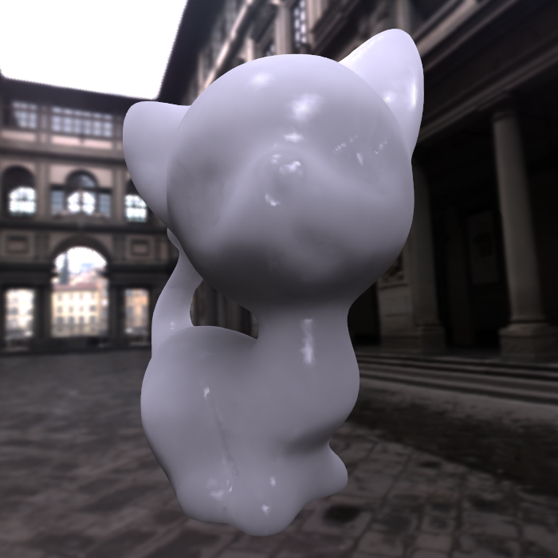
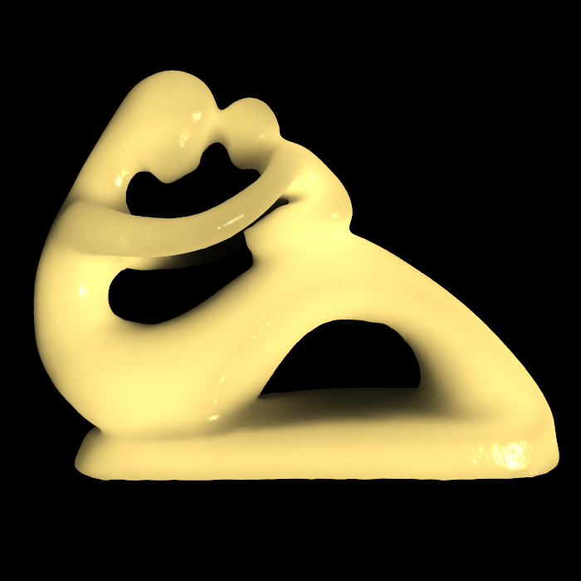
Results
Pacific Graphics 2012
Accurate Translucent Material Rendering under Spherical Gaussian Lights
Notes:
Now let’s see some results generated by our method.
These results consist of both multiple and single scattering parts.

Slide 30
Conclusion
Pacific Graphics 2012
An extended BSSRDF model
under Spherical Gaussian light
accounts for oblique scattering path
including multiple and single scattering
Accurate Translucent Material Rendering under Spherical Gaussian Lights
Notes:
In conclusion,
We have proposed an extended BSSRDF model for translucent material rendering.
Our model handles environment lighting by using Spherical Gaussian lights.
And our model accounts for oblique scattering path, rather than assuming scattering events happens vertically under the incident point.
Finally, our model is complete, including multiple and single scattering parts.

Slide 31
Future Works
Pacific Graphics 2012
Heterogeneous translucent materials
Participating media
……
Accurate Translucent Material Rendering under Spherical Gaussian Lights
Notes:
Our method could be improved in several ways.
First, our model handles homogeneous materials, which means that the material are the same over the surface, such as density or ingredient. We think it worthy to extend our model to handle heterogeneous materials, which would significantly enhance the visual effects.
Secondly, as participating media, such as atmosphere and fog, share nearly all properties with translucent materials, we are also interested in exploring ways to extend our model to handle participating media in the future.

Slide 32
The End
Pacific Graphics 2012
Thank you!
Any questions?
Accurate Translucent Material Rendering under Spherical Gaussian Lights
Notes:
So, thank you for attention!

