Slide 1
Ray-aligned Occupancy Map Array (ROMA) for Fast Approximate Ray Tracing
Zheng Zeng¹, Zilin Xu², Lu Wang², Lifan Wu³, Ling-Qi Yan¹
¹University of California, Santa Barbara
²Shandong University
³NVIDIA
Notes:
Thanks for the introduction! Good afternoon, I will present our work called ray-aligned occupancy map array, or ROMA. So, what does it do? it offers a software solution to fast and approximate ray tracing.

Slide 2
Background
Notes:
I’ll first give a little bit of background.

Slide 3
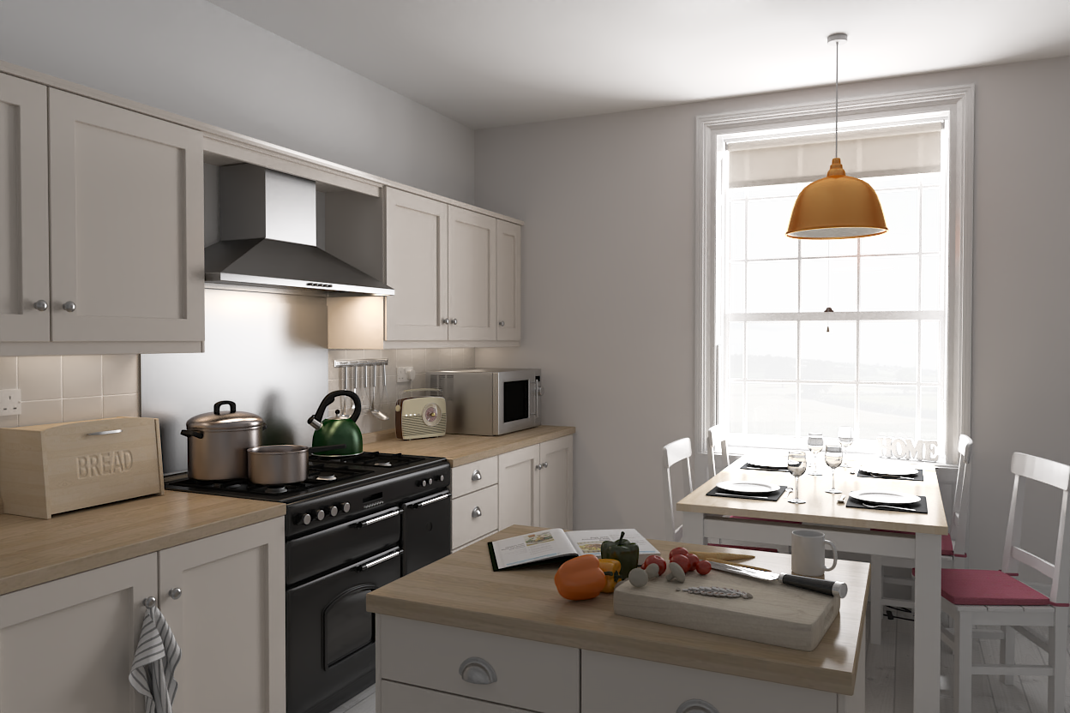
Real-time ray tracing
How to make it real-time?
Ray traced results
Notes:
It is generally believed that ray tracing is the key to achieving photorealistic results
Since it is easier and more consistent to simulate global illumination effects such ambient occlusion, soft shadows, and indirect illumination.
(click) However, how to make it real-time is a long-standing problem in both industry and academia.
(next)

Slide 4

Hardware Ray Tracing (HWRT) is good, but …
Make it “real-time”
Ray tracing hardware
[NVIDIA Ada Lovelace]
Ray traced results
Only high-end platforms
support it!
Hardware Ray Tracing (HWRT)
Notes:
Recently, ray tracing hardware has been designed to accelerate ray tracing
With its support, we can achieve real-time frame rates
This is called HWRT
(click) However, despite its rapid progress, HWRT is not pervasively available. For now, only high-end platforms support it.
(next)

Slide 5
Hardware Ray Tracing (HWRT) is good, but …
Hardware Ray Tracing (HWRT)
Approximate
Software Ray Tracing (SWRT)
Notes:
So, for today, we still need an alternative, a software ray tracing (SWRT) solution, to approximate HWRT
to provide users an option to scale down on low-end platforms, for example, mobile devices and VR headsets.
(next)

Slide 6
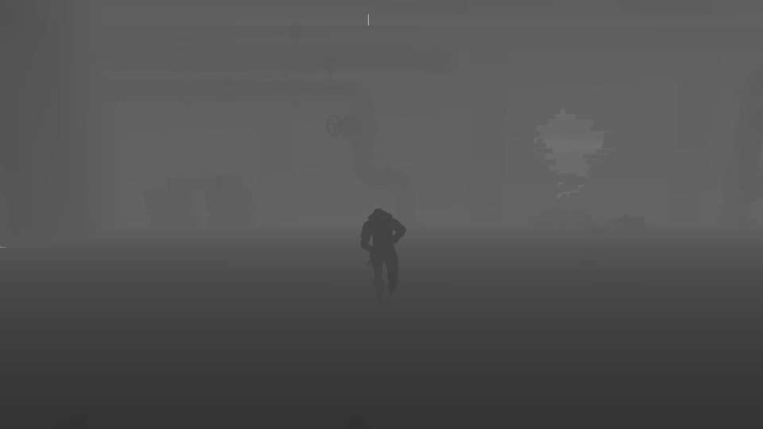
SWRT: Screen-space Ray Tracing
It may miss the geometries out of the screen and behind the nearest surfaces.
Depth map
…
…
…
…
Tracing is not that fast due to multiple and inconsistent number of iterations.
Heightfield
Heightfield
Generation
Tracing
Notes:
A widely used SWRT solution is screen-space ray tracing
(click) it treats depth map from G-Buffers as a heightfield
(click) then march against it.
Screen space ray tracing could achieve fast tracing performance,
(click) however, it may miss the geometries out of the screen and behind the nearest surfaces
(click) Besides, multiple steps per thread, and inconsistent number of steps per thread have to be performed to trace rays. This results in serious thread divergence. So, it is not that fast.
(next)

Slide 7
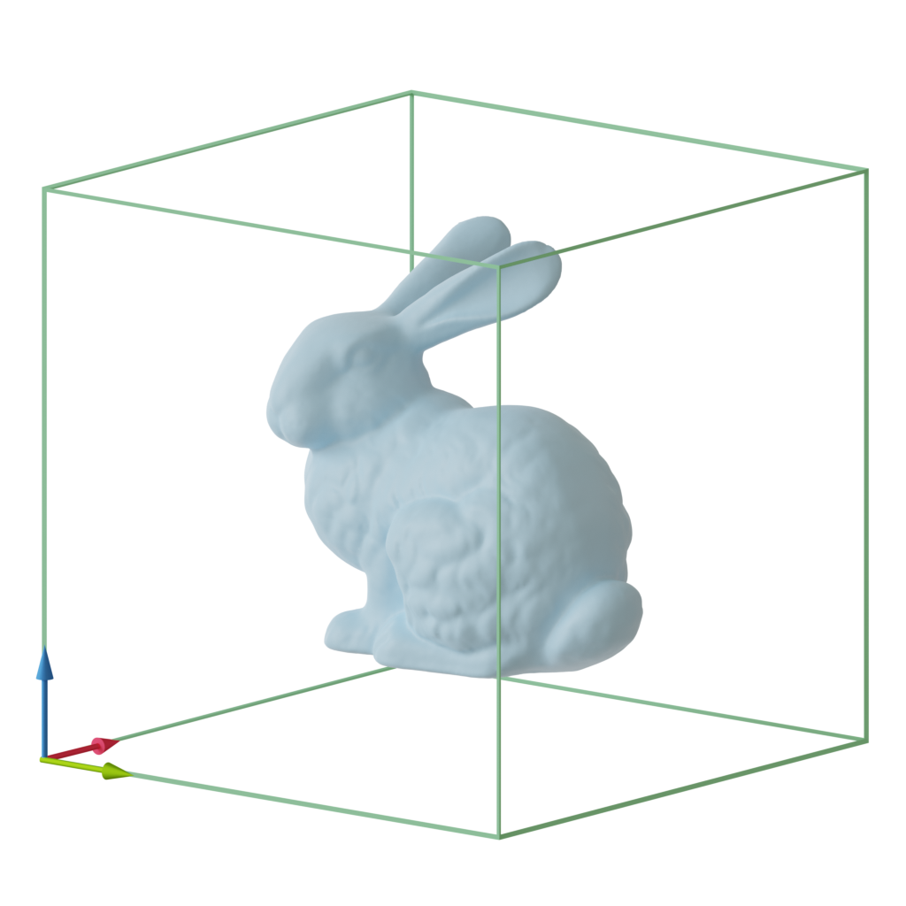
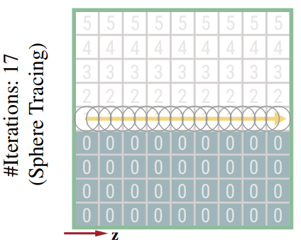

SWRT: Distance Fields (DFs)
6
5
4
3
3
3
3
3
3
3
4
5
6
7
8
9
5
9
4
3
2
2
2
2
2
2
2
3
4
5
6
7
8
4
9
3
2
1
1
1
1
1
1
1
2
3
4
5
6
7
Rasterization
4
8
3
2
1
0
0
1
0
0
1
2
3
4
5
6
7
4
8
3
2
1
0
0
0
0
0
1
2
3
4
5
6
7
3
8
2
1
0
0
0
0
1
1
1
2
2
3
4
5
6
3
7
2
1
0
0
0
0
0
0
0
1
1
2
3
4
5
3
6
2
1
0
0
0
0
0
0
0
0
0
1
2
3
4
3
5
2
1
0
0
0
0
0
0
0
0
0
1
1
2
3
6
4
5
4
3
3
3
3
3
3
3
4
5
6
7
8
9
9
3
2
1
0
0
0
0
0
0
0
0
0
0
1
2
3
5
4
4
3
2
2
2
2
2
2
2
3
4
5
6
7
8
9
3
2
1
0
0
0
0
0
0
0
0
0
0
1
2
3
4
4
3
2
1
1
1
1
1
1
1
2
3
4
5
6
7
8
4
3
2
1
0
0
0
0
0
0
0
0
0
1
2
3
Jump Flooding
4
4
3
2
1
0
0
1
0
0
1
2
3
4
5
6
7
8
4
3
2
1
0
0
0
0
0
0
0
0
0
1
2
3
4
4
3
2
1
0
0
0
0
0
1
2
3
4
5
6
7
8
5
4
3
2
1
1
1
1
1
1
1
1
1
1
2
3
3
4
2
1
0
0
0
0
1
1
1
2
2
3
4
5
6
7
6
5
4
3
2
2
2
2
2
2
2
2
2
2
3
4
3
5
2
1
0
0
0
0
0
0
0
1
1
2
3
4
5
6
Tracing is not that fast due to multiple and inconsistent number of iterations.
Costly to update on a per-frame basis!
6
5
4
3
3
3
3
3
3
3
3
3
3
3
3
4
3
5
2
1
0
0
0
0
0
0
0
0
0
1
2
3
4
5
7
6
5
4
4
4
4
4
4
4
4
4
4
4
4
5
3
6
2
1
0
0
0
0
0
0
0
0
0
1
1
2
3
3
4
2
1
0
0
0
0
0
0
0
0
0
0
1
2
3
3
4
2
1
0
0
0
0
0
0
0
0
0
0
1
2
3
4
4
3
2
1
0
0
0
0
0
0
0
0
0
1
2
3
4
4
3
2
1
0
0
0
0
0
0
0
0
0
1
2
3
5
4
4
3
2
1
1
1
1
1
1
1
1
1
1
2
3
6
4
5
4
3
2
2
2
2
2
2
2
2
2
2
3
4
6
5
5
4
3
3
3
3
3
3
3
3
3
3
3
3
4
7
5
6
5
4
4
4
4
4
4
4
4
4
4
4
4
5
One y-z plane slice
6
Generation
Tracing
Notes:
Another popular SWRT solution is distance fields, or DF, coupled with sphere tracing.
(click) Distance fields of DFs isare generated by first rasterizing an object into a uniform grid,
(click) Then, using it as the seed, run a algorithm called jump flooding algorithm, or JFA, to compute and fill the the distance fields.
(click) Then, sphere tracing is used to perform fast tracing against DFs to find nearest intersection.
(click) The major drawback is the complexity building the DF because a lot of floating numbers need to be computed and written. So, it is very hard to support dynamic objects by updating the DF on a per-frame basis.
(click) Besides, similar to screen-space ray tracing, tracing against DFs is also not as fast as expected due to multiple and inconsistent number of iterations.
(click) Moreover, there are cases, for example, when rays are grazing through a surface, sphere tracing will be very slow, taking a large number of small steps to advance the ray.
(next)

Slide 8
SWRT: Occupancy Maps (OMs)
Rasterization
[Eisemann et al. 2006]
[Thiedemann et al. 2011]
0
3264
0
0
0
0
1
1
0
0
1
1
0
0
0
0
0
0
Bit-field
uint
Pack along z-axis
(compactly represented)
One y-z plane slice
Generation
Tracing
Notes:
Unlike DFs, occupancy maps, or bit bricks by the industrial friends, can be directly generated into binary grid cells with rasterization.
(click) Once generated, every 32 binary cells along the camera’s z-axis can encoded into a 32-bit integer value.
(click) Which means that, to store an OM with resolution 128 cubic, we only need to use a 128 square texture with 4-channels.
(click) As for tracing, we can directly trace it in a 3D DDA style to check all voxels one by one along the ray
(click) But there’s better way to do that. We can traverse the texels rather than voxels. For each texel, a group of cells along the z-axis can be checked at once with one texture fetch. Take this simple example:
(next)

Slide 9
SWRT: Occupancy Maps (OMs)
Rasterization
[Eisemann et al. 2006]
[Thiedemann et al. 2011]
0
3264
0
0
0
0
1
1
0
0
1
1
0
0
0
0
0
0
Bit-field
uint
Pack along z-axis
(compactly represented)
Right shift
== 0?
One y-z plane slice
Left shift
Generation
Tracing
Notes:
For the first texel, these two highlighted cells are the range the ray covers along it z-axis.
To check whether they are occupied or not,
(click) we first left shift and back to eliminate the bits that we are not interested on the left
(click) Then, we right shift and back the value to eliminate the bits that we are not interested on the right
(click) Now, if the resulting value is equal to 0, there is no intersection between the OM and the ray in this texel.
(next)

Slide 10
SWRT: Occupancy Maps (OMs)
Rasterization
[Eisemann et al. 2006]
[Thiedemann et al. 2011]
0
3264
0
0
0
0
1
1
0
0
1
1
0
0
0
0
0
0
Bit-field
uint
Right shift
Pack along z-axis
(compactly represented)
…
!= 0, there is an intersection!
Fast!
Left shift
Not that fast.
One y-z plane slice
Generation
Tracing
Notes:
Repeat this process,
(click) (click) (click) until we find an intersection!
So, this is the basic idea of how OM works
(click) Generating such OM is fast, since it only requires rasterization
(click) However, tracing against it is not as fast as expected, since it still requires an number of iterations.
(next)

Slide 11
Our goal
Rasterization
[Eisemann et al. 2006]
[Thiedemann et al. 2011]
0
3264
0
0
0
0
1
1
0
0
1
1
0
0
0
0
0
0
Bit-field
uint
Pack along z-axis
(compactly represented)
…
!= 0, there is an intersection!
Fast!
Not that fast.
One y-z plane slice
Generation
Tracing
Better utilize the trait of fast generation
Further speed up ray tracing against OMs
Notes:
In this work, our goal is to better utilize the trait of the fast generation
(click) and to further speed up ray tracing.

Slide 12
Method
Notes:
Now let’s take a look at our method.

Slide 13
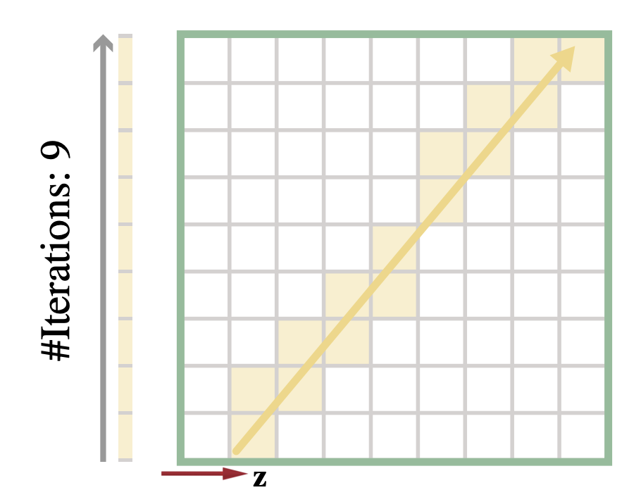
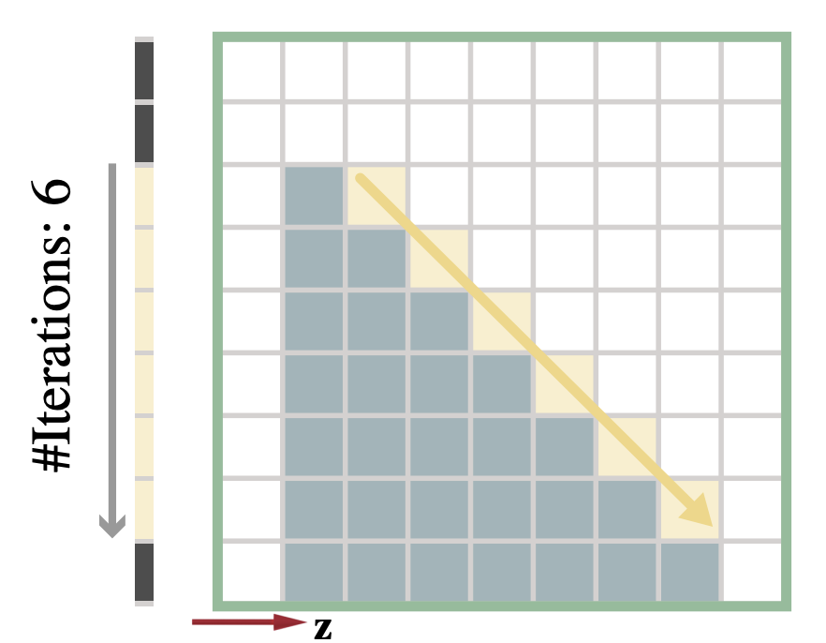
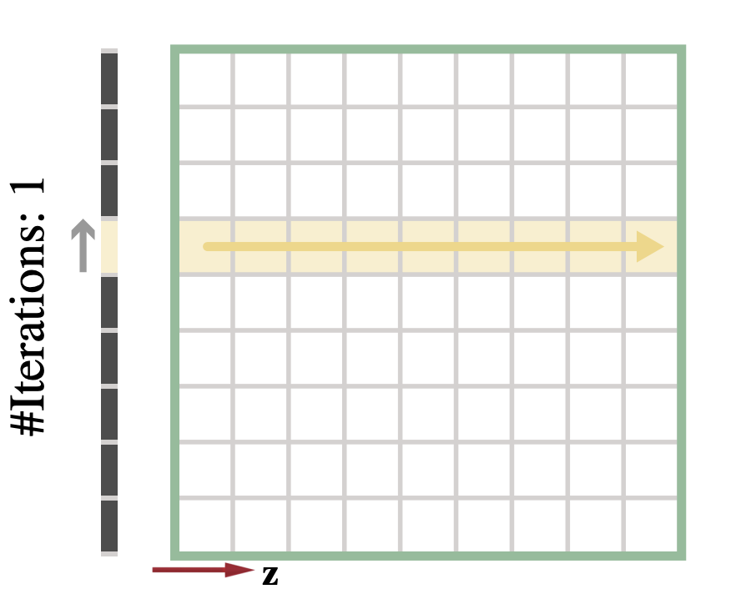
Key observation
When ray is tracing along the z-axis, only a single lookup is required!
If all our rays are tracing along the z-axis
(OMs are aligned with rays),
we will achieve O(1) tracing performance.
Notes:
Our key observation is that as the ray direction gets closer to the z-axis, fewer steps are required
(click) And when the ray is tracing *just* along the z-axis, only a single lookup is required!
(click) So, think about this. If we can generate all possible occupancy maps from all different directions, given any ray, we can always find an OM whose z-axis is aligned with the ray, then we will immediately achieve O(1) tracing performance.
(next)

Slide 14
Key observation
If all our rays are tracing along the z-axis
(OMs are aligned with rays),
we will achieve O(1) tracing performance.
An infinite number of ray-aligned OMs is required.
Each ray-aligned OM invokes one pass of rasterization.
Notes:
Of course this is too ideal, because we can immediately see two problems.
(click) First, to suit any ray direction, we will need an infinite number of ray-aligned OMs. This is intractable in practice.
(click) Second, generating each ray-aligned OM invokes one pass of rasterization. This will result in significant overhead.
(next)

Slide 15
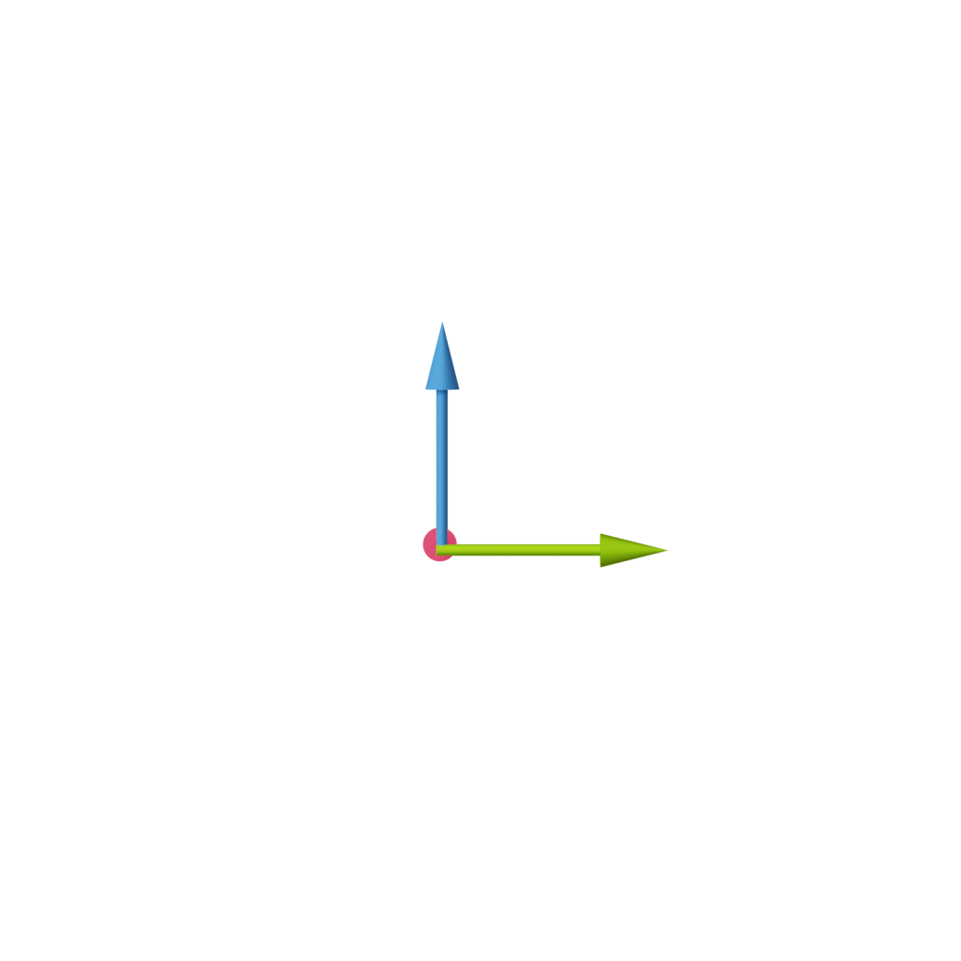
Key idea
An infinite number of ray-aligned OMs is required.
Each ray-aligned OM invokes one pass of rasterization.
Candidate directions
Sampled direction
Rasterization
Notes:
Our method is aimed to solve these two problems. For the first problem, we have a key insight that it is unnecessary to generate occupancy maps for all possible directions.
(click) We can instead generate OMs only for a subset of candidate directions, which are distributed evenly on a hemisphere.
(click) After that, for any ray to be traced, we just select the occupancy map with the closest direction we’ve generated; then, instead of tracing the actual ray, we always trace along the z-axis of the selected OM,
(next) that is, we snap the ray direction to the z-axis!

Slide 16
Key idea
Only a subset of ray-aligned OMs are required.
Each ray-aligned OM invokes one pass of rasterization.
Candidate directions
Sampled direction
“Snap”!
Ray-Aligned
OM Array
(ROMA)
Rasterization
Notes:
Essentially, this is to enforce all rays to be sampled only from a discrete set of directions, corresponding to an array of occupancy maps.
(click) That’s why we call it, Ray-Aligned OM Array, or ROMA.
So, how about the second problem to quickly generate these occupancy maps? This time, we key observation is that, an occupancy map is not like a depth map, it is already 3D, and it already contains the complete 3D geometric information from every viewing angle
So, instead of re-generating one occupancy map multiple times for different candidate directions
(next)

Slide 17
Key idea
Only a subset of ray-aligned OMs are required.
Each ray-aligned OM invokes one pass of rasterization.
Candidate directions
Rasterization
Ray-Aligned
OM Array
(ROMA)
Rotate
Base Occupancy Map (BOM)
Notes:
we only need to rasterize the scene once to get a base occupancy map (BOM)
(click) then simply “rotate” it multiple times, to generate the entire ROMA.
(next)

Slide 18
Key idea
Only a subset of ray-aligned OMs are required.
Only one pass of rasterization is required.
Candidate directions
Rasterization
Ray-Aligned
OM Array
(ROMA)
Rotate
Base Occupancy Map (BOM)
Notes:
Now, only one pass of rasterization is needed.
(next)

Slide 19
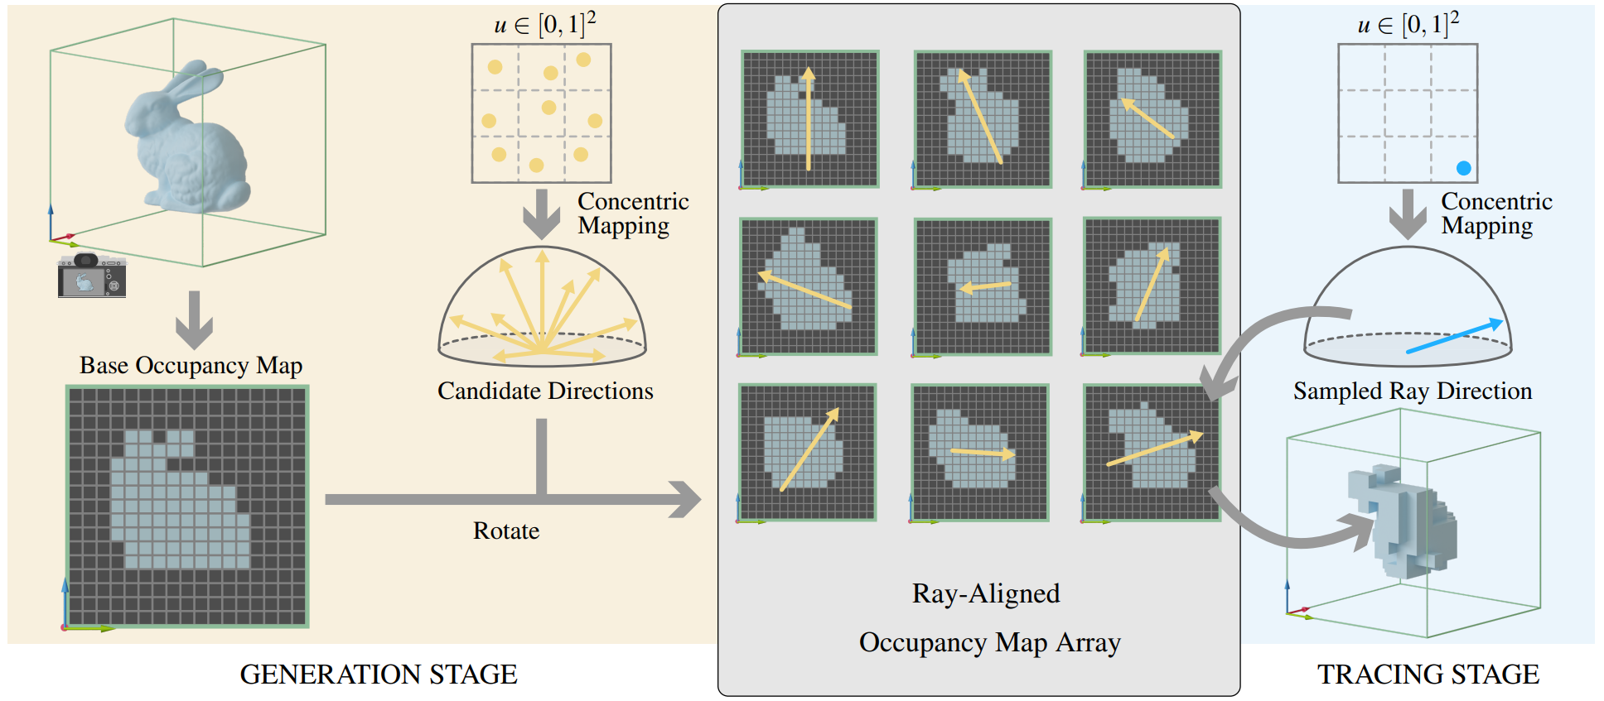
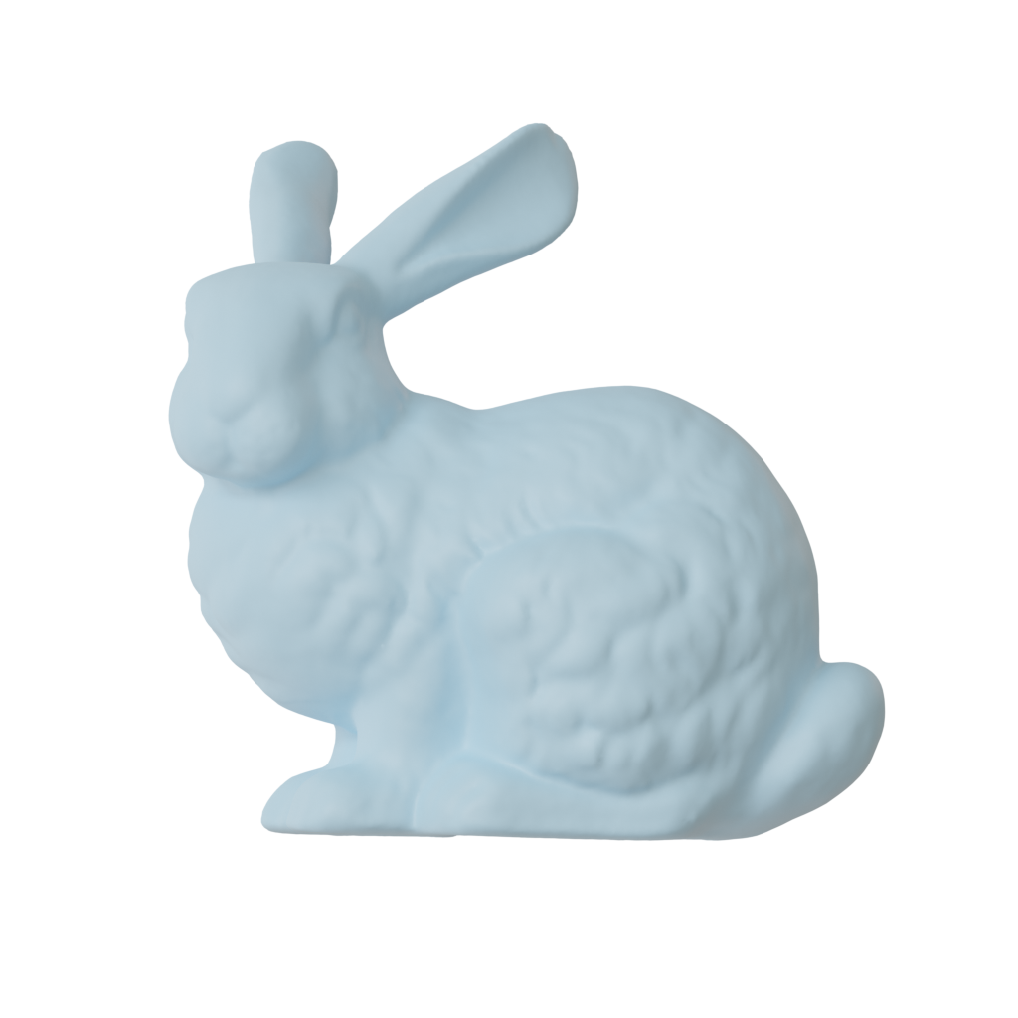
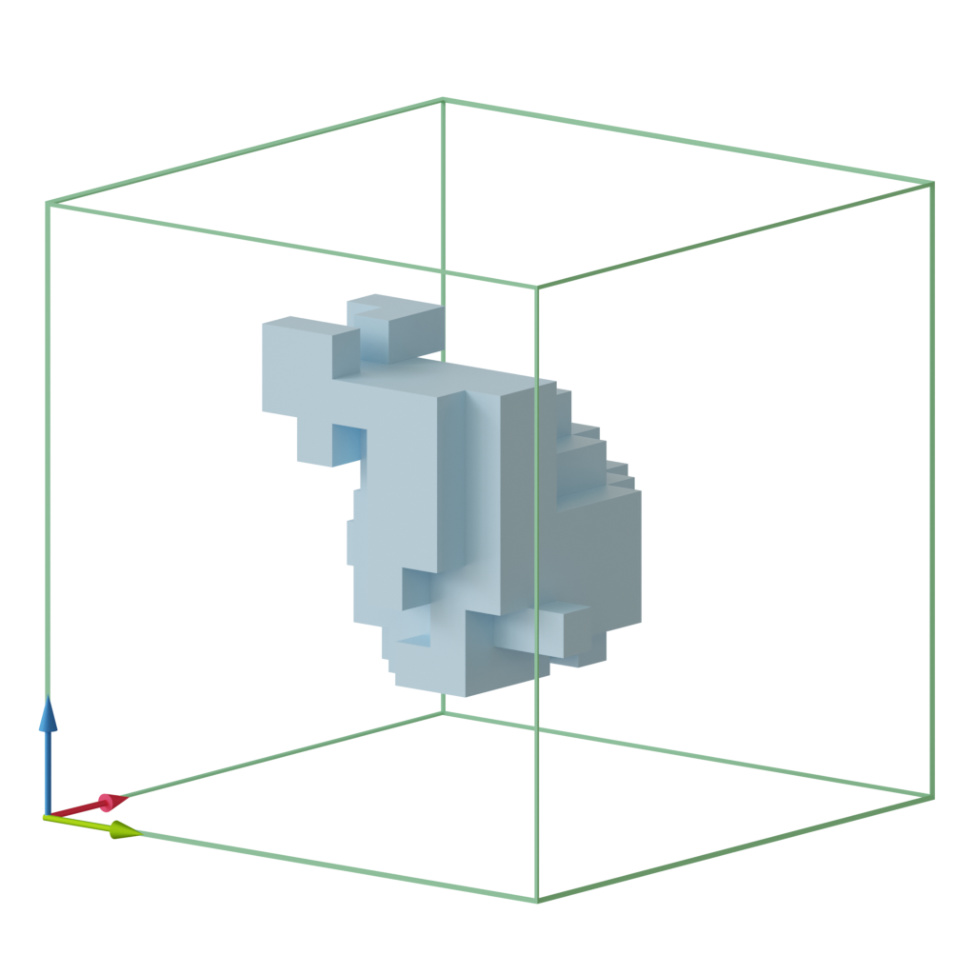
Overview
Notes:
Therefore, our full pipeline is like:
(click) Step 1: generate a Base Occupancy Map (BOM)
(click) Step 2: copy the BOM and rotate towards different candidate directions.
(click) Step 3: Given any ray, find and “snap” it to its closest candidate direction, and perform 1D ray tracing in O(1) time.
Next, we’ll go over some key implementation details.
(next)

Slide 20
Step 1: Generate BOM
[Forest et al. 2009]
z
Rasterization
Rasterization
Union
Base Occupancy Map (BOM)
Occupancy Map with holes
Notes:
In step 1, we generate the base occupancy map, BOM, which can be quickly generated using rasterization.
(click) However, surfaces with slopes close to the camera’s z-axis will hardly be rasterized into fragments and thus will not occupy any cells
(click) This results in holes in the BOM
(click) To address this issue, as suggested by previous work, we simply perform three times of rasterization with cameras placed towards three axis directions: x, y, and z, and then compute the union of the three resulting OMs
This sounds like a lot of extra overhead, but in our test, this is still very fast to support re-building on a per-frame basis.
And we believe it can still be accelerated, for example, by employing geometry shaders to manually convert triangles into the BOM.
(next)

Slide 21
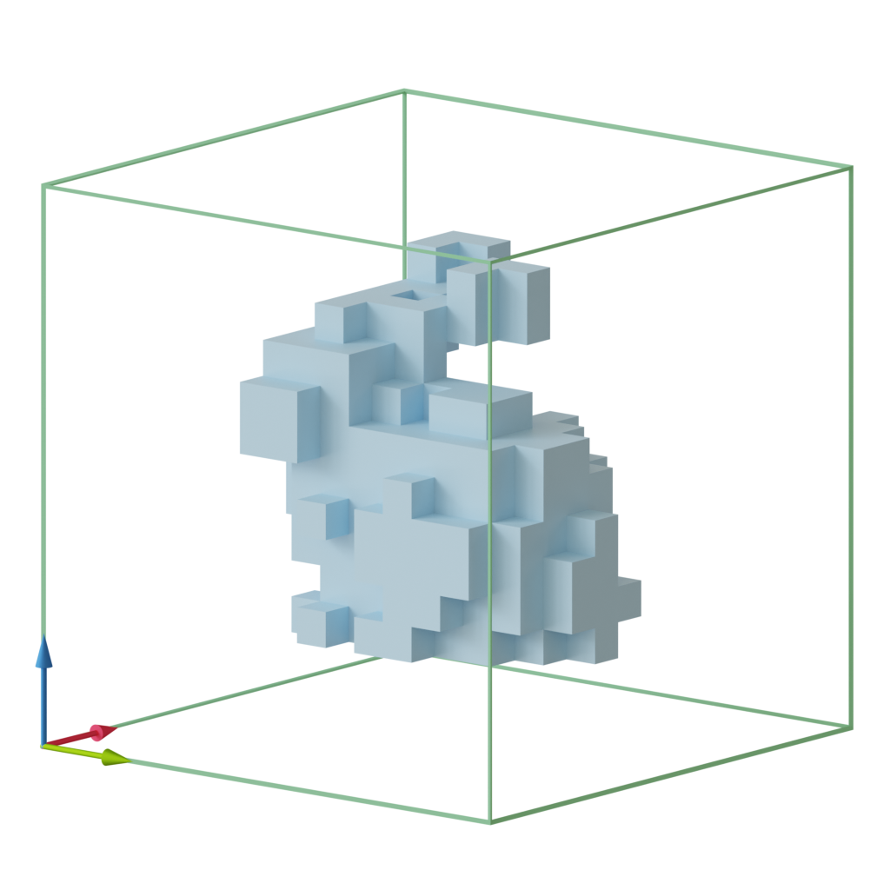
Step 2: “Rotate” BOM to ROMA
World space
NDC space of
Base Occupancy Map (BOM)
Base Occupancy Map (BOM)
Ray-Aligned OM Array
(ROMA)
Notes:
In step 2, we rotate BOM to generate ROMA
In practice, we do it the other way around:
(click) For each texel on the ROMA, based on its index, we can first find its corresponding candidate direction and camera pose,
(click) And we trace through its z-axis, and find the direction it corresponds to in the BOM,
(click) Then we can just fetch the bits from BOM, and write to the ROMA’s texel.
This only involves simple coordinate transformations and texture fetches in the BOM with good locality, and can be efficiently implemented using a compute shader, and is decoupled from scene complexity.

Slide 22
Step 3: “Snap” and Trace
Concentric mapping
Candidate directions
Which is the closest candidate direction?
Concentric mapping
Sampled direction
Ray-Aligned OM Array
(ROMA)
Notes:
In the Step 3, we “snap” the sampled ray to its closest candidate direction and perform tracing. So how to achieve that?
(click) Given a sampled ray, the first step is to find the “closest” candidate direction.
This can be done by comparing the dot products of the sampled ray direction and all the candidate directions, *one by one*. This is intuitive but clearly inefficient.
(click) Our key observation here is that we can use stratified sampling to generate the candidate directions,
(click) then for any sampled ray direction, we can immediately find its corresponding stratum; instead of finding the actual closest candidate direction, the candidate direction in that stratum is already close enough.
(click) BTW, we employ the concentric mapping to map a square to the hemisphere. This mapping maps concentric squares to concentric circles on the hemisphere and preserves fractional areas.
(next)

Slide 23
Step 3: “Snap” and Trace
Ray-Aligned OM Array
(ROMA)
Notes:
- After finding the candidate direction and its associated ray-aligned OM, we snap the sampled ray to that candidate direction! (next)

Slide 24
Step 3: “Snap” and Trace
any hit query
Left-shift:
== 0?
or Right-shift:
“Snap”!
Ray-Aligned OM Array
(ROMA)
Notes:
Then how do we actually trace the snapped ray in a 1D bit array?
(click) For visibility, we only need to check if there is an intersection along the ray, that is, an *any hit* query, which can be done in two steps,
(click) first, we left shift, or right shift, depends on the direction,
(click) to eliminate the cells that are outside the range the ray covers.
(click) then we check if the resulting integer values is non-zero – in that case, there is an intersection.
(next)

Slide 25
Step 3: “Snap” and Trace
any hit query
Left-shift:
== 0?
or Right-shift:
“Snap”!
closest hit query
Foremost-bit:
Floor(log2( ))
Ray-Aligned OM Array
(ROMA)
or Low-bit:
log2( )
Notes:
For finding the exact intersecting position, that is, performing a *closest hit* query, there is only one extra step after the any hit query:
(click) Based on the ray direction, we need to find the formost-bit or lowest-bit.
(click) Finding the position of the foremost bit is easy, simply take the integer version of log base 2.
(click) For finding the position of the lowest bit, we first get its negative value, or inverse and plus 1,
(click) Then we perform an AND operation of the two values, to let the lowest bit stand out,
(click) Finally, take the integer log base 2 again.

Slide 26
Spatiotemporal scheme
Higher positional and angular resolutions are critical for ROMA.
However, the extra time and space costs are always unacceptable.
Angular resolution
Candidate directions
Rasterization
Ray-aligned
OM Array
(ROMA)
Rotate
Positional resolution
Base Occupancy Map (BOM)
Notes:
Now, with our ROMA, we can already achieve fast generation and fast tracing.
(click) However, since OM is a discrete representation of scene geometries, the resolution of each OM in our ROMA, we call it the positional resolution of our method, is critical for representing the scene well and avoiding aliasing.
(click) Also, the number of candidate rays or the number of OMs in a ROMA, we name, the angular resolution, determines how many directions we can really trace
(click) Of course, higher positional and angular resolutions are desired. But the extra time and space costs are not always acceptable.
(next)

Slide 27
Spatiotemporal scheme
A spatiotemporal scheme to further boost performance while alleviating aliasing!
Resample candidate directions with jitters on a per-frame basis!
Jitter the camera on a per-frame basis!
Candidate directions
Rasterization
Ray-aligned
OM Array
(ROMA)
Rotate
Base Occupancy Map (BOM)
Notes:
Inspired by the idea of Temporal Anti-Aliasing, we propose to use a spatiotemporal scheme to distribute the resolutions and computational workload spatially and temporally.
(click) More specifically, when generating the BOM, we jitter the camera position differently per frame;
(click) and before rotating to ROMA, we resample the candidate directions, also differently per frame.
(next)

Slide 28
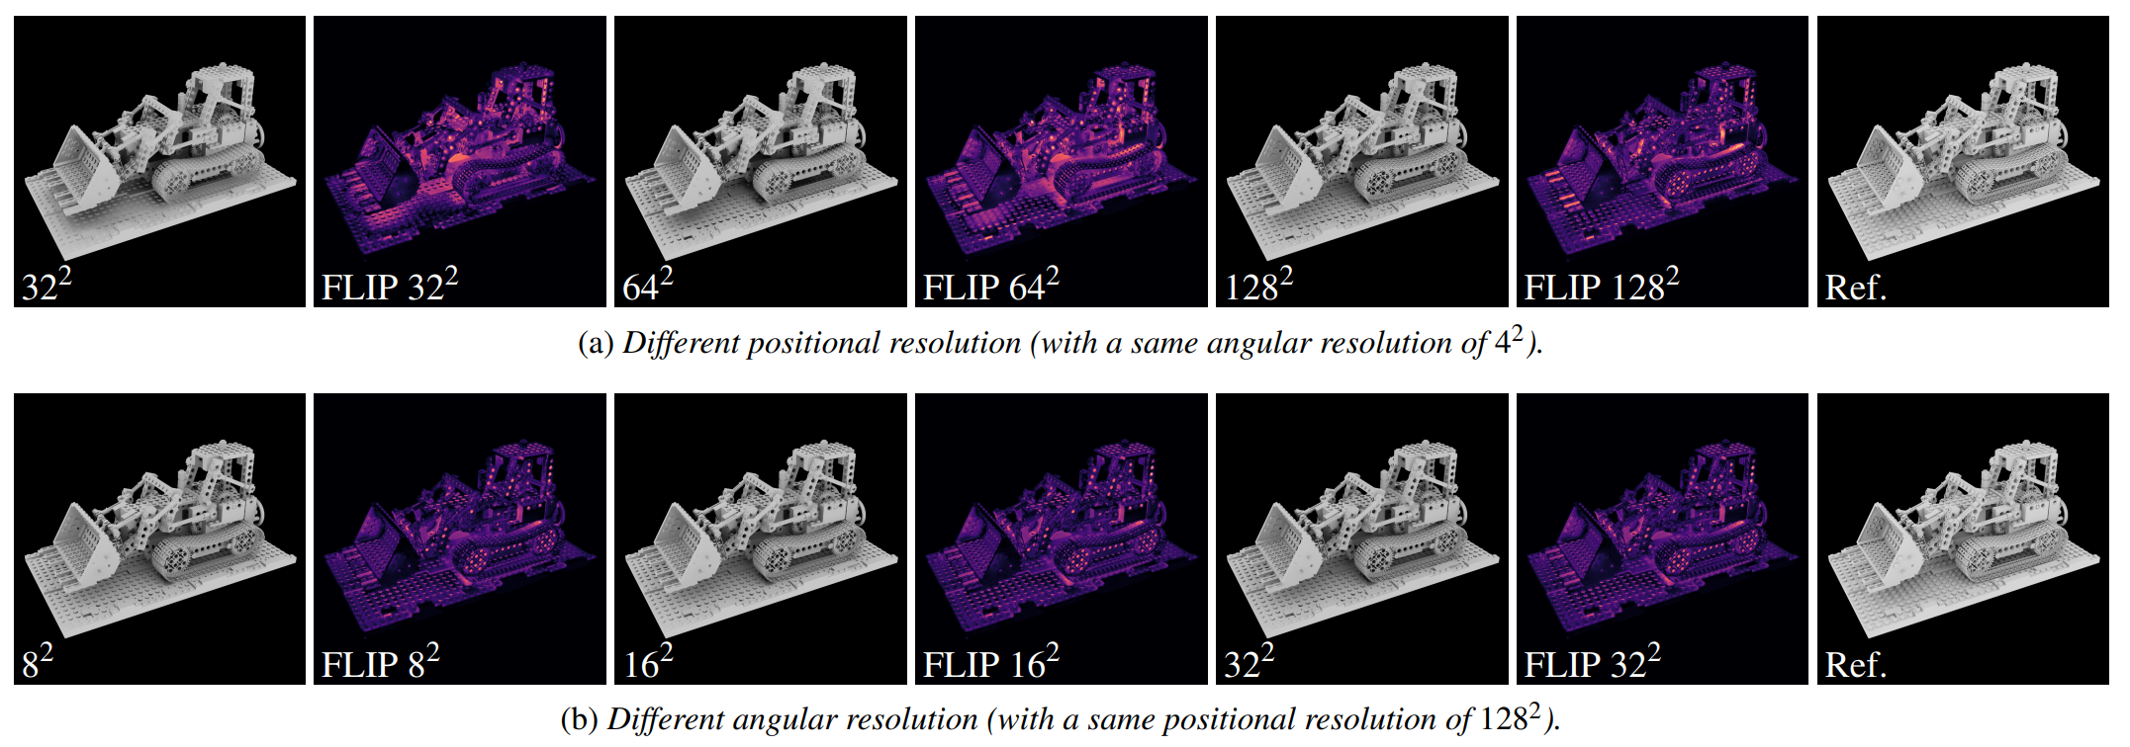
Spatiotemporal scheme
Notes:
With this spatiotemporal scheme coupled with a denoiser, we have essentially increased the effective positional and angular resolutions within a limited budget and alleviated aliasing.
(click) As shown in this figure, a positional resolution of 128^2 and an angular resolution of 4^2 can already achieve visually pleasing results with fast performance
(next)

Slide 29

“Snap” or not
Sometimes, we cannot simply snap the ray
Candidate direction
Sampled direction
Notes:
The other thing to note is that, “snapping” a sampled ray to a candidate direction is the best way to perform ray tracing with ROMA. But sometimes, we cannot simply snap the ray.
(click) Take this example, a ray is traced towards the sun,
(click) if we snap this ray to its candidate direction, the resulting visibility would be wrong.
(next)

Slide 30
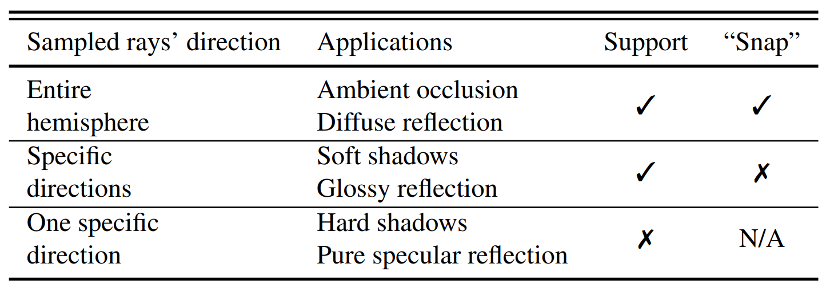
“Snap” or not
Sometimes, we cannot simply snap the ray
Entire hemisphere
Specific directions
One Specific direction
Notes:
So, this means, for different applications, we have different choices on snapping the ray or not
(click) For applications like ambient occlusion and diffuse indirect illumination, the sampled rays are distributed on the entire hemisphere, so each single ray query does not have to be very precise. In this case, we can safely snap the ray.
(click) For applications like soft shadows, the solid angle covered by an area light is much smaller. In this case, the rays have to point to specific directions. So we choose not to “snap” the ray for accuracy.
(click) Finally, for applications using rays pointing to a single direction, like hard shadows from point lights or pure specular reflection, although we can still choose not to “snap” the ray and use the original direction, there will still be aliasing caused by the limited positional resolution. This is a common challenge to all voxel-based methods.

Slide 31
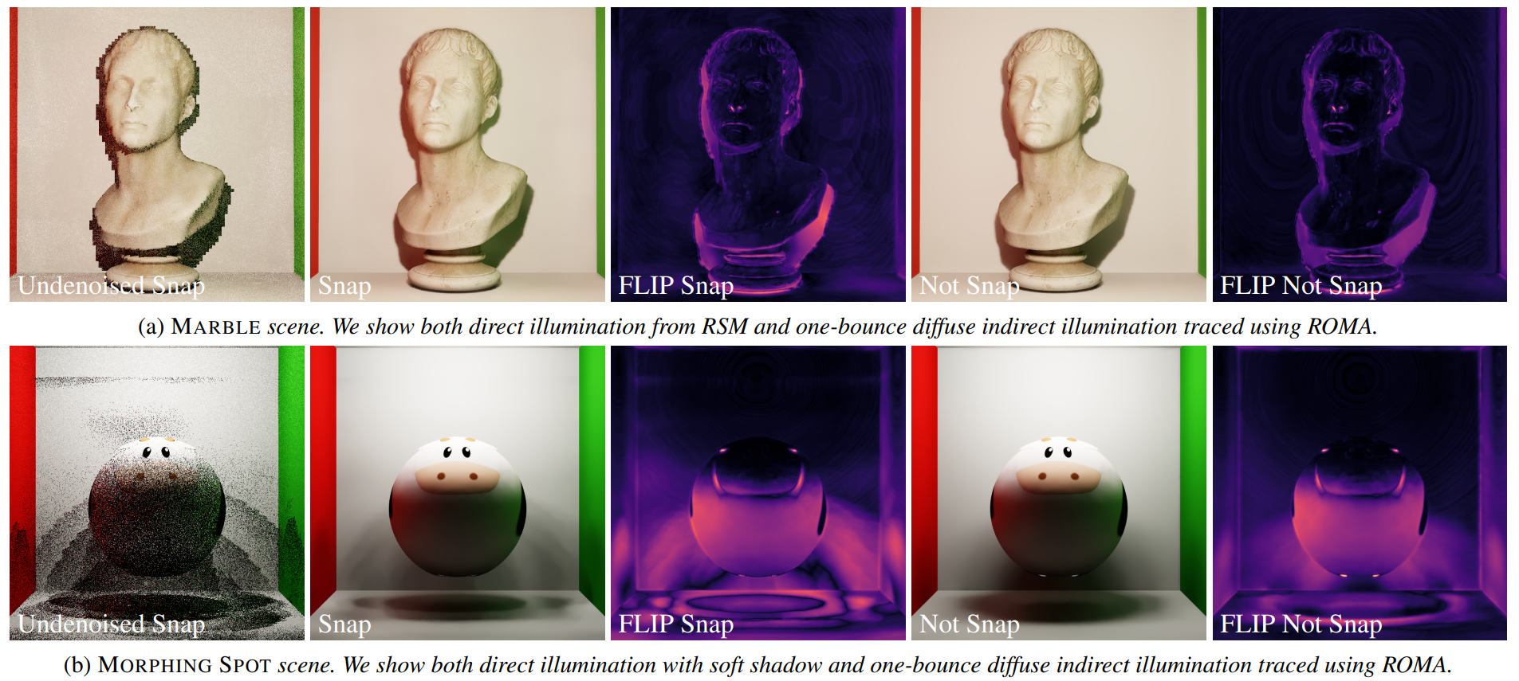
“Snap” or not
0.24 ms
2.05 ms
(4^2 ang. res.)
0.15 ms
0.23 ms
(8^2 ang. res.)
Notes:
Choosing to not snap the ray is not always slow.
In the first row, it’s showing color bleeding from diffuse global illumination. When we “snap” the rays, the performance is boosted to 0.24ms, in comparison to 2.05ms when not “snapping”. This is because in this case, we just need to use a small angular resolution of 4^2. In this angular resolution, when tracing the un-snapped rays, they are far from the z-axis, so they are slow to trace. But it doesn’t matter to diffuse GI, since we will always use the snapped rays.
(click) In the second row, please note the soft shadows from area lights, “snapping” the rays would cause artifacts; so we choose to trace un-“snapped” rays for better visual quality while using a higher angular resolution of 8^2. What’s good is that, the unsnapped rays still trace very fast in this case, because they are much closer to the chosen candidate directions. With unsnapped rays, we still maintain a good performance of 0.23ms, in comparison to 0.15ms when “snapping”.

Slide 32
Result
Notes:
Finally, let’s take a look at our results

Slide 33
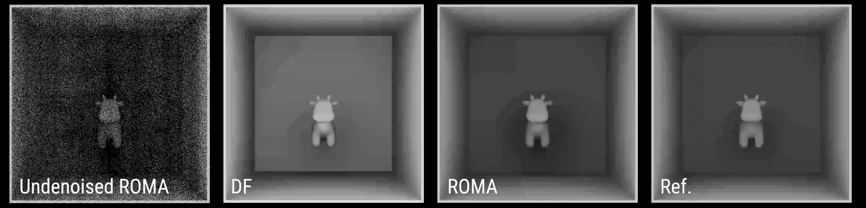
Ambient Occlusion (AO)
Notes:
Here we compare ROMA with DF on simulating ambient occlusion for a morphing object.
The video itself does not reflect the performance; it’s just 60FPS playback.
The comparison indicates that our ROMA achieves better visual quality than DFs.
(next)

Slide 34
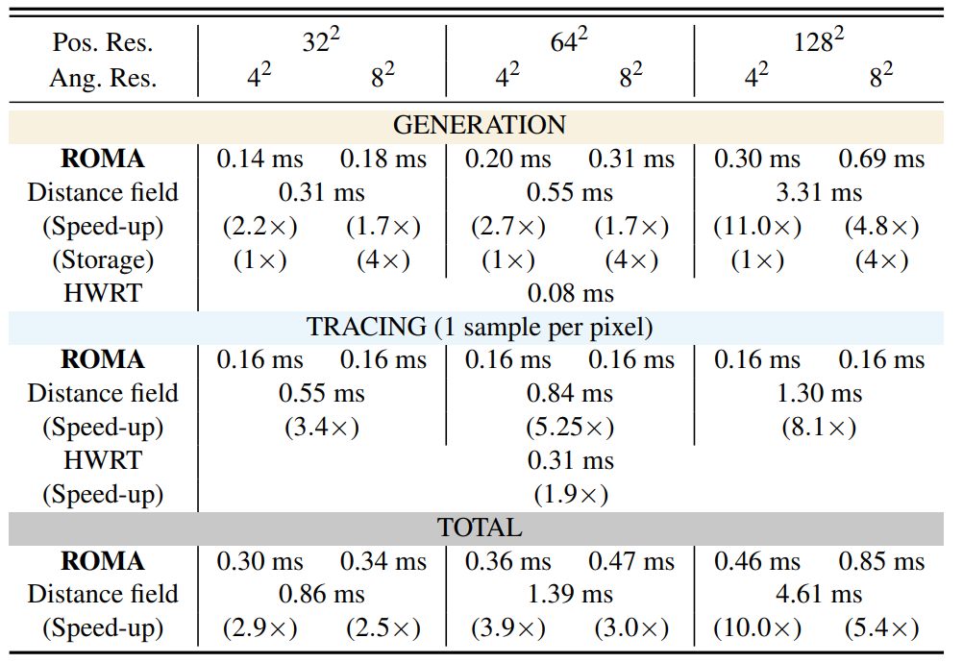
Performance
The times are measured on 1080P for ambient occlusion (snapped rays).
Pos. resolution: resolution of OMs; ang. resolution: the number of candidate directions.
Always < 1ms!
1.7x-11.0x faster
11x faster
Aways 0.16ms!
3.4x-8.1x faster
1.9x faster
2.5x-10x faster
Notes:
For the performance on simulating AO. We show runtime breakdown between ROMA, distance field (DF), and hardware ray tracing (HWRT) here
(click) Note that the times are measured on 1080P for AO.
(click) (click) At the generation stage, our ROMA is built within 1 ms, even with a positional resolution of 128^2
(click) In contrast, DF requires 3.3 ms to build, which is 11.0× slower than ours.
(click) The speedup becomes less as the resolution decreases, but our generation speed is still consistently faster.
(click) At the tracing stage, ROMA can answer ray intersection queries in 0.16 ms regardless of ROMA’s resolutions, thanks to our constant time tracing method for snapped rays.
(click) And tracing is around 3.4×–8.1× faster than DF
(click) In total we are 2.5×–10× faster than DF combined with the generation time.
(click) Although ROMA generation is slower than the hardware BVH construction and update for HWRT, the tracing speed with ROMA is about 1.9× faster than HWRT.

Slide 35
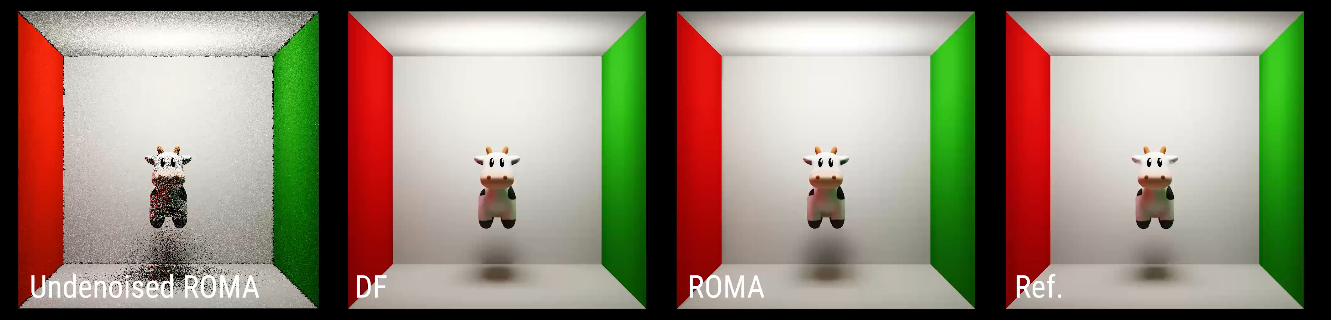
One-bounce Diffuse GI & Soft Shadows
We want to show:
  Soft shadows from direct illumination (un-snapped rays)
  Color bleedings from indirect illumination (snapped rays)
Generation: ~2.86 ms (3.2x)
Tracing: ~0.90 ms (2.0x)
Generation: ~0.89 ms
Tracing: ~0.45 ms
Notes:
Next, we compare ROMA with DF on simulating soft shadows and diffuse indirect illumination.
We want to show:
Soft shadows from direct illumination using un-snapped rays and color bleeding from indirect illumination using snapped rays.
The comparison indicates that ROMA achieves comparable visual quality especially on simulating color bleedings.
For the performance, ROMA can achieve 3.2x speed-up in generation and 2.0x speedup in tracing compared with DFs.
(next)

Slide 36
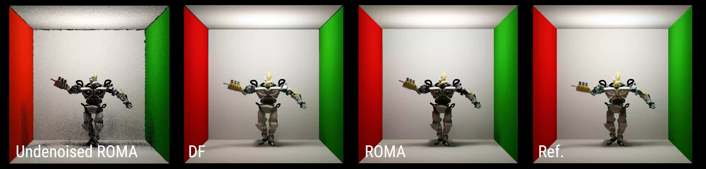
One-bounce Diffuse GI & Soft Shadows
We want to show:
  Soft shadows from direct illumination (un-snapped rays)
  Color bleedings from indirect illumination (snapped rays)
Generation: ~2.86 ms (3.2x)
Tracing: ~0.90 ms (2.0x)
Generation: ~0.89 ms
Tracing: ~0.45 ms
Notes:
Next, on the dancing robot scene, we can take a closer look at soft shadows.
The comparison indicates that ROMA can achieve comparable visual quality on simulating soft shadows.
// On the body of the robot, there are over-darkenings caused by self intersection. This is due to the limited positional resolution and the ray origin bias used by ROMA.
(next)

Slide 37
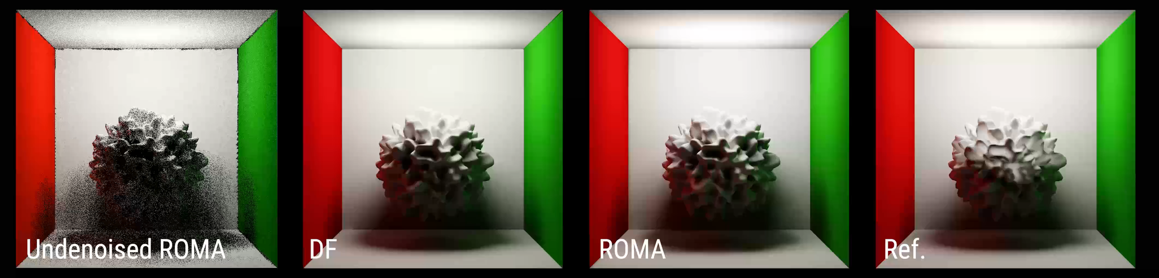
One-bounce Diffuse GI & Soft Shadows
We want to show:
  Soft shadows from direct illumination (un-snapped rays)
  Color bleedings from indirect illumination (snapped rays)
Generation: ~2.86 ms (3.2x)
Tracing: ~0.90 ms (2.0x)
Generation: ~0.89 ms
Tracing: ~0.45 ms
Notes:
This is another example on a morphing spiky sphere.
It shows that ROMA can produce visually pleasing soft shadows and color bleedings from complex geometry.
(next)

Slide 38
Conclusion
Notes:
Now, let’s wrap up.

Slide 39
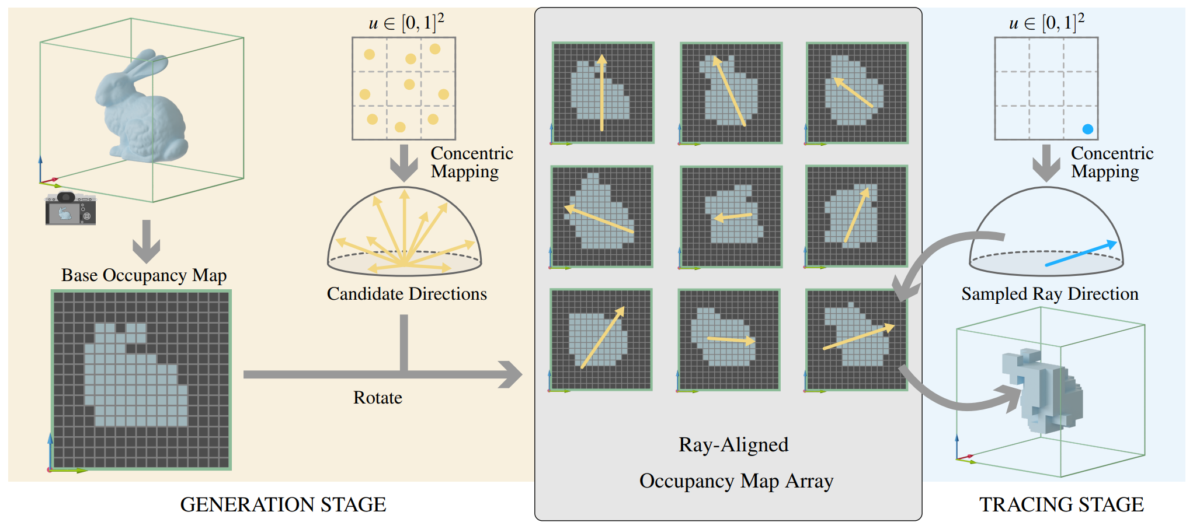
Conclusion
A new SWRT solution, ROMA, that enables fast approximate ray tracing.
Fast: generation & tracing.
Approximate: scene voxelization & tracing snapped rays.
Fully scalable: balancing the performance and quality in a spatiotemporal way.
Notes:
We proposed a new SWRT solution, called ROMA. And we have shown its application on in AO, diffuse GI and soft shadows.
It is a fast approximate ray tracing
(click) Fast means fast generation and fast tracing
(click) Approximate lies in limited spatial and angular resolutions and tracing snapped rays.
(click) Finally, it’s fully scalable as we can balance the performance and quality with different spatial and angular resolutions in a spatiotemporal way.

Slide 40
Limitations
ROMA generation is slower than the BVH construction/update for HWRT on small-scale scenes.
  ROMA generation does not have specially optimized refitting method and is not handled by drivers.
ROMA does not have these good properties as DFs have.
  Filtered to get coarser levels.
  Differentiable rendering.
Shadow acne / light leaking.
Notes:
Our method has limitations. ROMA generation is still slower than the hardware BVH construction and update.
(click) ROMA generation does not have specially optimized refitting method and is not handled by drivers.
But considering that the tracing speed with ROMA is about 1.9× faster than HWRT even without hardware support, we believe ROMA is already a good HWRT alternative.
(click) Besides, although compared with DFs, ROMA is faster, apart from performing ray tracing, ROMA does not have some good properties DFs have,
(click) For example, DFs can be filtered to create coarser levels.
(click) DFs can be used in differentiable rendering.
(click) Finally, like shadow maps, ROMA has to manually set a normal bias to avoid shadow acne caused by self-intersections due to the insufficient positional resolution.

Slide 41
Future work
Extend ROMA to support larger scenes.
  Cascades.
  Local ROMAs for near-field tracing and global ROMA for far-field tracing. (Lumen)
  Local mesh ROMAs coupled with AABB tree traversal. (AMD’s Brixelizer)
Hardware support for ROMA to boost its performance.
Explore hybrid solutions
  Combine screen-space ray tracing for near-field tracing and using ROMA only for far-field tracing.
Notes:
And we leave them to future work.

Slide 42
Ray-aligned Occupancy Map Array for Fast Approximate Ray Tracing
Thank you!
ROMA wasn't built in a day, but in <1 millisecond :)
Notes:
Thanks for your attention, and I’m be happy to take any questions now.

