Slide 1
Towards Effective Partition Management for Large Graphs
Shengqi Yang, Xifeng Yan, Bo Zong and Arijit Khan
Computer Science, UC Santa Barbara
{sqyang, xyan, bzong, arijitkhan}@cs.ucsb.edu
Project Homepage
http://grafia.cs.ucsb.edu/sedge

Slide 2
Motivation - Challenges
New requirements for data processing
Ubiquitous demands on graph data management.
Information Networks
Social Networks
Biological systems
Communication Networks
Efficient data processing in extremely large graphs.
Google: 1 trillion indexed pages
Facebook: >500 million active users
De Bruijn: 500 million vertices
Notes:
Data management community are facing more and more challenges from the new requirements for unstructured data processing.
Large scale, highly interconnected networks pervade both our society and the information world around us.
The graphs of interest are often massive with millions, even billions of vertices. For example, the Facebook online social network includes more than 500 million users. DNA short read assembly could easily generate a de Bruijn graph with billions of vertices.

Slide 3
Motivation – Existed solutions
Memory-resident solution
Running on single server.
Difficult/Impossible to accommodate the content of an extremely large graph.
Low concurrency.
Simple distributed solution (e.g., Hadoop)
Running on commodity cluster
High concurrency and enough memory space
Some successful applications
Not ideal (poor locality and little work per vertex)
Notes:
Graph algorithms usually have poor locality and little work per vertex.

Slide 4
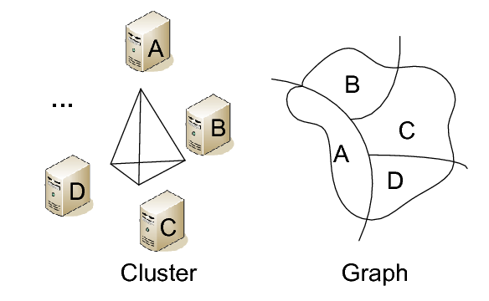
Pregel from Google (2010)
Graph partitioning and distribution
Notes:
Pregel divides a graph into partitions and distribute them to multiple machines for parallel processing of graph queries.

Slide 5
Is Pregel suitable?
How Pregel works (BSP model)
Distribution Model: Graph partitioning
Computational model: run on each partition (vertex)
Communication model: message passing
Why Not Pregel?
Limitations
Notes:
Messages are typically sent along the edge between two vertices. But a message may be sent between any two vertices if they know each other.

Slide 6
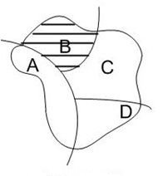
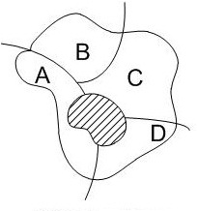
Pregel: Limitations
Unbalanced workload
Inter-machine communication
Notes:
Pregel can serve queries that are uniformly distributed in the graph. However, they are not good at dealing with unbalanced query workload: queries that are concentrated in one part of the graph.

Slide 7
Our Solution: Sedge
SEDGE: a Self Evolving Distributed Graph Processing Environment
Solving the problems facing Pregel
Workload balancing (replication)
Communication reduction
Novel partitioning techniques.
2-level partition architecture that supports the new generated partitions.
Notes:
We want to achieve two goals. On one hand, to minimize query response time, our solution has to eliminate the inter-machine communication as much as possible. On the other hand, to maximize query throughput, our system needs to utilize each worker to its best of capability.

Slide 8
Outline
Partitioning techniques
Complementary partitioning
On-demand partitioning
Two-level partition management
System Architecture
Experiments
Conclusions

Slide 9
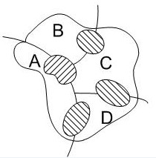
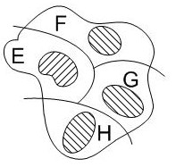
Techniques: Complementary partitioning
Complementary partitioning : repartition the graph with region constraint
These two sets of partitions will run independently.
Notes:
Complementary Partitioning is to repartition a graph such that the original cross-partition regions become internal
ones.
In the new partition set, the queries on original cross-partition edge, e, will be served within the same partition. Therefore, the new partition set can handle graph queries that have trouble in the original partition set. If there is room to hold both S1 and S2 in clusters, for a query Q visiting the shaded area R in S1, the system shall route it to S2 to eliminate communication cost.
Meanwhile, the new partition set can also share the workload with original partition set. This complementary partitioning idea can be applied multiple times to generate a series of partition sets. We call each partition set a “primary partition set.” Each primary partition set is self complete, where a Pregel instance can run independently.

Slide 10
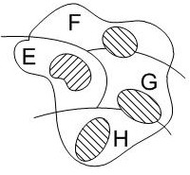
An Iterative Solution
…
…
Iteratively repartition the graph
Pros
Effective communication reduction
Cons
Space limitation

Slide 11
Cross-partition query profiling
P1
P2
v2
v1
v3
v5
C1
v4
C3
C2
Blocks: coarse-granularity units that trace the path of cross-partition queries. e.g., C1,C2 and C3.
Advantages:
Query generalization.
Profile a query with fewer features.

Slide 12
Techniques: On-demand partitioning
P1
P2
P3
v2
v1
v3
v5
v4
C3
C1
C2
Envelope: a sequence of blocks that covers a cross partition query.
Envelope Collection: put the maximized number of envelopes into a new partition wrt. space constraint.
Notes:
To deal with the hotpots that cross multiple partitions, we propose a dynamic partitioning technique.

Slide 13
A Similarity-Based Greedy Algorithm
The algorithm intends to combine similar envelopes sharing many common color-blocks.
2-step greedy algorithm:
1) Similarity search (nearest neighbor search).
Locality Sensitive Hashing (LSH): Min-Hash, in O(n)
2) Envelope combining
Cluster the envelopes in the same bucket produced by Min-Hash.
Combine the clusters with highest benefit.
Notes:
We use Min-Hash as a probabilistic clustering method that assigns a pair of envelopes to the same bucket with a probability proportional to the similarity between them.
It is straightforward to consider these buckets as clusters and combine the envelopes within the same buckets together.

Slide 14
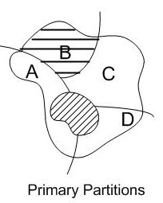
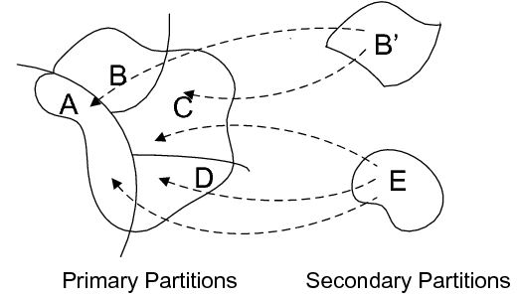
Two-level partition architecture
Two-level partition architecture
Primary partitions. e.g., A, B, C and D. They are inter-connected in two-way
Secondary partitions. e.g., B’ and E. They are connected with primary partitions in one-way

Slide 15
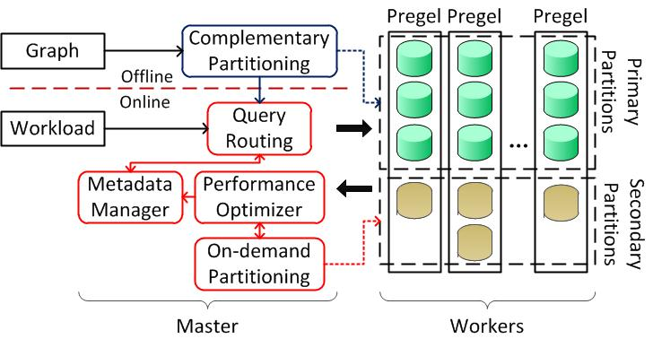
Sedge: System Architecture
Notes:
The offline part acts at the initial stage. It partitions the input data/graph in a distributed manner and puts them to the
workers. It creates multiple partition sets so that each set runs a Pregel Instance independently. During the runtime, the online part collects statistical information from workers and actively generates and removes partitions to accommodate the changing workload. Therefore the set of online techniques built in Sedge must be very efficient.
Our implementation is focused on partition management.

Slide 16
System Evaluation: RDF graphs
SP²Bench
Employ the DBLP library as its simulation basis.
100M tuples (11.24GB).
Query templates (5 of 12): Q2, Q4, Q6, Q7, Q8.
E.g. Q4: Given a journal, select all distinct pairs of article author names for authors that have published in the journal.
Cluster environment
31 computing nodes.
Among these nodes, one serves as the master and the rest as workers.

Slide 17
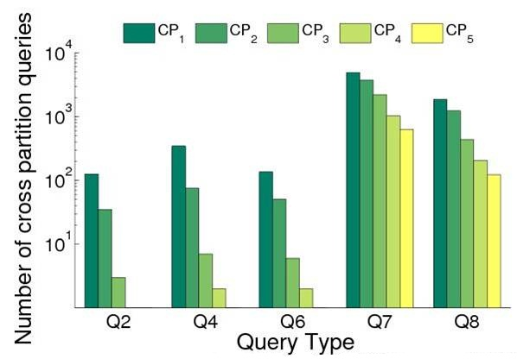
Effect of complementary partitioning
Experiment setting
Partition configuration: CP1~CP5
Workload: 10⁴ Random queries
Result
Significant cross query reduction
Cross query vanishes for Q2,Q4 and Q6
Notes:
Figure shows the effect of the approach. Note that the Y-axis is plotted in log scale. The missing bars for the CP4 and CP5 of Q2 , the CP5 of Q4 and the CP5 of Q6 correspond to the value of 0, i.e., the cross-partition query vanishes.
The experiment demonstrates that by adding more complementary partition sets, the number of cross-partition queries can be dramatically reduced.

Slide 18
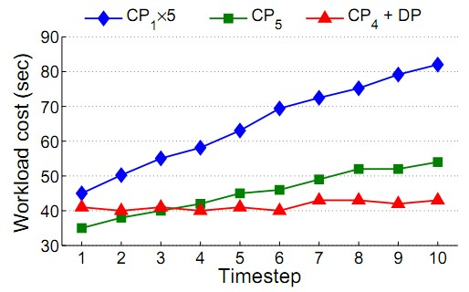
Evolving query workload
Experiment setting
Partition configuration: CP1*5, CP5 and CP4+DP
Workload: evolving 10⁴ random queries
Result
CP1*5 vs. CP5: effect of complementary partitioning
CP5 vs. CP4+DP: effect of on demand partitioning

Slide 19
System Evaluation: real graphs
Datasets
Web graph: 30M vertices, 956M edges.
Twitter: 15M users, 57M edges.
Bio graph: 50M vertices, 51M edges.
Synthetic graph: 0.5B vertices, 2 Billion edges.
Query workload
neighbor search.
random walk.
random walk with restart.

Slide 20
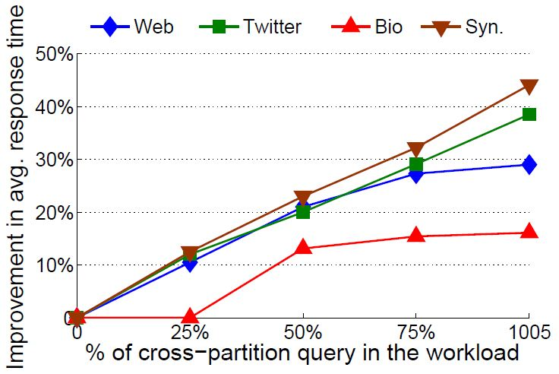
Scalability Cross-partiti0n queries vs. Avg. response time
Experiment setting
Partition configuration: CP1+DP.
Workload: 10⁴ random queries with 0%, 25%, 75% and 100% cross queries.
Result
Effective for cross queries.
Effective for partitioning difficult graphs, i.e., Twitter and Bio graphs.

Slide 21
Conclusions
Conclusions
Partitioning techniques
Complementary partitioning
On-demand partitioning
Two-level partition management
Future work
Efficient distributed RDF data storage
Distributed query processing

Slide 22
Thank You!

